Slide 1
Acetaminophen Toxicity and Treatment
Davin Shikaze SPEP student
BScPhm candidate 2014

Slide 2
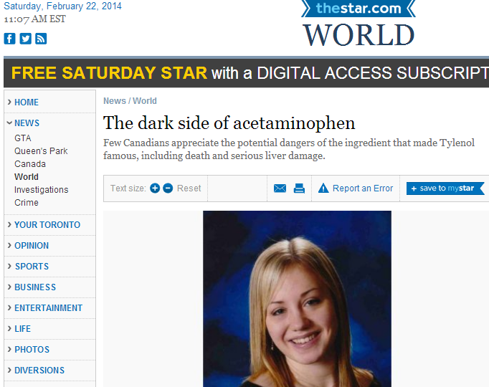
News
Notes:
Between 2009-2012 acetaminophen overdoses were linked to over 10 000 emerge visits across Canada. Globally, #1 cause of drug-induced liver injury. There was another article published on Tuesday about a possible link between acetaminophen use during pregnancy and development of ADHD. Mainly will only scare mothers and cause anxiety.

Slide 3
Outline
Structure, metabolism and mechanism of toxicity
Maximum Daily Dose
How much is too much?
Risk factors for increased toxicity
N-acetylcysteine (NAC)
  Mechanism of Action
  Rumack Nomogram: When to treat?
  Comparison of PO and iv protocols
  Dosing NAC iv
  Standard dosing protocol for acute overdose

Slide 4
Outline
Gastric Lavage and Activated Charcoal
Treatment Endpoints
Summary
Order Sheet

Slide 5
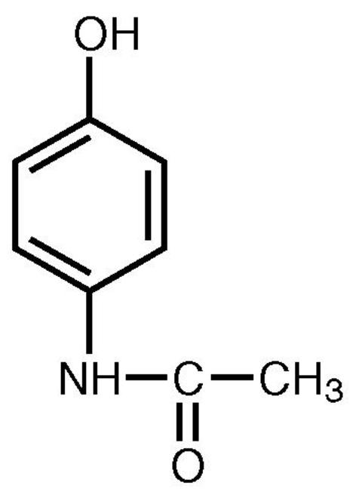
Acetaminophen
Tylenol®, Paracetamol®, N-acetyl-para-amino-phenol (APAP)
Image taken from: http://www.theodora.com/drugs/ultracet_tablets_ortho_mcneil.html
Notes:
It’s been around since 1955, analgesic antipyretic. You Can pick up to 50 tabs of extra strength (650mg) at a 7-11 near you

Slide 6
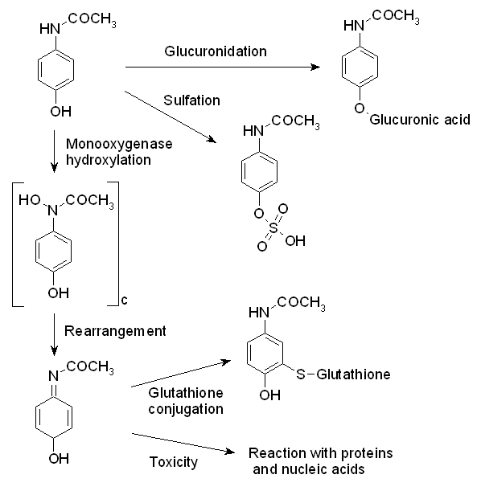
Metabolism
Image taken from: http://upload.wikimedia.org/wikipedia/commons/3/34/Paracetamol_metabolism.png
70%
15%
Non-toxic
5-10% Cytochrome
P-450
GSH
Non-toxic
NAPQI +
Positively charged Carbon
TOXIC!!!
Notes:
Over 70% is glucuronidated, around 15% sulfated but greater proportion is sulfated in children i.e. under 12 years old, 2% excreted in urine unchanged. 5% is metabolized by cytochrome P450 which results in a toxic intermediate N-acetyl-p-benzoquinone imine (NAPQI) which can form covalent bonds with DNA, RNA, proteins ultimately leading to cell death resulting in hepatic necrosis.

Slide 7
Mechanism of toxicity
Image taken from: http://upload.wikimedia.org/wikipedia/commons/3/34/Paracetamol_metabolism.png
5-10% Cytochrome
P-450s
GSH
Non-toxic
+
Positively charged Carbon
TOXIC!!!
Notes:
Over 70% is glucuronidated, around 15% sulfated. 5% is metabolized by cytochrome P450 which results in a toxic intermediate N-acetyl-p-benzoquinone imine (NAPQI) which can form covalent bonds with DNA, RNA, proteins ultimately leading to cell death resulting in hepatic necrosis. Once GSH has been depleted by 70% NAPQI bind to proteins, DNA, RNA.

Slide 8
Maximum Daily Dose
Adults: 4 g/day
Infants and older children: 75 mg/kg/day or 4 g/day, whichever is less
Newborn Infants (do not use if < 30 weeks):
65 mg/kg PO daily.
  Rectal: 30-33 wks: 20 mg/kg/dose PR q12h (max: 40 mg/kg/day)
  34-39 wks: 25 mg/kg/dose PR q8h (max: 75 mg/kg/day)
  ≥ 40 wks: 30 mg/kg/dose PR q6h (max: 120 mg/kg/day)
SickKids 2013-14 Drug Handbook and Formulary
Notes:
Adults maximum dose 1 g qid. Even chronic alcoholics are safe at the 4 g daily dose.
Infants and children 10-15 mg/kg/dose q4-6hr prn.

Slide 9
How much is too much?
Single dose of ≥ 7.5 g in adult
Single dose of ≥ 150 mg/kg in children
Can be considered potentially toxic, although these thresholds are conservative.
Hodgman and Garrard 2012
Notes:
Prospective study of adults who took upto 8 g over 3 days, and no toxicity was found. E-CPS states 150 mg/kg or more is toxic. Other literature says 10 g which is a bit over 30 regular strength tablets.

Slide 10
Risk Factors for increased toxicity

Slide 11
Risk Factors that increase risk of hepatotoxicity
Prolonged fasting or malnourishment (GSH deficient)
Chronic alcohol ingestion: increased CYP2E1
Smokers: increased CYP1A2
P450 inducers: anticonvulsants (phenytoin, carbamazepine) antituberculosis (rifampin, isoniazid), St. John’s Wort
Drugs that compete for glucuronidation pathway: Septra, zidovudine
Elderly
Hodgman and Garrard 2012
Notes:
Acute alcohol ingestion NOT a risk factor as competition for 2E1 may be protective, i.e. less NAPQI formed. 2E1 is major enzyme which is induced by long term EtOH exposure.

Slide 12
Treatment Options

Slide 13
Mechanism of toxicity
Image taken from: http://upload.wikimedia.org/wikipedia/commons/3/34/Paracetamol_metabolism.png
5-10% Cytochrome
P-450
GSH
Non-toxic
+
Positively charged Carbon
TOXIC!!!
Notes:
Over 70% is glucuronidated, around 15% sulfated. 5% is metabolized by cytochrome P450 which results in a toxic intermediate N-acetyl-p-benzoquinone imine (NAPQI) which can form covalent bonds with DNA, RNA, proteins ultimately leading to cell death resulting in hepatic necrosis. Once GSH has been depleted by 70% NAPQI bind to proteins, DNA, RNA.

Slide 14
N-acetylcysteine (NAC)

Slide 15
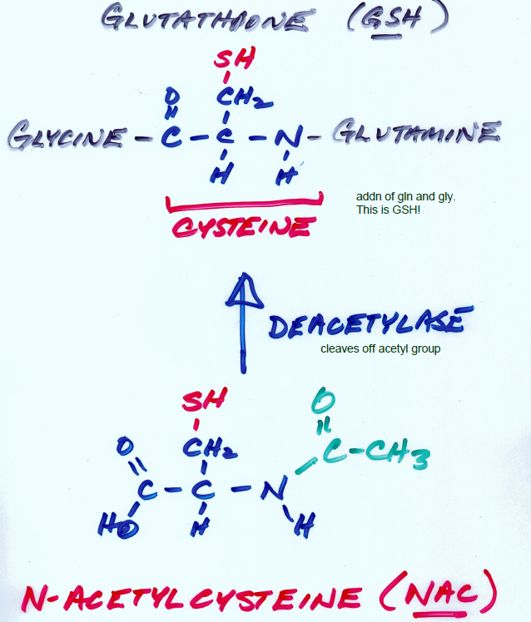
Wells 2013
Notes:
Early studies in rats which elucidated the mechanism of toxicity concluded that nucleophiles such as cysteamine could be used to treat APAP overdose in humans. Cysteamine was first used but adverse effects made it a less than ideal antidote. Toxic effects of cysteamine include rapid onset of anorexia, n/v, drowsiness and patients ‘felt miserable’.

Slide 16
When to treat?
Rumack and Matthew Nomogram

Slide 17
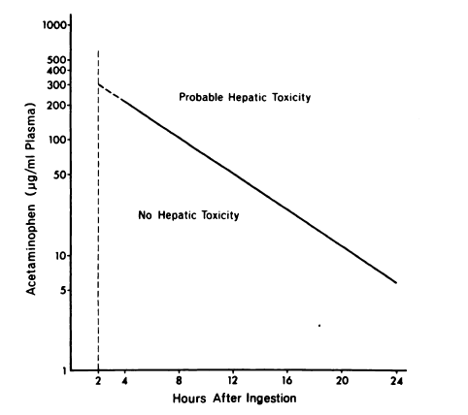
Acute Single Dose: Original Nomogram (1975)
Rumack and Matthew 1975
Notes:
1975 paper, Rumack and Matthew constructed this nomogram based on 32 patients. Hepatotoxicity AST or ALT>1000 U/L. 200 risk line.

Slide 18
Timing Issues
Takes at least 4 hrs for complete absorption in order to obtain peak serum concentration
XR formulations, codiene preparations may slow absorption, thus peak after 4 hrs
Pt may not know dose or time it was taken
Pt may not be willing to tell you
NAC effective if given within 8 hrs of a single overdose, but falls thereafter

Slide 19
Development of PO and iv protocols
US developed PO protocol because the manufacturer Bristol-Myers Squibb was not interested in spending resources to obtain approval of NAC as an iv drug
UK developed iv protocol, which was subsequently adopted by the US in 2004 when iv NAC Acetadote® became available through Cumberland Pharmaceuticals
Notes:
Oral protocol 18 doses over 72 hours. 140 mg/kg loading dose then 70 mg/kg.

Slide 20
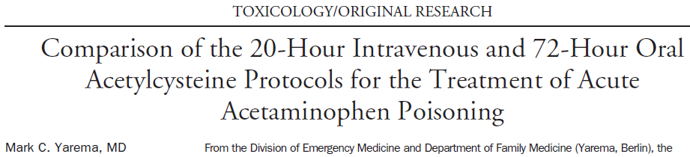
Which is better PO or iv?
Notes:
Observational Study. Oral NAC is absorbed into splanchnic flow and produces higher levels in the liver but due to first pass effect, lower levels in the blood as compared to iv. The iv administration doesn’t provide as much to the liver, but higher blood NAC concentration. It is unclear which is most important in determining hepatic outcome.
20

Slide 21
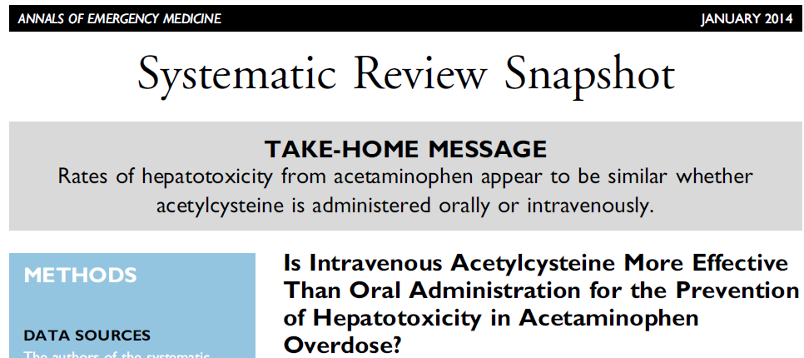
Which is better PO or iv?
Notes:
New for 2014
21

Slide 22
Comparison of safety of iv vs PO
Anaphylactoid (10-20%) with iv and vomiting (33%) with PO formulations most common
Risk of anaphylactoid reactions decreased if administered over 60 min
Palatability of NAC can be improved by diluting it in a 5% solution in cola or juice
Notes:
Higher incidence of anaphylactoid reaction in patients with lower serum acetaminophen levels. Mast cell degranulation without involving IgE as initial mediator. Bronchospasm have also been reported, thus caution in asthmatics should be exercised. Generally appears 30-60 min after initiation of NAC

Slide 23
Anaphylactoid Reaction
Non-IgE mediated by histamine and depends on blood acetylcysteine concentrations
Flushing, pruritus, rash, angioedema, hypotension, dyspnea and tachycardia
The Ottawa Hospital Recommends:
  Stop NAC
  Give Diphenhydramine 50 mg IV
  When symptoms resolved, restart NAC infusion at half the rate
Notes:
If severe, administer epinephrine 0.1 mg iv over 5 minutes. Saw an order set with an order for pre-treatment with diphenhydramine 1mg/kg iv x 1 (to prevent anaphylactoid reaction)

Slide 24
Dosing NAC iv

Slide 25
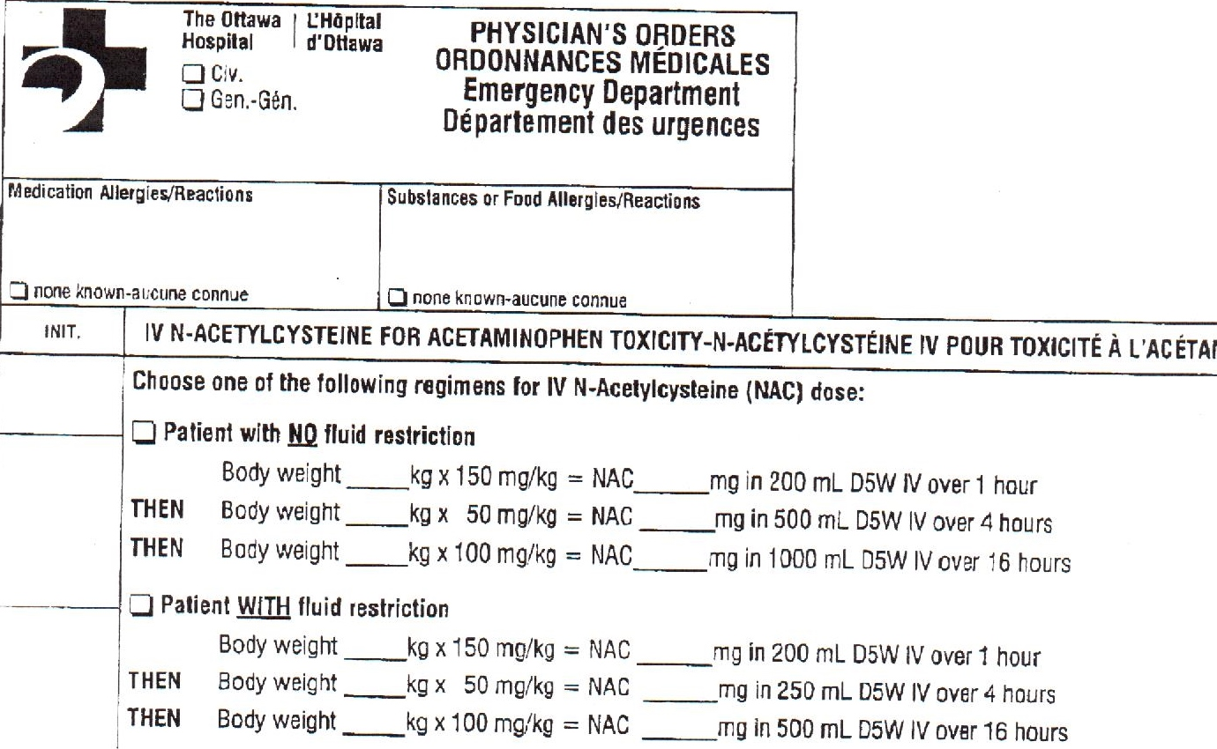
Notes:
The Ottawa Hospital Order sheet does not have a ceiling weight, as observational studies did not demonstrate an increase in adverse events based on dosing by actual weight. However, no benefits were seen with weights above maximum amount. UptoDate said that you could dose obese patients either on weight or with a ceiling weight of 100kg for iv and 110 for PO.

Slide 26
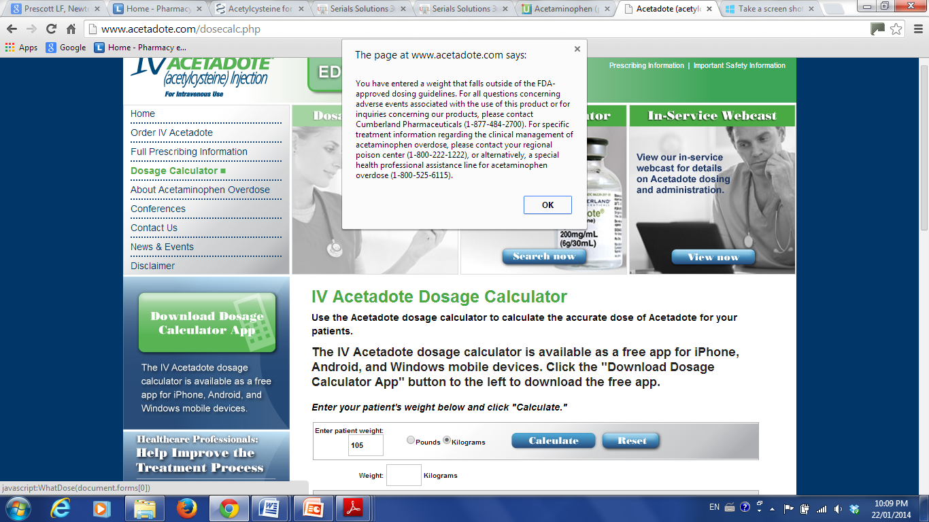
Notes:
I gave the number a call was put through to the California poison control centre and they said they cap the maximum first initial dose at 15 g. Looking at the study which examined obese individuals, the median weight was 110 kg. Thus I would go with the BMJ recommendations of capping at 16.5 g.

Slide 27
Treatment Endpoints
Treat for the entire 21 hour regime and take another acetaminophen level before the end of 3rd bag
If [acetaminophen] < 10 mcg/ml and no increase in ALT/INR, discontinue treatment
Continue treatment with 3rd bag if abnormal

Slide 28
Gastric Lavage and Activated Charcoal

Slide 29
CPS recommends
Step 1 “The stomach should be emptied by lavage or inducing emesis with syrup of ipecac…”

Slide 30
Gastric Lavage
Rapid absorption of acetaminophen suggests benefit from reduced gastric absorption is unlikely in many cases (Buckley and Eddleston 2007)
Combination of gastric lavage and activated charcoal may not be better than activated charcoal alone (Christopherson et al. 2002)
Effect of activated charcoal given 2 hour post ingestion substantially less than at 1 hour (Christopherson et al. 2002)
Risk of aspiration with induced vomiting

Slide 31
Activated Charcoal
RCTs with healthy volunteers have demonstrated that activated charcoal can reduce acetaminophen serum concentrations if given 1 and 3 hours post ingestion (Wananukul et al. 2010, Sato et al. 2003)
Activated charcoal does not interfere with the efficacy of oral NAC (Spiller et al. 1994)

Slide 32
Summary
Acetaminophen is metabolized by CYP P450 to a toxic metabolite which is neutralized by GSH
A supratherapeutic dose of acetaminophen can exhaust GSH stores which leads to hepatotoxicity
Risk factors for increased hepatotoxicity include use of P450 inducers, chronic alcoholism and malnourishment
Notes:
2E1, 1A2, 2A6 (valproate, nicotine), 3A4 and 2D6 (codeine to morphine)

Slide 33
Summary
N-acetylcysteine (NAC) is an exogenous source of GSH which can neutralize the toxic metabolite
NAC should be administered within 8 hours of acetaminophen ingestion to be maximally effective
72 hour PO and 21 hour iv NAC regimens are effective and safe for treating acetaminophen overdose
iv treatment has lower risk of vomiting

Slide 34
Summary
A common adverse effect of NAC iv is an anaphylactoid reaction
Pts with a lower plasma acetaminophen concentration are at higher risk for this anaphylactoid reaction
Anaphylactoid reaction can be managed by temporarily stopping NAC and giving diphenhydramine 50mg iv
NAC regimen can be continued at half the rate once anaphylactoid reaction subsided
Activated charcoal only likely to be beneficial if administered within 2 hours of acetaminophen ingestion

Slide 35
Order Sheet

Slide 36
Estimated Time of Ingestion:
 |  | Labwork Order
Clerk | Nurse | Has patient ingested over acetaminophen 7.5 g OR 150 mg/kg? | ASO
 |  |  Serum acetaminophen and full blood lab work
 |  | Activated Charcoal Order
Clerk | Nurse | Administer Activated Charcoal if within 2 hours of acetaminophen ingestion AND low risk of aspiration | Med Time | ASO
 |  |  Single dose activated charcoal 50 g PO STAT OR if patient < 12 y.o. AND < 50 kg  Single dose activated charcoal 1 g/kg PO STAT
 |  | Anaphylactoid Reaction Prophylaxis
Clerk | Nurse |  | Med Time | ASO
 |  |  Pre-treat with diphenhydramine 50 mg iv x 1 dose to prevent anaphylactoid reaction (If < 50 kg, give 1mg/kg)
Notes:
Also useful to get the time of ingestion. Monitor ALT/AST, INR, PTT, serum bicarbonate, SCr, BUN, electrolytes. Baptist Health Systems Hospital in US

Slide 37
 |  | IV N-acetylcysteine (NAC) regimen choose ONE | Med Time | ASO
 |  | Patient with NO fluid restriction  Body weight kg x 150 mg/kg = NAC mg in 200 mL D5W over 1 hour. MAX single dose 15 000 mg. THEN Body weight kg x 50 mg/kg = NAC mg in 500 mL D5W over 4 hours. THEN Body weight kg x 100 mg/kg = NAC mg in 1000 mL D5W over 16 hours.
 |  | Patient WITH fluid restriction  Body weight kg x 150 mg/kg = NAC mg in 200 mL D5W over 1 hour. MAX single dose 15 000 mg. THEN Body weight kg x 50 mg/kg = NAC mg in 250 mL D5W over 4 hours. THEN Body weight kg x 100 mg/kg = NAC mg in 500 mL D5W over 16 hours.
Notes:
Fluid restriction: eg. CHF, ESRD, hyponatremic patients

Slide 38
 |  | Subsequent Labwork Order: Take at 8 hours after initiation of 3rd iv NAC bag
Clerk | Nurse |  Serum acetaminophen and full blood lab work If [acetaminophen] > 10 mcg/ml or ALT/INR increased from last measurement, order additional NAC below If [acetaminophen] < 10 mcg/ml and no further ALT/INR increase, stop treatment at end of 3rd iv NAC bag |  | ASO
 |  | IV N-acetylcysteine (NAC) regimen choose ONE | Med Time | ASO
 |  | Patient with NO fluid restriction  Body weight kg x 100 mg/kg = NAC mg in 1000 mL D5W over 16 hours. Patient WITH fluid restriction  Body weight kg x 100 mg/kg = NAC mg in 500 mL D5W over 16 hours.
 |  | Additional Orders: ____________________________________________________________________________________________________________________________________________________________________________________________________________________________________________ ___________________________________________________________

Slide 39
References
Acetaminophen (paracetamol) poisoning in adults: Pathophysiology, presentation, and diagnosis. UptoDate 2014. Accessed online January 20, 2014 from <http://www.uptodate.com.myaccess.library.utoronto.ca/contents/acetaminophen- paracetamol-poisoning-in-adults-pathophysiology-presentation-and-diagnosis?source=search_result&search=signs+of+acetaminophen+toxicity&selectedTitl e=2~150>
Altomare E, Leo MA, Lieber CS. Interaction of acute ethanol administration with acetaminophen metabolism and toxicity in rats fed alcohol chronically. Alcohol Clin Exp Res 1984;8(4):405–8.
Buckley N and Eddleston M. Paracetamonl (acetaminophen) poisoning. Clinical Evidence 2007;12:2101.
Christopherrson AB, Levin D, Hoegberg LCG, Angelo HR and Kampmann JP. Activated charcoal alone or after gastric lavage: a simulated large paracetamol intoxication. Br J Pharmacol 2002;53:312-17.
Dart RC, Green JL, Kuffner EK, et al. The effects of paracetamol (acetaminophen) on hepatic tests in patients who chronically abuse alcohol - a randomized study. Aliment Pharmacol Ther 2010;32(3):478–86.
Dart RC, Erdman AR, Olson KR, Christianson GC, Manoguerra AS, Chyka PA, Caravati EM, Wax PM, Keyes DC, Woolf AD, Scharman EJ, Booze LL and Troutman WG. Acetaminophen Poisoning: an Evidence-Based Consensus Guideline for Out-of-Hospital Management. Clin Toxicol 2006;44:1-18.
Ferner RE, Dear JW and Bateman DN. Management of paracetamol poisoning. BMJ 2011;342:d2218.
Hodgman MJ and Garrard AR. A Review of Acetaminophen Poisoning. Crit Care Clin 2012;(28) 499–516.
Paracetamol Toxicity. Wikipedia.org. Accessed online January 19, 2014 from http://upload.wikimedia.org/wikipedia/commons/3/34/Paracetamol_metabolism.png
Rumack BH and Matthew HM. Acetaminophen Poisoning and Toxicity. Pediatrics 1975;55;871-76.

Slide 40
References
Sato RL, Wong JJ, Sumida SM, Marn RY, Enoki NR and Yamamoto LG. Efficacy of Superactivated Charcoal Administered Late (3 Hours) After Acetaminophen Overdose. Am J Emerge Med 2003;21(3):189-191.
Schwarz E and Cohn B. Is Intravenous Acetylcysteine More Effective Than Oral Administration for the Prevention of Hepatotoxicity in Acetaminophen Overdose? Ann Emerge Med. 2014;63(1):79-80.
SickKids Drug Handbook and Formulary 2013-2014. The Hospital for Sick Children. Toronto, Ontario.
Spiller HA, Krenzelok EP, Grande GA, et al. A prospective evaluation of the effect of activated charcoal before oral N-acetylcysteine in acetaminophen overdose. Ann Emerg Med 1994;23(3):519–23.
Ultracet® (tramadol hydrochloride/acetaminophen) Prescribing Information. Drug Reference Encyclopedia. Accessed online January 19, 2014 from <http://www.theodora.com/drugs/ultracet_tablets_ortho_mcneil.html>
Wananukul W, Klaikleun S, Sriapha C and Tongpoo A. Effect of activated charcoal in reducing paracetamol absorption at a supra-therapeutic dose. J Med Assoc Thai. 2010 Oct;93(10):1145-9.
Waring WS, Stephen AF, Robinson OD, Dow MA and Pettie JM. Lower incidence of anaphylactoid reactions to N-acetylcysteine in patients with high acetaminophen concentrations after overdose. Clin Toxicol 2008;46:496-500.
Waring WS, Stephen AF, Malkowska AM, et al. Acute ethanol coingestion confers a lower risk of hepatotoxicity after deliberate acetaminophen overdose. Acad Emerg Med 2008;15(1):54–8.
Wells PG. Hepatic Toxicology. Introductory Toxicology PHM325/PCL362. Lecture given on February 14, 2013.
Yarema MC, Johnson DW, Berlin RJ, Sivilotti MLA, Nettel-Aguirre A, Brant RF, Spyker DA, Bailey B, Chalut D, Lee JS, Plint AC, Purssell RA, Rutledge T, Seviour CA, Stiell IG, Thompson M, Tyberg J, Dart RC and Rumack BH. Comparison of the 20-Hour Intravenous and 72-Hour Oral Acetylcysteine Protocols for the Treatment of Acute Acetaminophen Poisoning. Ann Emerge Med. 2009;54(4):606-614.

Slide 41
Thank you Matt De Marco, Daniella Del Frate and everyone in the pharmacy department!
Notes:
Thank you Miriam for the candy gram

