Slide 1
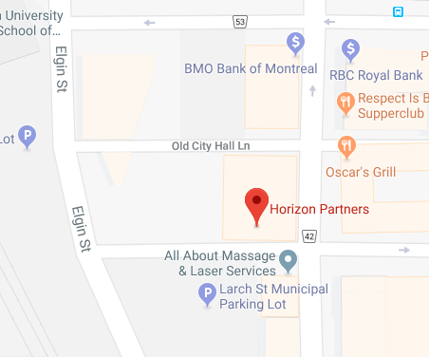
Slide 3
Chronic Pain Part 1
Legacy Opioid Patients….
Recognize CNCP patients that could benefit from an opioid taper.
Learning Objectives
1
2
Discuss evidence for benefits and risks of opioid taper or switch for CNCP patients
3
Review CNCP opioid patient prescribing safeguards and patient counselling resources.
Speaker: to Mathew DeMarco R.Ph
*New Venue*
Hollis Wealth Management 201 Larch 4th Floor (same building as SRO) 6 pm: Drinks 630-8 PM : 630 pm : Diner & Presentation
Date: Tuesday November 20th
RSVP NOW@ www.sudburyjournalclub.com

