Slide 1
HIV
PHARMACEUTICAL CARE
An Overview of the Role of the Pharmacist
Presented by: Brittany Franchuk (UW PharmD Candidate 2015)

Slide 2

Disclosure
This dinner and learning opportunity was kindly provided by Merck

Slide 3
Pharmacists HIV ROLE: Professional Practice Data
“Pharmacists’ involvement in the care of HIV-positive patients has been associated with improved patient outcomes, including enhanced adherence, reduced pill burden and dosing frequency, greater increases in CD4 cell counts, higher rates of viral suppression, and decreases in medication errors.”
Role of the Pharmacist in Caring for Patients with HIV/AIDS: Clinical Practice Guidelines. Can J Hosp Pharm. 2012 Mar-Apr; 65(2): 125–145.
Notes:
This is just some confidence behind what we are talking about today in that pharmacists really can make a difference for these patients!
The goal of this presentation tonight will be to provide you some tools and resources that will help you feel better prepared when helping these patients
2 things:
Interactive resource presentation that will be posted with links to help you when previewing and assessing HIV prescriptions/meds
Focus on the names of the drugs from the start

Slide 4

Overview
GOALS OF THERAPY
Indicated and Effective
  Guideline Preferred and Alternative Agents
Safety
  Adverse Effects
  Drug Interactions
Compliance
  Clinical Implications of Non-Adherence
  Recommendations to Optimize
  Crushing, Splitting and Other Dosage Forms
Cost
  Types of coverage available
Counseling
  Counselling Sheets/Resources
PEP and PrEP recommendations
Earvin “Magic”Johnson
Diagnosed 1991
Notes:
*Explain the story of Magic Johnson

Slide 5

Goals Of therapy
Maximal suppression of viral replication and promotion of immune reconstitution through combination antiretroviral therapy and preventing transmission of HIV by achieving undetectable viral load
Promote long-term adherence
Avoid drug interactions
Minimize adverse effects
Simplify treatment regimens and decrease drug costs
Manage comorbid conditions
Notes:
Suppress viral load to prevent transmission, then encourage adherence so this continues.
While on ARV therapy you want to avoid drug interactions and minimize adverse effects as well as simplify the treatment regimen to decrease drug costs
And finally manage comorbid conditions

Slide 6
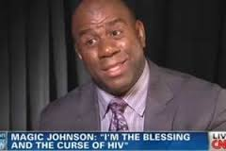
Overview
Goals of Therapy
INDICATED AND EFFECTIVE
  Guideline Preferred and Alternative Agents
Safety
  Adverse Effects
  Drug Interactions
Adherence
  Clinical Implications of Non-Adherence
  Recommendations to Optimize
  Crushing, Splitting and Other Dosage Forms
Cost
  Types of coverage available
Counseling
  Counselling Sheets/Resources
PEP and PrEP recommendations
Earvin “Magic”Johnson
Diagnosed 1991

Slide 7
Indication and Effectiveness
Preferred and Alternative Regimens For Treatment Naïve or Experienced Patients
2 NRTI BACKBONE
(All come as combination)
Add One of the Following: NNRTI, PI, or Integrase Inhibitor
Truvada
(Tenofovir/Emtricitabine
aka TDF / aka FTC
NNRTIs – Efavirenz, Etravirine, Rilpivirine
OR
OR
Kivexa
(Abacavir/Lamuvidine)
aka ABC / aka 3TC
PIs – Darunavir/r , Lopinavir/r, Atazanavir/r
OR
OR
Guideline update
Combivir
(Zidovudine/Lamuvidine) aka AZT / aka 3TC
Integrase Inhibitors –
Raltegravir, Elvitegravir , Dolutegravir
Notes:
Stop everyone right here and soak It up
The basis of ART is to combine drugs to target the virus via different ways. This is done by inhibiting different viral enzymes such as transcriptase, protease and most recently integrase
Triple therapy has been proven to be more effective than mono or dual therapy thus the key to HIV therapy is that you have a 2 NRTI backbone + a NNRTI, PI or Integrase inhibitor
Explain short forms: NRTI = nucleoside reverse transcriptase inhibitors; NNRTI = non-nucleoside reverse transcriptase inhibitors; PIs = protease inhibitors (explain that /r = boosted with ritonavir which is another PI. Boosted with this agent because it is the most potent CYP3A4 inhibitor in that drug class. Ritonavir not used alone though in higher doses due to adverse effect profile → GI side effects?)
Guideline update: Integrase inhibitors are now included in the guidelines. They weren’t in the old guidelines because they’re a newer drug class that has just been developed in the past couple of years which has less resistance and better adverse effect profile which we’ll talk about.
Key point = triple therapy to target the virus via different mechanisms
*Make sure everyone understands this slide* → KEY SLIDE!!!!!

Slide 8
3rd Drug Comparison Table
In addition to 2 drug NRTI Backbone, Antiretroviral (3rd drug) Class | Effectiveness | Barrier to Resistance | Drug Interactions | Adverse Effects | Dosage Form
 |  |  |  | Rilpivirine | 1PILL/DAY Complera Atripla
 |  |  |  | Atripla | 3 pills/day Etravirine + Truvada
 |  |  |  |  | 3 – 5 pills/day: 1-2 times daily + Truvada
 |  |  | Stribild |  | 1PILL/DAY Stribild Triumeq
 |  |  |  |  | 3 pills/day Raltegravir + Truvada
NNRTIs – Efavirenz, Etravirine Rilpivirine
PIs – Darunavir/r , Lopinavir/r Atazanavir/r
Integrase Inhibitors Raltegravir, Elvitegravir , Dolutegravir
*/r = plus ritonavir booster
*Complera, Atripla, Stribild, Triumeq = once a day combination pills
= NEW
Notes:
This table compares the different options that you have to add on to the 2 NRTI backbone.
Ask mat to remind you why drug interactions is yellow for NNRTI’s → it’s because these drug interactions can be managed by monitoring for adverse effects. Don’t necessarily require an intervention
Ask mat where efavirenz falls in terms of adverse effects – we don’t really use it because it has the worst adverse effect profile in the drug class
NNRTI → drug interactions that you can monitor vs. PI drug interactions are worse = strong cyp 3A4
Key points:
- All equally effective
NNRTI’s have lowest barrier to resistance (is it just a point mutation that causes resistance in this case? Double check/look into before presentation to explain?)
PI’s: have drug interactions (CYP3A4 and CYP 2D6 inhibitors) and GI ADRs
Integrase inhibitors: have best safety profile (interactions and adverse effects).
*usually we choose and rank drugs based on efficacy but in the case of the HIV patient compliance and thus dosage form is key and most important*

Slide 9
INDICATION AND EFFECTIVENESS
1 pill once a day options* |  | Most popular 2 -3 pill/day regimens
Complera | Rilpivirine/tenofovir/emtricitabine | Prezista/r + Truvada | Darunavir/r + tenofovir/emtricitabine
Stribild | Elvitegravir/cobicistat/tenofovir/emtricitabine | Reyataz/r + Truvada | Atazanavir/r +tenofovir/emtricitabine
Atripla | Efavirenz/tenofovir/emtricitabine | Isentress + Truvada | Raltegravir + tenofovir/emtricitabine
Triumeq | Dolutegravir/abacavir/lamivudine | Tivacay + Truvada | Dolutegravir + tenofovir/emtricitabine
*Primarily new starts and switches
Notes:
Explain that this chart summarizes the most popular HIV regimens and shows how the different drug classes are combined
Also explain the symbols: X and Star
X is to highlight the fact that Atripla is rarely used in practice here due to the genotype of the HIV virus in Sudbury is resistant to it → K103
Star: Triumeq = NEW drug on the market (not covered by ODB yet; private plan only)

Slide 10
INDICATION AND EFFECTIVENESS
1 pill once a day options* |  | Most popular 2 -3 pill/day regimens
Complera | Rilpivirine/tenofovir/emtricitabine | Prezista/r + Truvada | Darunavir/r + tenofovir/emtricitabine
Stribild | Elvitegravir/cobicistat/tenofovir/emtricitabine | Reyataz/r + Truvada | Atazanavir/r +tenofovir/emtricitabine
Atripla* | Efavirenz/tenofovir/emtricitabine | Isentress + Truvada | Raltegravir + tenofovir/emtricitabine
Triumeq | Dolutegravir/abacavir/lamivudine | Tivacay + Truvada | Dolutegravir + tenofovir/emtricitabine
*Primarily new starts and switches
2 DRUG NRTI BACKBONE
Notes:
Backbone is essential to all the regimens

Slide 11
INDICATION AND EFFECTIVENESS
1 pill once a day options* |  | Most popular 2 -3 pill/day regimens
Complera | Rilpivirine/tenofovir/emtricitabine | Prezista/r + Truvada | Darunavir/r + tenofovir/emtricitabine
Stribild | Elvitegravir/cobicistat/tenofovir/emtricitabine | Reyataz/r + Truvada | Atazanavir/r +tenofovir/emtricitabine
Atripla | Efavirenz/tenofovir/emtricitabine | Isentress + Truvada | Raltegravir + tenofovir/emtricitabine
Triumeq | Dolutegravir/abacavir/lamivudine | Tivacay + Truvada | Dolutegravir + tenofovir/emtricitabine
*Primarily new starts and switches
3RD DRUG NNRTI

Slide 12
INDICATION AND EFFECTIVENESS
1 pill once a day options* |  | Most popular 2 -3 pill/day regimens
Complera | Rilpivirine/tenofovir/emtricitabine | Prezista/r + Truvada | Darunavir/r + tenofovir/emtricitabine
Stribild | Elvitegravir/cobicistat/tenofovir/emtricitabine | Reyataz/r + Truvada | Atazanavir/r +tenofovir/emtricitabine
Atripla | Efavirenz/tenofovir/emtricitabine | Isentress + Truvada | Raltegravir + tenofovir/emtricitabine
Triumeq | Dolutegravir/abacavir/lamivudine | Tivacay + Truvada | Dolutegravir + tenofovir/emtricitabine
3RD DRUG PROTEASE INHIBITOR (PI)

Slide 13
INDICATION AND EFFECTIVENESS
1 pill once a day options* |  | Most popular 2 -3 pill/day regimens
Complera | Rilpivirine/tenofovir/emtricitabine | Prezista/r + Truvada | Darunavir/r + tenofovir/emtricitabine
Stribild | Elvitegravir/cobicistat/tenofovir/emtricitabine | Reyataz/r + Truvada | Atazanavir/r +tenofovir/emtricitabine
Atripla | Efavirenz/tenofovir/emtricitabine | Isentress + Truvada | Raltegravir + tenofovir/emtricitabine
Triumeq | Dolutegravir/abacavir/lamivudine | Tivacay + Truvada | Dolutegravir + tenofovir/emtricitabine
3RD DRUG INTEGRASE INHIBITOR

Slide 14
Indication and effectiveness
ADD A PROTEASE INHIBITOR
Reyataz/r | Atazanavir/r
Kaletra/r | Lopinavir/r
PREGNANCY
2 NRTI BACKBONE
Kivexa* | abacavir/lamuvidine
Truvada | tenofovir/emtricitabine
Combivir | zidovudine/lamivudine
OR
ADD A NNRTI
Sustiva* | efavirenz
*CI in first 8 weeks of pregnancy – neural tube defects
* To use Kivexa pt must be HLA-B*5701 negative
OR
ADD AN INTEGRASE INHIBITOR
Isentress | raltegravir
HIV and Pregnancy Guidelines:
http://aidsinfo.nih.gov/contentfiles/lvguidelines/perinatalgl.pdf
Notes:
Regimens on slide are from HIV pregnancy guidelines:
Then add a PI that’s boosted with ritonavir
Explain that Kaletra now appears on the list. Has evidence for pregnancy but wasn’t on previous list of common usual regimens due to high pill burden (2 pills BID → 4 pills/day + Kivexa = 5 pills/day) and worse GI adverse effect profile. (seems a bit counter-intuitive to give a pregnant patient something that may exacerbate pre-existing nausea but it’s one of the agents with the most evidence in pregnancy thus it’s still recommended)
Other PI regimens – darunavir is no longer on the list since it hasn’t been studied in pregnancy → no data
Other recommendations with pregnancy data include:
i) NNRTI – efavirenz (not typically used in practice though due to CNS effects – depression, insomnia, vivid nightmares. Worse side effect profile in NNRTI drug class). Would only use if mom already on it during her pregnancy (after the 8 week mark)
ii) Integrase Inhibitors – raltegravir is the only one in this drug class that has pregnancy data
My bottom line:
- Likely would recommend choosing atazanvir from the PI class or isentress (integrase inhibitor if CYP3A4 interactions are a problem with PI’s)

Slide 15
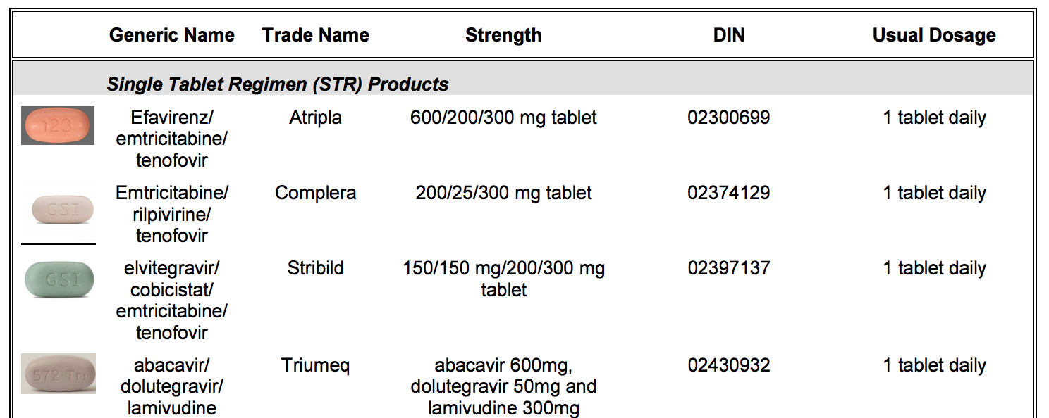
Indication and Effectiveness
Verifying the Dose
Lexi-comp or eCPS
Hivclinic.ca has a great 1 page summary http://hivclinic.ca/main/drugs_extra_files/HIV%20MEDICATIONS%20at%20a%20glance.pdf
Hivclinic.ca also has a “usual regimens” for Opportunistic Infections and ART
http://hivclinic.ca/main/drugs_extra_files/Regimens%202012.pdf

Slide 16
Indication and Effectiveness
Treatment Guidelines for HIV and Opportunistic Infections
AIDSinfo, US Department of Health and Human Services
  http://aidsinfo.nih.gov/guidelines
International Antiviral Society-USA
  www.iasusa.org/guidelines/index.html
British HIV Association
  http://www.bhiva.org/Guidelines.aspx
European AIDS Clinical Society
  www.europeanaidsclinicalsociety.org

Slide 17
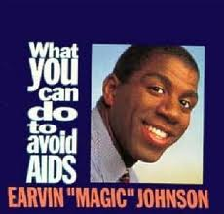
Overview
Goals of Therapy
Indicated and Effective
  Guideline Preferred and Alternative Agents
SAFETY
  Adverse Effects
  Drug Interactions
Compliance
  Clinical Implication of Non-Adherence
  Recommendations to Optimize
  Crushing, Splitting and Other Dosage Forms
Cost
  Types of coverage available
Counseling
  Counselling Sheets/Resources
PEP and PrEP recommendations

Slide 18
Safety
Common Adverse Effects by Drug Class
Adverse drug reactions to antiretrovirals occur frequently
and are a major reason for discontinuing or changing
therapy
2 NRTI BACKBONE
(All comes as combination)
Truvada
(Tenofovir/Emtricitabine)
aka FTC
NRTI’s (Emtricitabine , lamivudine, zidovudine, abacavir, tenofovir)
Anemia (zidovudine)
Nephrotoxicity (tenofovir)
Osteoporosis
Lipodystrophy
Hypersensitivity reaction (abacavir)
OR
Kivexa
(Abacavir/Lamivudine)
aka 3TC
OR
Combivir
(Zidovudine/Lamuvidine aka AZT/ aka 3TC
Notes:
Some notes:
Monitor SCr while on tenofovir. Can cause AKI via renal tubule injury. CI when CrCl <10 and not on hemodialysis. Otherwise dosing interval is adjusted based on renal function once CrCl,50
Although there is a risk of osteoporosis the guidelines don’t recommend routine BMD testing. Only done based on clinical judgement if you think the patient has a high fracture risk
Genetic testing is done if using abacavir. Patient must be HLA-B*5701 negative otherwise they are at risk of hypersensitivity reaction

Slide 19
Safety
Common Adverse Effects by Drug Class
NNRTI’s (efavirenz, etravirine, rilpivirine, )
CNS: Insomnia, vivid dreams, difficulty concentrating, depression, suicidal ideations
CNS effects usually subside or improve 2-4 weeks after initiation
Dyslipidemia
Liver toxicity
Drug rash
Add One of the Following: NNRTI, PI, or Integrase Inhibitor
NNRTIs – Efavirenz, Etravirine, Rilpivirine
Etravirine > Efavirenz (Atripla) > Rilpivirine (Complera)
Notes:
Etravirine is the worst for CNS and dyslipidemia
Atripla = insomnia
Rilpivirine: lipid neutral and no increase in depression

Slide 20

Safety
Common Adverse Effects by Drug Class
PROTEASE INHIBITORS
(Atazanavir, Darunavir, Lopinavir)
Kidney stones , Jaundice (Atazanavir)
Liver toxicity
Lipodystrophy
New onset diabetes
Dyslipidemia
Diarrhea (Lopinavir > atazanavir, darunavir)
Drug Rash
Add One of the Following: NNRTI, PI, or Integrase Inhibitor
PIs – Darunavir/r , Lopinavir/r, Atazanavir/r
Recommended to TAKE WITH FOOD
Notes:
*Almost all PI’s are taken with food to minimize GI side effects and to increase absorption. (exception: indinavir – empty stomach)
Preparing for questions:
Ken may ask the incidence of new onset diabetes from PIs → <1% of patient’s (rare ADR)
Is it reversible once drug stopped? (most likely)

Slide 21
Safety
Common Adverse Effects by Drug Class
INTEGRASE INHIBITORS
(Raltegravir, Elvitegravir, Dolutegravir)
Nausea and diarrhea
Headache
Add One of the Following: NNRTI, PI, or Integrase Inhibitor
Integrase Inhibitors – Raltegravir, Elvitegravir , Dolutegravir
Notes:
*Integrase Inhibitors have the best adverse effect profile – as you can see it’s just a short list and the side effects listed here are manageable

Slide 22
Safety
Drug Interactions
Clinically significant drug interactions have been reported in 27%–40% of HIV patients
Many are manageable
Identified Risk Factors
Receiving PIs, NNRTIs
Number of concomitant medications – increases comorbidities
Current use of illicit drugs
Coinfection with hepatitis C virus (HCV)
Age identified as an independent risk factor

Slide 23
Safety
Drug Interactions – Case Presentation
54 yo male; HIV + since 2005
On Darunavir/r + Truvada (PI + 2 NRTI backbone)
Admitted to Hospital after symptoms of pneumonia for 5 days at home
PCP/PJP pneumonia ruled out, diagnosed with CAP after cultures revealed strep in the sputum
At discharge, antibiotics and flovent are prescribed for residual symptoms of CAP including SOB
Drug therapy problem?
    Lexi will tell you there is a CYP 3A4 mediated drug interaction
    Darunavir/r may increase serum concentration of fluticasone → Cushing's syndrome
      moon face, buffalo hump, obesity, striations, acne, hirsutism, hypertension, osteoporosis, glucose intolerance, increased risk of infections and adrenal suppression
      An increased number of Cushing’s cases have been seen in practice lately
  How to manage → Drug information approach
    http://hivclinic.ca/main/drugs_interact.html
    http://www.hiv-druginteractions.org/
Notes:
*Darunavir/r is a CYP3A4 inhibitor

Slide 24
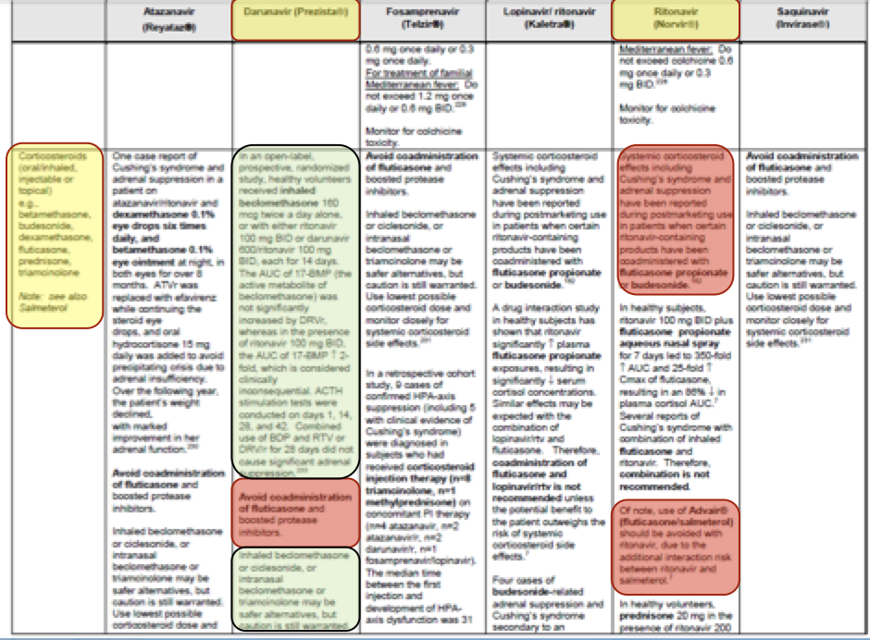
http://hivclinic.ca/main/drugs_interact.html → Protease Inhibitors
Notes:
*Point out at this point that they could find this same information by using the app HIV ichart (free for iphone and android)
- Explain that the protease inhibitors are listed across the top – in our case we’re interested in darunavir and ritonavir (highlighted in yellow along the top)
Along the y-axis are other drug classes so in this case we’re looking at corticosteroids
The red boxes show what to avoid – fluticasone and Advair (has fluticasone in combo)
The green boxes show what’s recommended instead → beclomethasone (QVAR)
* This is a great resource to use since it includes PK data and instead of just saying there is an interaction, it provides a recommendation on what to do and what alternative to use

Slide 25
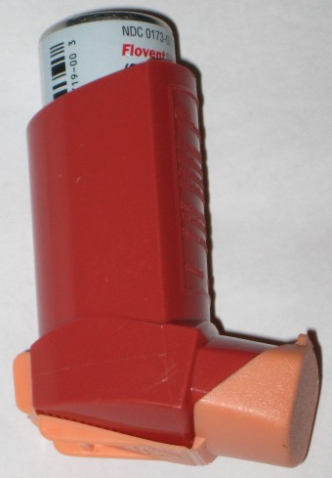
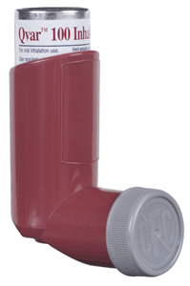
SAFETY
How to manage drug interaction
Change Flovent (fluticasone) to QVAR (beclomethasone)
Beclomethasone is not a substrate for CYP3A4
Bill as a pharmaceutical opinion for ODB patients
Notes:
*Really highlight the fact that community pharmacists can easily catch and prevent this type of interaction.
Dosing of QVAR not listed on slide because it varies depending on the severity of the asthma. Most commonly 100 mcg (1 puff) BID = moderate asthma
Although beclomethasone is still a corticosteroid it’s not metabolized by CYP3A4 (drug interaction due to enzymes not drug class since one corticosteroid interacts and the other does not)
ODB patients – not only 65+ but lots of trillium patients at clinic due to scoioeconomic and financial issues

Slide 26
SAFETY
Common Drug Interaction
Antiretrovirals and statins (ie. Stribild + Atorvastatin)
Flagged as CYP3A4 interaction
Theoretical interaction due to cobicistat booster (CYP3A4 inhibitor)
May increase atorvastatin concentrations
Recommended to initiate atorvastatin at the lowest dose and titrate as needed while monitoring for adverse effects:
  GI – nausea, diarrhea, dyspepsia
  Myalgia
  HA
If the interaction is significant consider changing to rosuvastatin (CYP2D6 not CYP3A4)
Notes:
*Interactions with statins is another type of interaction that we are commonly asked about at clinic
*Highlight fact that interaction is due to the booster not the actual antiretrovirals and that the key to this interaction is to manage by monitoring
*only common side effects listed
KEY POINT:
This interaction is managed by monitoring compared to the previous interaction which required a change in therapy
*At this point before we move on I want to point out that there are many other drug interactions besides the two most common ones we’ve talked about here. But the bottom line is the same – determine if the interaction can be managed by simply monitoring for adverse effects before deciding that a change in therapy is needed. Compliance is important in all patients but even more so in the HIV patient. Thus we often don’t want to make too many medication changes unless necessary.
*Also, if you’re ever unsure about an interaction with antiretrovirals and how to manage it feel free to contact the HAVEN clinic and use us as a resource. We’re more than happy to assist you if needed.

Slide 27
Safety
Complementary and Alternative Medicine
CAM has been associated with combination antiretroviral therapy non-compliance
CAM users may have a less favourable attitude toward traditional medicine than other patients
Interactions
  NHPs have been shown to induce or inhibit important metabolic pathways involved in
  the metabolism of PIs and NNRTIs
    How → via CYP450, UGT and P-glycoprotein pathways
  Most Common Offenders
  St John’s wort -3A4 inducer
  Echinacea -3A4 inducer
  Garlic -3A4 inhibitor
  Gingko biloba -3A4 inhibitor
  Drug information approach
    Natural Standard
    Nation Medicine Comprehensive Database
    CAMline
Notes:
3A4 inducers may decrease efficacy of ARV by decreasing levels???? (ask mat)
3A4 inhibitors may increase ARV levels increasing the risk of adverse effects

Slide 28

Overview
Goals of Therapy
Indicated and Effective
  Guideline Preferred and Alternative Agents
Safety
  Adverse Effects
  Drug Interactions
ADHERENCE
  Clinical Implication of Non-Adherence
  Recommendations to Optimize
  Crushing, Splitting and Other Dosage Forms
Cost
  Types of coverage available
Counseling
  Counselling Sheets/Resources
PEP and PrEP recommendations

Slide 29
Adherence
Clinical Implication of Non-Adherence
Adherence Percentage | Virologic Breakthrough
95% | 22% (0% for naïve patients)
90-95% | 55%
80-90% | 67%
Paterson DL, Swindells S, Mohr J, Brester M, Vergis EN, Squier C, Wagener MM, Singh N.Adherence to protease inhibitor therapy and outcomes in patients with HIV infection. Ann Intern Med. 2000 Jul;133(1):21-30
Notes:
Bottom line: even a little bit of non-adherence can lead to virologic breakthrough → non adherence leads to resistance!
*Missing doses here has bigger effects
95% → missing 2 doses/month

Slide 30
Adherence
Clinical Implication of Non-Adherence
Medication adherence is a crucial factor that affects the extent and duration of response to combination antiretroviral therapy
Suboptimal compliance may be associated with:
increased viral load
virologic breakthrough
development of resistance
reduced efficacy of future combination therapy
increased risk of hospital admission
increased progression to AIDS and decreased survival
Use of single-tablet, once-daily regimens has been associated with higher adherence
rates and reduced risk of hospital admission relative to multi-tablet, once-daily regimens
Adherence fatigue, which is relatively common, may compromise the long-term effectiveness of therapy. HCP’s must be diligent to consistently ask probing questions
Notes:
Key point: one pill once a day regimens have been proven to increase adherence. This is why at the clinic we try to start all of our patients on and switch others to this type of regimen. Now we’re typically only using the multi-tablet regimens when resistance to parts of the combination pills is an issue and factor.

Slide 31
ADHEREnCE
Recommendations to Optimize Adherence
Know your patient and all the psychosocial factors that influence taking ART
Maintain privacy and confidentiality
Use fixed-dose combination medications
Counsel the patient about optimal medication use
Explain adverse effects and how they can be managed
Encourage use of dosettes/blister packs
Encourage the use of reminder devices (txts)
Incorporate taking medications as a part of daily routine
Notes:
In regards to this slide, I know that this is something that all of you do every day thus this is meant to simply be a friendly reminder of some strategies you can use
1 pill/day is best for the system approach!* → highlight that this is the approach we use most often at clinic when counselling patients
Re: counselling:
Explain the implications of non-adherence to the patient so they know the importance of taking it regularly
Explain to them what to do in the case that they do accidentally miss a dose
Explain adverse effects that you will monitor for and how they can be managed if the need arises. The goal is to explain ADRs in a way that will not discourage the patient from taking the drug
Explain how drug interactions will be monitored and managed. Reassure them that they will be managed in a way that does not compromise efficacy of ARVs (many patients worry about this and as a result may not take some of their drugs!)

Slide 32
ADHEREnCE
  Crushing and Liquid Dosage Form Problem Solving
68 yo male HIV+ 1991
On combination of efavirenz and truvada
Patient has a history of esophageal CA, operated and radiation in 2010
Patient reports pain when swallowing and requests crushed or liquid dosage form
Which medication can be crushed or are available as a liquid formulation ?
    Drug information approach
      *Liquid formulations* → http://hivclinic.ca/main/drugs_extra_files/LIQUID%20DRUG%20FORMULATIONS.pdf
      *Crush* → http://hivclinic.ca/main/drugs_extra_files/crushing%20ARVs_C%20Hughes.pdf
      *Pediatric Formulations* → www.faetc.org/PDF/Pocket_Guides/pediatric_hiv_drug_card.pdf
      http://www.ismp.org/tools/donotcrush.pdf

Slide 33
ADHERENCE
Crushing and Liquid Dosage Form Problem Solving
TRUVADA (2 NRTI BACKBONE) | EFAVIRENZ (NNRTI)
Split tablets 2)Crush and stir in water, grapefruit juice or orange juice | 1) Liquid suspension available 30 mg/ml Store at room temperature Good x 30 days after opening 2) Open capsules and mix powder with: Applesauce, grape jelly or yogurt Use within 30 minutes of mixing Drink a small glass of water afterwards May result in “hot jalapeno” sensation

Slide 34
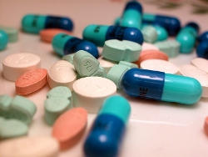
Overview
Goals of Therapy
Indicated and Effective
  Guideline Preferred and Alternative Agents
Safety
  Adverse Effects
  Drug Interactions
Adherence
  Clinical Implication of Non-Adherence
  Recommendations to Optimize
  Crushing, Splitting and Other Dosage Forms
COST
  Types of coverage available
Counseling
  Counselling Sheets/Resources
PEP and PrEP recommendations

Slide 35
COST AND COVERAGE
Antiretroviral therapy is very expensive
  $10 0000/year just for Truvada
  $14,486/year for Truvada + Prezista
  $16,387/year for Stribild
Types of HIV drug coverage:
  ODB (trillium)
  Private insurance (unlikely – around 10/350 patients at clinic)
  Drug cards available for Stribild and Complera (60 day supply only)
  Compassionate supply
Any coverage issues are usually identified and resolved by the patient’s HIV Clinic
Notes:
Key point:
As community pharmacists you should not have to worry about coverage issues as it should technically be looked after by the clinic before the patient comes to see you
Bottom line re: cost → regimens are > 1000 /month!

Slide 36

Overview
Goals of Therapy
Indicated and Effective
  Guideline Preferred and Alternative Agents
Safety
  Adverse Effects
  Drug Interactions
Adherence
  Clinical Implication of Non-Adherence
  Recommendations to Optimize
  Crushing, Splitting and Other Dosage Forms
Cost
  Types of coverage available
COUNSELLING
  Counselling Sheets/Resources
PEP and PrEP recommendations

Slide 37
COUNSELLING
33 yo male from Jamaica
HIV+ New Diagnosis , CD4 19, VL 59,235
Hospitalized for pneumonia
  Confirmed Pnemocystic jirovecii (PJP/PCP)
In hospital: Rx TMP/SMX IV TID x 21 days
Patient discharged home on: TMP/SMX SS 1 tab po daily, Azithromycin 1250 po Qweekly and Complera 1 tab po daily
You are asked to provide counselling and a Medscheck
    Drug information approach
      http://hivclinic.ca/main/drugs_fact.html
      http://hivmedicationguide.com/Default.asp
Notes:
*Mention: VL should be <40; CD4 should be >500
*Mention that both of the links provided on the slide are great resources for counselling information

Slide 38
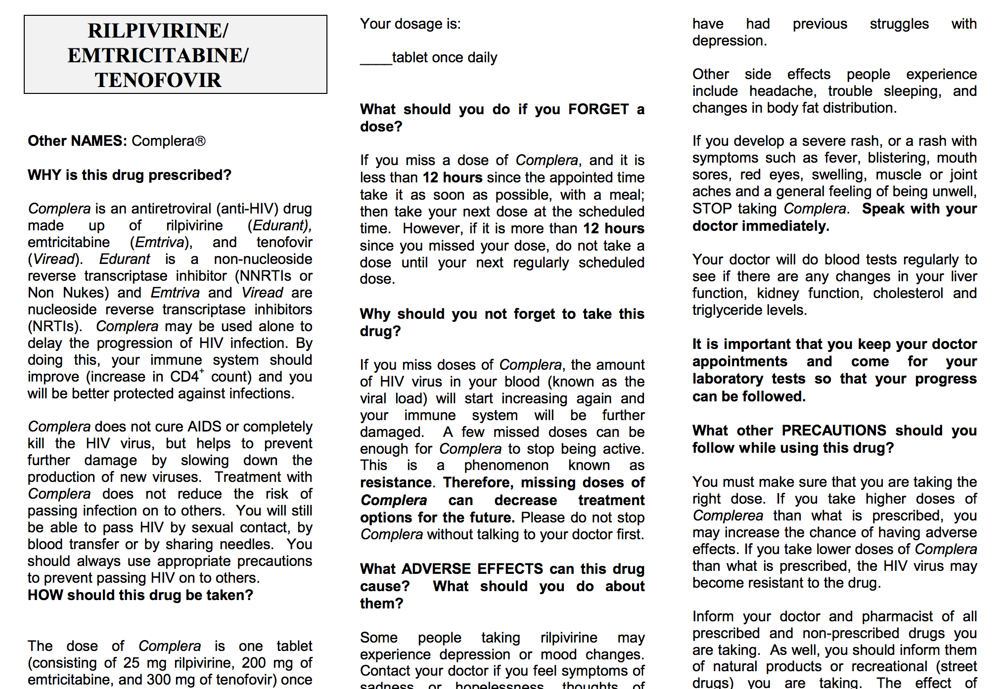
TAKE WITH FOOD
Notes:
This is a screenshot of the type of information you will find at the first link: http://hivclinic.ca/main/drugs_fact.html
Hiv clinic.ca is a great resource because they have fact sheets for all of the antiretrovirals that are formatted the same way
Highlight key counselling sections for pharmacists
How to take the drug
What to do if pt misses a dose (ie. Take right away or wait until next dose)
Adverse effects
Pregnancy and drug interaction information is also included on the second page

Slide 39
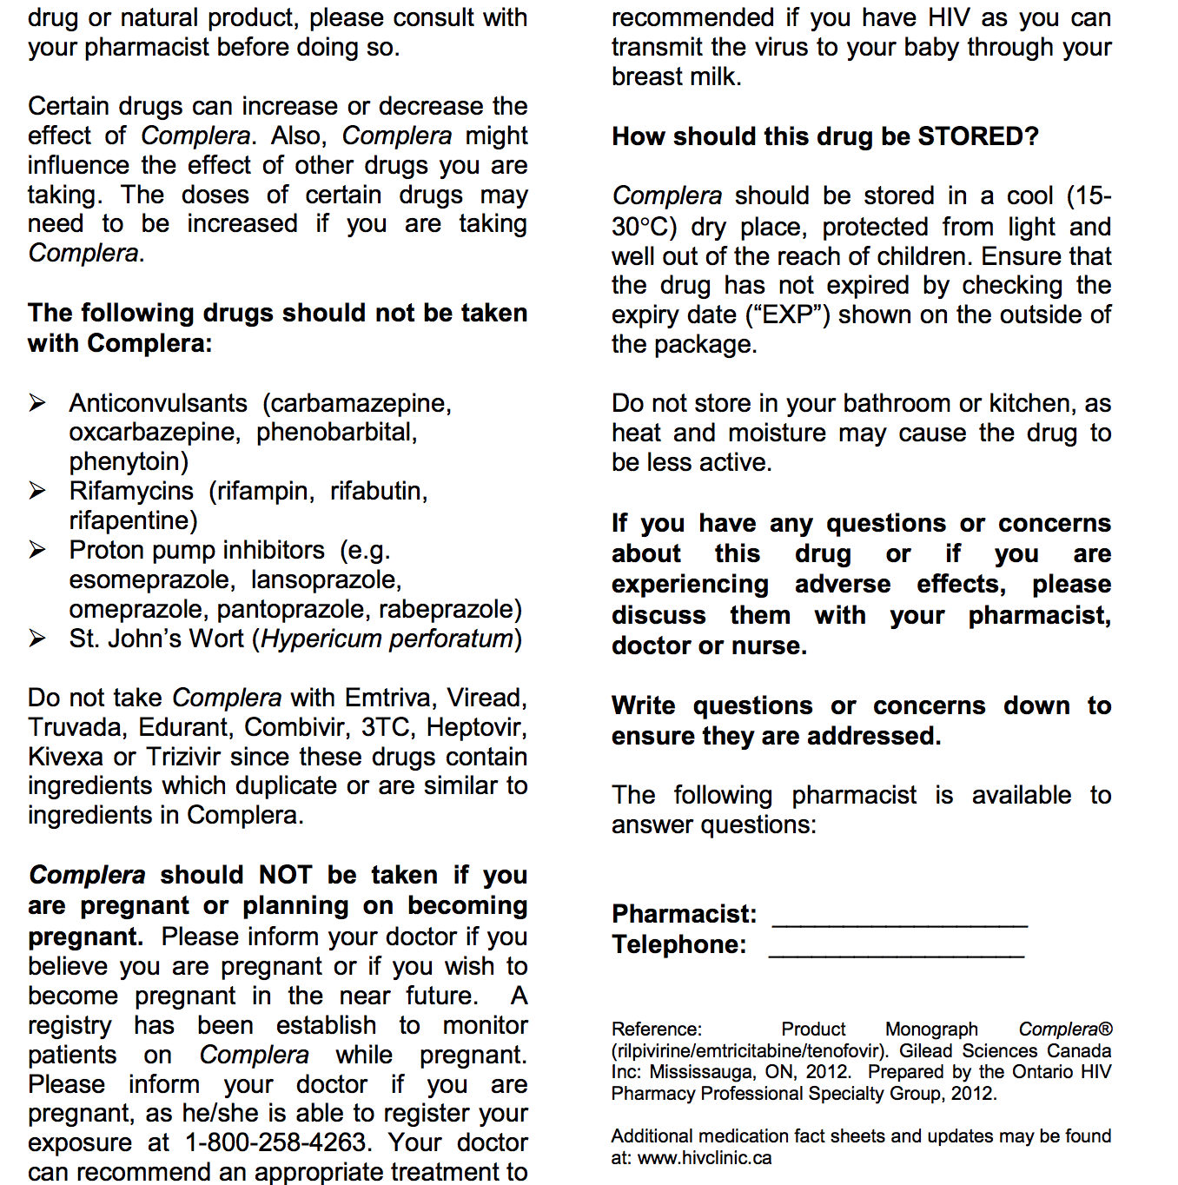
Notes:
Drug interactions, pregnancy and storage information is also included

Slide 40

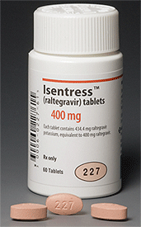
Overview
Goals of Therapy
Indicated and Effective
  Guideline Preferred and Alternative Agents
Safety
  Adverse Effects
  Drug Interactions
Adherence
  Clinical Implication of Non-Adherence
  Recommendations to Optimize
  Crushing, Splitting and Other Dosage Forms
Cost
  Types of coverage available
Counseling
  Counselling Sheets/Resources
PEP AND PREP RECOMMENDATIONS

Slide 41
PrEP: Pre-exposure prophylaxis
Truvada (tenofovir/emtricitabine) 1 tab po daily
Indication: For uninfected patients at substantial risk for becoming infected
Anyone who is in a sexual relationship with an HIV positive partner
Protection for an uninfected partner during conception and pregnancy
Is not in a mutually monogamous relationship with a partner who recently tested HIV-negative and is a:
  gay or bisexual man who has had sex without a condom or who has been diagnosed with a STI within the past 6 months
  heterosexual man or woman who does not always use condoms when having sex with partners known to be at risk for HIV
Anyone who has, within the past 6 months, injected illicit drugs and shared equipment or been in a treatment program for injection drug use
Efficacy: When taken daily as directed, PrEP can reduce the risk of HIV infection by ≥ 90%
Notes:
What do you do if the partner’s HIV is known to be resistant to ingredients in Truvada or if pt has renal dysfunction?
Recommendations don’t address this
If renal dysfunction split up Truvada into individual ingredients
Can give different dual therapy combo if resistance is a concern
Notes:
Although Truvada was approved as an HIV tx back in 2004 it wasn’t until 2012 that it was approved as PrEP
No duration of therapy mentioned in guidelines. Assuming you take PrEP as long as you are deemed high risk
References:
http://www.cdc.gov/hiv/pdf/PrEPguidelines2014.pdf
http://www.huffingtonpost.com/sean-cahill/new-cdc-prep-guidelines-could-transform-hiv-prevention_b_5338197.html

Slide 42
PrEP: Pre-exposure prophylaxis
Cost and Convenience
1 pill once a day = convenient
Expensive ($841/ 30 day supply)
Not covered by ODB for HIV –ve patient
Patient Specific Factors to consider:
Renal dysfunction
  can’t use combination pill if CrCl<50 ml/min
  Individual ingredients ok
Pregnancy
Breastfeeding*
Safety – Adverse Drug Reactions
Dizziness and HA
GI – Nausea, vomiting, diarrhea, intestinal gas
Skin rash or discolouration
Rare – Increased liver and muscle enzymes
- nephrotoxicity
PrEP 2014 Guideline:
http://www.cdc.gov/hiv/pdf/prepguidelines2014.pdf
Notes:
Pregnancy:
Both FDA and drug labeling permit this use
Data directly related to safety of PrEP on developing fetus is limited though
A single small study of periconception use of TDF in uninfected women found no ill effects on the pregnancy and no HIV infections.
TDF is also continued during pregnacy in HIV + mother → retrospective evidence also suggests no harm to the fetus from being on this medication
Explain risks and benefits to pt so they can make an informed decision
Breastfeeding:
HIV + mom’s technically shouldn’t be breastfeeding in the first place as the virus can be transmitted via breast milk even if the mom’s viral load is suppressed with treatment. However, if the mom chooses to avoid the recommendation to breastfeed (perhaps religious or cultural reasons) it is still ok to use Truvada
Safety during lactation has not been adequately studied
But data from studies of infants born to HIV + mothers and exposed to Truvada via breast milk suggest limited drug exposure
Product monograph technically says to avoid breastfeeding while on Truvada (due to lack of data; manufacturer covering themselves)
WHO recommends it during pregnancy and breastfeeding for the prevention of perinatal and postpartum mother to child transmission
Explain risks and benefits to patient so they can make an informed decision
Bottom line: monograph says not to use it but in practice it is in pregnancy and breastfeeding
Renal dysfunction (orange not red since still able to use individual ingredients. Just the combination hasn’t been studied less than 50 ml/min)
PrEP not recommended if CrCl <50 ml/min due to lack of data (safety not evaluated) → look into using individual ingredients to dose adjust (tenofovir + emtricitabine so 2 pills?) → change to individual ingredients so then the dosing interval can be adjusted as per renal function.
Truvada = tenofovir and emtricitabine. Tenofovir can be used as low as 10 ml/min. Emtricitabine’s dosing interval is also extended as per renal function and be used <15 ml/min and in hemodialysis

Slide 43
PrEP: Pre-exposure prophylaxis
KEY COUNSELLING POINTS:
Importance of adherence
  help the patient choose a time of day that’s easy for them to remember to take PrEP
If patient misses a dose instruct them to take it as soon as possible except if it is time for their next dose
Importance of continuing to use condoms
Explain adverse effects
Explain signs and symptoms of acute HIV infection
Follow up Q3months while on PrEP to assess:
  HIV testing
  Adherence
  Side effects
  Assess pregnancy intent
  Renal function
Notes:
Adherence
important to prevent possibly getting infected if going to be exposed.
Refer back to systems approach
Won’t be as effective if not taken daily and non compliance can lead to resistance developing (want to avoid since this is our common backbone usually)
PrEP is not 100% effective and thus does not replace the need for condoms (with the exception of trying to conceive). Make sure that this is clearly address with the patient.
Explain adverse effects so they know the difference between those and signs and sx of acute HIV infection (fever, maliase, myalgia → flu like sx)
Adverse effects of prep listed on previous slide
Importance of continuing condom use after conception to protect against sexually transmitted infections and to add protection against HIV infection
- Signs and symptoms of acute HIV infection and the need for urgent HIV testing if HIV infection is suspected

Slide 44
PEP: Post-exposure Prophylaxis
Indication: An HIV negative person who has had a possible exposure to HIV in the last 72 hours
Getting cut or stuck with a needle that was used to draw blood from a person who may have HIV
Getting blood or other body fluids that may be contaminated with HIV in the eyes, mouth or on skin when it is chapped, scraped or affected by certain rashes
Contaminated blood transfusion
Sharing contaminated needles
Unprotected and/or oral sex
Sexual assault
GUIDELINE UPDATE
 | Occupational |  | Non-occupational
Regimen | Truvada daily + Raltegravir 400 mg BID |  | Truvada daily + Raltegravir 400 mg BID
Duration | 28 days* |  | 28 days*
Access | Emergency room Physician office Urgent care clinics HIV clinic
Coverage | Workplace insurance Workers Compensation | Private insurance Violence and Sexual Assault Program may provide assistance
Notes:
*Explain chances of transmission and compare occupation vs. non-occupational exposure at this point*
Explain that there are 2 types of PEP
Occupational = when someone working in a healthcare setting is exposed to material infected with HIV
Non-occupational = exposed outside of work (sexual assault, unprotected sex, needle sharing injection drug use)
Key points:
- Explain that new guidelines recommend 3 drug regimen (before was just the dual NRTI backbone)
* beside duration = may be continued longer than 28 days in case by case situations if HIV testing results indeterminate or signs of acute HIV infection
Explain that there was recently a guideline update (old guidelines 2005 → newly updated 2013)
Guidelines changed due to drug interactions and adverse effects
Mat looking into what old recommendations were → dual therapy not triple therapy?
Re: regimen:
Lamuvidine can replace emtricitabine but then can’t use combo pill (don’t mention in presentation though or will confuse them) - FYI
Renal dose adjustment required of Tenofovir if Crcl<50 ml/min → may not be able to use fixed dose combo

Slide 45
PEP: Post-exposure Prophylaxis
Efficacy:
  Can reduce the risk of HIV infection if taken within 72 hours of exposure and taken daily x 4 weeks
  Start as soon as possible after exposure
  Not 100% effective at preventing HIV
Safety - Adverse Reactions
  CNS: dizziness, HA
  GI: nausea, vomiting, diarrhea
  Rash or skin discolouration (small spots/freckles)
  Osteoporosis
  Rare – Increased liver and muscle enzymes, nephrotoxicity
Patient specific factors:
  Renal dysfunction, Pregnancy and Breastfeeding*

Slide 46
PEP: Post-exposure Prophylaxis
Key Counselling Points:
  PEP should not replace other prevention methods (condoms, clean needles)
  PEP should not be used regularly to prevent HIV
  Importance of finishing full 28 day regimen
  Discontinue PEP if the source of possible infection is confirmed to be HIV –ve
  Educate the patient and answer questions about the chances of transmission
  Explain adverse effects and how they can and will be managed
  Instruct patient to see doctor if any of the following develop:
    Flu-like (fever, myalgias/arthralgias), skin rash, lymphadenopathy, pharyngitis, back or abdominal pain, pain on urination or blood in urine, yellowing of skin or whites of the eyes, symptoms of hyperglycemia
  Monitoring plan for seroconversion
    Baseline HIV test at time of exposure, then follow up testing at 6 weeks, 12 weeks and 6 months

Slide 47
IN SUMMARY
Antiretroviral therapy = 2 NRTI backbone + (NNRTI or PI or Integrase Inhibitor)
1 pill once a day regimens are preferred when possible
>3 antiretrovirals are used sometimes depending on the patient’s resistance profile
PrEP = Truvada 1 tab po daily
PEP = Truvada 1 tab po daily + Raltegravir 400 mg po BID x 28 days
Decide if drug interactions can be managed by monitoring for adverse effects before changing therapy
Explain to the patient how drug interactions and adverse effects can be managed so that these don’t affect compliance
Check on and re-inforce the importance of compliance when patient gets refills
Utilize the HAVEN Clinic as a resource for HIV drug information
Notes:
ART = 3 drug regimen = 2 NRTI backbone + NNRTI, PI or Integrase Inhibitor (3rd agent is chosen based on patient specific factors – resistance profile, side effect profile or history, compliance issues etc)
1 pill once/day regimens are preferred when possible
Explain adverse effects to the patient in a way that they understand and in a way that doesn’t cause non-compliance
Check on and re-inforce the importance of compliance when pt gets refills
PrEP = Truvada daily (only the backbone). Proven to be effective in this case. Don’t use triple therapy in this case because don’t want to encourage resistance
PEP = Truvada + Raltegravir x 28 day duration. Use triple therapy in this case because if there is a small amount of virus in the person we want to make sure we suppress and kill it before it causes HIV infection
Mention something about the community pharmacist being in a prime position to manage drug interactions via monitoring (or just word as many drug interactions can be managed by monitoring)
Mention flagging flovent and changing to QVAR if pt on antiretrovirals (easy fix for community pharmacists) to prevent cushings
http://aidsinfo.nih.gov/contentfiles/lvguidelines/adultandadolescentgl.pdf
Hivclinic.ca is a great resource tool – counselling, drug interactions
Post link to 2014 guidelines here for conveinance

Slide 48

QUESTIONS?
HAVEN Clinic
Sudbury Outpatient Centre
865 Regent St. South
Telephone: (705) 523-7148
Fax: (705) 523 - 7077
Hours: Monday to Friday 8:30 am – 4:30 pm
Pharmacist: Mathew DeMarco
Notes:
*note that picture is an old sign but was to highlight the fact that we’re located at the old hospital!

