Slide 1
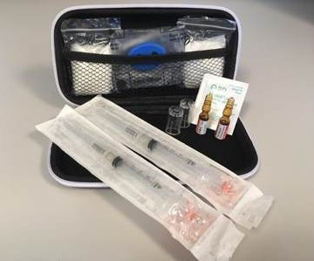
Presents…….. Naloxone Kits... For Pharmacists
Speakers:
Lisa Toner HCV Outreach Coordinator
Camille Lavoie, RN HCV Treatment Nurse
Mathew DeMarco R. Ph, HSN Pharmacist
2016/11/16

Slide 2
Learning Objectives
Review OCP and MoHLTC policy regarding the provision of naloxone kits by pharmacists
Increase capacity to properly train consumers on overdose prevention and response with the use of naloxone
Increase proficiency to assess, engage, and effectively refer sub-populations to alternative services

Slide 3
Outline
Introduction
Overdose Prevention and Response with Naloxone
OCP Responsibility of the Pharmacist
OPA FAQs

Slide 4
Current Opioid Crisis
In Ontario over the past 2 decades, there has been a 2-fold increase in opioid-related deaths, mostly in younger people aged 25 to 54 years.
In fact, every 3 days, at least 1 Canadian dies from a fentanyl overdose.
Notes:
**Accidental overdoses can occur in both individuals who use opioids as prescribed by their physician, and those using opioids for non-medical reasons. Of particular concern in these deaths is the increasing role of prescription opioids such as fentanyl and illicit opioids such as heroin and fentanyl analogues.
Opiiate are a huge problem for the hea;th system for mortality, morbidity very burdomsome, very expensive…
Sudbury appears to be at the epicenter of this crisis in Ontario….. 2nd in and firt for RATE of opiate overdose and 1st for rate of emerg or hosp for oipiate overdose
And its getting worse!!! Ontairo is averaging 700 death a year and this number is increasing consistently…..
Ontario is number one is Canada !

Slide 5
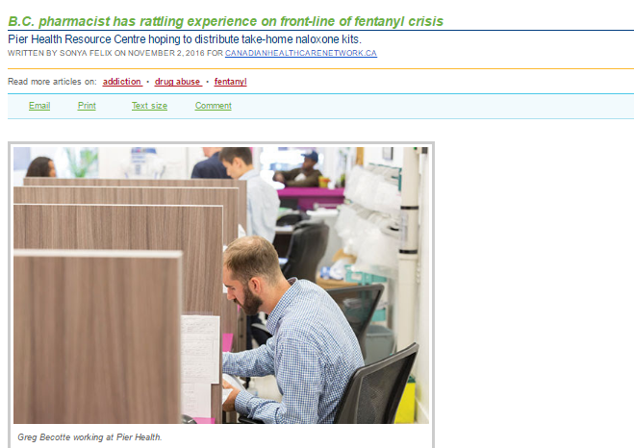
Naloxone in the Media…
Notes:
Ftrs van, regular patients partner comes in saying their OD
No kits there – made one
Patient did recognize so he went with them to help
Got there, blue had a pulse, appeared not to be breathing, tried to arous, called 911, gave naloxone, put in the recovery position gurgled started to breathm then stopped agaib
started giving breathes but stopped after 2 when he realized the airway may be clogged with vomit vomited gave secobd dose and cor comoressions and paient vomited profusely…
Post script is that she was a recently discharged patient, they are trying to brainstorm how to come up with a program to provide these kits in community pharmacies with education and compensation for professional servoces….]
When Greg Becotte joined Pier Health Resource Centre as a staff pharmacist last year, he saw it as an interesting opportunity to work with vulnerable people in Vancouver’s Downtown East Side (DTES). But “interesting” hardly describes his recent experience administering naloxone to a young woman who had overdosed on opiates.
“It was pretty rattling,” he says, describing his first time administering the anti-overdose drug.
When addiction is so deep, you really wonder what you can do.He became aware of the emergency situation when a young man ran into Pier Health, a pharmacy clinic that provides comprehensive healthcare to DTES residents.
“This person is well-known to us and he was screaming and hollering that he needed a Narcan kit because his girlfriend was overdosing,” Bercotte says, explaining that the B.C. government has made thousands of take home naloxone kits available through various health agencies and first responders.
“But these kits aren’t available to pharmacies,” he adds. “We only have naloxone stock that we’ve ordered ourselves without funding. Out front we have an emergency kit that’s just a plastic bag with some ampules of naloxone and some syringes that we have ready in case we have an emergency in the clinic. I never expected to have to leave with the ‘kit’.”
Bercotte offered the bag but the panicked man didn’t recognize it as a Narcan kit, which usually comes in a carrying case. So Bercotte accompanied him back to a neighbouring building where there was a young woman lying on a bed, turning blue.
“A bunch of people were standing around yelling and screaming and someone said they’d called 911. So I put on gloves and gave her the first shot of naloxone. She started to gurgle and I thought she must have vomitted so I put her in recovery position. But after a couple of minutes she stopped breathing again.”
In the meantime, the boyfriend was angry that the woman had used all of his drugs and he began yelling at her. “When she stopped breathing again, he realized she could die so he started mouth to mouth,” Bercotte says. “I told him to stop because he would just be pushing vomit back into her throat. He was just getting in the way so I let him give the second shot of naloxone—he was a lot better at injecting than performing CPR. She started breathing again and vomitted profusely. The paramedics arrived and took her to the hospital.”
After the second shot revived the woman, Bercotte looked down and saw that he was standing on dozens of used syringes littering the floor. “I thought about how in injection training we were taught about the importance of a sterile environment—this was far from sterile.”
While Bercotte saved the woman’s life, he isn’t optimistic about her future. “I never saw her again but heard she was back at the house,” he says. “It’s pretty scary. You can stabilize people and they may be okay for a short time but then they go back. Often when people go to the hospital after an overdose, they go into withdrawal and so leave the hospital looking for a fix. When addiction is so deep, you really wonder what you can do.”
But that doesn’t mean giving up.
Pier Health Resource Centre is hoping the BC government will provide Narcan kits to the clinic to hand out to opioid users, says Kelly McAllister, a registered nurse who specializes in psychiatry and works part time at Pier Health.
“We are in the midst of a public health crisis and take-home naloxone kits are now available at various sites in Vancouver,” she says. “A lot of people get the kits but not through pharmacies. If we don’t get approval to distribute the kits, then we’re thinking about initiating our own program to include an educational component on how to prevent and recognize an opiate overdose and how to administer the injection. But without government funding, we’d either have to charge patients or the clinic would have to absorb the cost.”
Bercotte points out that Vancouver spends about $1 million a day in the DTES dealing with drug issues. “But this doesn’t get to the root of the problem because the mental health component isn’t there. So we are brainstorming on how to have a response program at the clinic and figure out what else we can do.”
B.C.’s fentanyl crisis stats
550 people died from apparent illicit drug overdoses from January to September 2016.
Males accounted for 80% of these deaths.
The rate of illicit drug overdose deaths increased 45.5% in Jan to Sept 2016 compared with 2015.
The proportion of illicit drug overdose deaths for which fentanyl was detected increased to about 61% in 2016 fr

Slide 6
Naloxone Now Available as a Schedule II Drug….
In response to these opioid related overdoses across Canada and as recommended by the World Health Organization, naloxone has been made available for emergency use for opioid overdose outside hospital settings.
As of June 24, 2016 naloxone, pharmacists are authorized to dispense naloxone kits privately procured or from the MoHLTC
Notes:
***The goal of providing naloxone in community pharmacies is to increase public access to this life-saving medication. ** there are very few drugs with the NNT bebefits of this and accompanied by next to no risks!
WHO?

Slide 7
Who is Eligible? To dispense to…
Any patient or patient’s agent (agent) are now permitted to obtain Schedule II naloxone directly from any community pharmacist without a prescription.
Notes:
*The individual must also indicate their understanding that the person for whom the naloxone is intended has no known contraindications to the use of naloxone.*

Slide 8
Who is Eligible? To receive MoHLTC reimbursement for….
MoHLTC Re-imbursement: One (1) naloxone kit may be provided to an eligible person at one time.
Currently using opioids OR
Is a past opioid user who is at risk of returning to opioid use OR
A family member, friend or other person in a position to assist a person at risk of overdose from opioids
Notes:
*The individual must also indicate their understanding that the person for whom the naloxone is intended has no known contraindications to the use of naloxone.*

Slide 10
Dispense What?
The College notes that pharmacists are authorized to dispense any formulation of naloxone available for sale and distribution in Canada.
Nasal spray can be dispensed but MoHLTC reimbursement is for $35 and 2 doses of the basal spray costs $125

Slide 11
OCP Naloxone Kit Requirements
1) Two 1 mL ampoules or vials of naloxone hydrochloride 0.4 mg/ml injection
2) Two safety engineered syringes with 25 g one inch (or 3 inch) needles attached
3) Two safe ampoules opening devices ( “snappers” or “openers”) as applicable, not needed with vials
4) One pair of non-latex gloves
5) One rescue breathing barrier
6) One naloxone identifier card.
Notes:
OR OPA has a lit of vendors….
to ensure that a second dose of naloxone is available for administration if needed.
they reduce the risk of needle stick injury, can be disposed of in the trash, prevent re-use as there is no way to push the needle back out, and are unlikely to be used for any other purpose (unlike insulin syringes);
a plastic barrier that is used when administering cardiopulmonary resuscitation (CPR);
a card that can be filled out with the name of the person who has been trained in responding to opioid overdoses, the date the naloxone supplies were issued, and the expiry date of the naloxone.

Slide 13
Education and Training
Research and experience show, with basic training laypeople can recognize an overdose and administer naloxone just as well as a medical professional.
They give peers, friends, and families of people who use opioid drugs the chance to save a life as it has been proven to do so.
Notes:
*Furthermore, community based overdose prevention programs are empowering.
They give peers, friends, and families of people who use opioid drugs the chance to save a life.
***However, the availability of naloxone in community pharmacies does not replace the need for emergency care or minimize the importance of calling 911.

Slide 14
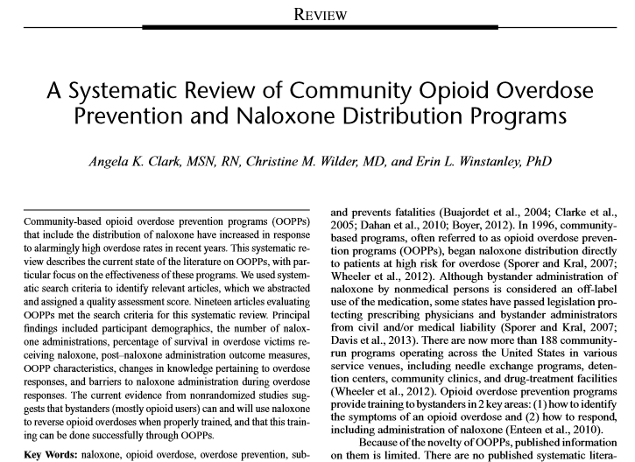
Education and Training
Notes:
*Furthermore, community based overdose prevention programs are empowering.
They give peers, friends, and families of people who use opioid drugs the chance to save a life.
**However, the availability of naloxone in community pharmacies does not replace the need for emergency care or minimize the importance of calling 911.

Slide 15
OVERDOSE PREVENTION AND RESPONSE: NALOXONE

Slide 16
Introduction
Camille Lavoie, Hepatitis Treatment Nurse
Lisa Toner, Outreach Coordinator (HCV)
Notes:
It’s important that while in a group setting we respect the shared and/or lived experience of others. Speakers or audience members may ask personal questions, share personal or familial experiences and we respect their willingness to share with us by keeping the information in the confines of the presentation. Thank you

Slide 17
Réseau ACCESS Network HIV/Hepatitis Health and Social Services
Non-profit, community-based charitable organization
Promotes wellness, harm and risk reduction and education
Supports individuals and serves the whole community in a comprehensive/holistic approach to HIV/AIDS, Hep C and related health issues
Notes:
Réseau ACCESS Network is a non-profit, community-based charitable organization, committed to promoting wellness, harm and risk reduction and education. Réseau ACCESS Network supports individuals - and serves the whole community - in a comprehensive/holistic approach to HIV/AIDS, Hep C and related health issues.
*catchment area includes Sudbury/Manitoulin

Slide 18
Philosophy
ACCEPT individuals as they are
AFFIRM everyone’s unique self-worth
Provide confidential ASSISTANCE
ADVOCATE for improvement of services and care
Be ACCOUNTABLE to those we serve and the community
Notes:
As a team working collaboratively and with passion, dedication and creativity:
We ACCEPT every individual regardless of race, colour, creed, religion, ethnic origin, gender, language, physical or mental status, sexual orientation, drug and/or alcohol use, age, gender identity, sexual risk behaviour and level of education.
We do all within our power to AFFIRM in each individual’s unique self-worth.
We provide ASSISTANCE to individuals in an atmosphere of confidentiality.
We ADVOCATE for continuous improvement in support services, education, harm reduction, public awareness, client health services, and ongoing public financial support.
We are ACCOUNTABLE to the public, individuals we serve, and our funders and supporters for our programs and services and stewardship of funds.

Slide 19
Réseau ACCESS Network Services
Direct Client Services
Case management, counselling, practical assistance, clinical and testing, outreach Provided to persons living with HIV/AIDS, and/or HCV, affected by HIV/AIDS and/or HCV, or those at risk of HIV/AIDS and/or HCV.
Education and Prevention
Presentations and workshops specific to needs of educational institutions, and workplaces, on issues of HIV/AIDS, HCV, diversity. Employees, students, community members within the Sudbury / Manitoulin Districts
Volunteers and student placement opportunities
Notes:
Speak directly to the Community Resources Coordinator for volunteer services or the Manager of Education and Community Development to apply for student placements.

Slide 20
Purpose
Naloxone funding
Services provided
Commonly used acronyms/terms
Training process
Documentation
Lessons learned
Notes:
The purpose of this presentation this evening is to review with you a brief history of how we were funded for naloxone at our agency, what our processes are like/who our clients are, some acronyms you may hear us use during the presentation, and most importantly we will provide you with the information that we teach our clients when they are being trained. We will review forms that we use for training, lessons learned, and answer any questions you may have.

Slide 21
Commonly used acronyms/terms
IDU - Injection drug use/Injection Drug User
PWID- Person who injects drugs
OHRDP- Ontario Harm Reduction Distribution Program
OD - Overdose
Peers- Individuals who have lived experience, working with individuals with similar lived experiences or individuals who get supplies dropped off at their housing
Outreach- going into the community to work with marginalized individuals to provide support
HCV - Hepatitis C Virus
ASO- AIDS Service Organizations
Notes:
Some of the commonly used acronyms you will hear throughout the presentation, and may have already heard include:

Slide 22
Harm Reduction
“Harm reduction is anything that reduces the risk of injury whether or not the individual is able to abstain from the risky behaviour” - David Ostrow, M.D., Ph.D.

Slide 23
Harm Reduction
Is a response that focuses on keeping people healthy
Minimizing death, disease, and injury
Harm reduction is a humanistic approach and maintains a realistic view
Reduces risk and produces benefits

Slide 24
History of naloxone funding
In October 2013, organizations with specific eligibility criteria were able to begin accessing naloxone from the Ministry of Health and Long-term Care with complementary overdose prevention kits, supplies and training material from the Ontario Harm Reduction Distribution Program (OHRDP).
Our eligibility: Ministry funded hepatitis C team
Notes:
In October 2013, organizations with specific eligibility criteria were able to begin accessing naloxone from the Ministry of Health and Long-term Care with complementary overdose prevention kits, supplies and training material from Ontario Harm Reduction Distribution Program (OHRDP).
The ELIGIBILITY CRITERIA included: public health units that manage needle exchange programs, community based programs contracted by public health units to manage a needle exchange program, or ministry funded hepatitis C teams

Slide 25
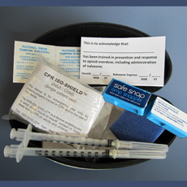
OHRDP
The OHRDP (Ontario Harm Reduction Distribution Program) provides harm reduction supplies, educational materials, knowledge translation and exchange opportunities to Needle Syringe Programs across Ontario.

Slide 26
Our journey to naloxone funding
May 2014 - began process to apply for naloxone funding, significant amount of community development, development of medical directives
December 2014 - submitted application for funding
January 2016 - received naloxone
February/March 2016 – community development, and we began handing out kits
Notes:
The journey for receiving funding at our agency for naloxone began back in May 2014 when we initiated processes for applying for naloxone funding. This included things like training staff, getting medical directives, and understanding the overall process.
In December 2014, we finalized this process and submitted our application for funding. During the time from May-December, there was a significant amount of community development completed within Sudbury. We worked with the emergency department and EMS medical directors to get their approval, did education with the police, and our community partners.
There was a significant amount of delays across Ontario for funding to be approved through the ministry, and we received approval by January 2016.
In February/March of 2016, we had to re-do a lot of our community development work we did with various organizations and agencies since so much time had passed since the initial roll out, and then we began handing out our naloxone kits.
As you can see, this has been a very long process and we are still working on educating the community and training clients.

Slide 27
Naloxone Program Offers:
Education to community
Outreach within the community
Drop-in training (clients or non-clients)
Training at partnering agencies upon request/individual basis
Notes:
Our processes always begin with education. We educate the community about what overdose is, what naloxone is, and how they can help. This presentation is the perfect example of this, but we have also trained other organizations such as: Canadian Mental Health Association and Monarch Recovery services. By educating the community and our partners, we are helping share the knowledge that naloxone is available within our community and for these partnering agencies to refer clients to us, so we can ensure they have the proper training on overdose prevention.
Our agency is one of the agencies you see within the community doing outreach during the evenings. Outreach is when workers such as Alex or Lisa go out and connect with marginalized individuals within the community in various locations throughout the city, but mostly downtown core to provide services, education, make referrals, and ensure people are safe. When the outreach workers are meeting individuals that they know are at risk of overdosing, or their friends they are providing the education of overdose prevention and referring the individuals into our office for training.
This is why we do drop-in training. The drop in training is not only for registered clients of our agency, but anyone who is at risk of overdosing.
We recently have initiated case conferences to review our registered clients within the agency who would benefit from this training as well, and when they connect for services are making this referral.
Who we do not train: we will train anyone at risk of overdosing over the age of 18. However, we do not give kits to individuals with such severe mental health issues such as psychosis as they need to be able to understand the education being provided. Individuals who are physically unable to inject themselves.

Slide 28
Training Process
The remainder of the presentation demonstrates the training provided to those who receive naloxone kits.

Slide 29
Notes:
Prior to going into the education with the individual, we have them complete this 8 question pre-test, which we also use after the session as a post test to see their learnings

Slide 30
Notes:
This next copy is a copy of the opioid history form which goes through an assessment with the client about their drug use, and if they have ever overdosed or used naloxone.

Slide 31
Notes:
Finally, this is a copy of the naloxone knowledge checklist and order to dispense form ………..
As you can see the top has a section for refills and to explain why they require a refill. When someone comes in asking for another vial, we want to know where it has gone – for example if they did use the naloxone, did they call emergency medical services, and what happened, etc.

Slide 32
Overview
What is an overdose
What increases the risk of overdose
How to recognize an overdose
How to respond to an overdose
What is naloxone, and how to use it
Referral process for others to be trained

Slide 33
Overdose Defined
Overdose is the use of a drug (or drugs) in an amount or way that causes acute harmful mental or physical effects
Overdose may produce short-lived or lasting effects, and can sometimes be fatal

Slide 34
Types of overdose
Depressant overdose: slows the central nervous system down to the point where several systems may stop working. Breathing slows or even stops.
Stimulant overdose: speeds the central nervous system up to the point of overworking certain
functions leading to failure

Slide 35
Who is at risk of an opioid overdose?
Overdose doesn’t discriminate, but there are some key risk factors:
Mixing Drugs
Using drugs of unknown potency
Low or Reduced Tolerance
Using Alone
Long-term use

Slide 36
Know your risks: mixing drugs
New drugs can combine with drugs that may have been used hours earlier.
Drugs may still be in the body long after a person can’t feel their effects.
Mixing drugs with similar effects increases the risk of overdose (ex: downers with downers)
Mixing drugs with different effects can disguise the amount of a drug in your system (ex: mixing an upper with a downer – may mask the high)
The majority of overdoses involve the use of a combination of drugs.
Notes:
Half life is important to consider, not that you should know the half lives of all the drugs, but some have half-lives that are much longer than the duration of the high, some have shorter. It can be hard to tell how much is in your system based on the effects of a drug alone.
For example, methadone can have a half life of 9-87 hours, but it’s duration of action is only 6-8 hours for a single dose, 22-48 hours if it’s a long standing regime.
Mixing downers with other downers can often increase the effects of both drugs, making overdose possible with smaller doses.
Mixing uppers with downers can sometimes mask the effects of the drugs. Someone may not necessarily feel high because the effects of another drug are having the opposite of the desired effect. Because of this, someone may use more of a substance thinking their dosage wasn't high enough

Slide 37
Know your risks: potency
Potency may vary dealer to dealer (referral to ACCESS)
Some drugs vary a lot in potency (ex: fentanyl)
Different drugs have different strengths (ex: codeine vs. fentanyl)

Slide 38
Know your risks: reduced tolerance
when tolerance is low, the opioids effects are much stronger and overdose is more likely
3-4 days without an opioid can be long enough to lower a person’s tolerance

Slide 39
Know your risks: reduced tolerance
Times when tolerance will be low or reduced:
Following a period when use of an opioid has reduced or stopped for any reason
After drug detox or a rehab program
After being in custody or jail
After hospitalization
Being a new or casual user
Can also be affected by health status, hydration, etc.
Tolerance is drug-specific; high tolerance for one drug does not translate to high tolerance for another.

Slide 40
Know your risks: reduced tolerance
Information you can provide to patients:
Use smaller amounts at first
Avoid using alone
Consider a safer route: oral, snorting, smoking
Stick to one route only

Slide 41
Know your risks: using alone
Overdosing when alone could be fatal:
less likely the situation will be noticed
you probably won’t be able to help yourself
Things you can do:
Have someone in the room
with you if possible
Leave the doors unlocked
Ask someone you trust to check on you

Slide 42
Know your risks: using alone
Overdosing when alone could be fatal, as it’s less likely the situation will be noticed and you probably won’t be able to help yourself.
Patient options:
If possible, have someone you trust in the same room, or have them check on you
Leave the door unlocked to facilitate EMS response
Using with others does not necessarily ensure safety:
Share your knowledge with those you use with regularly to help ensure a proper response, as well as those you trust (neighbours, friends, family, roommates, etc.)
Or, refer them to the program for training
If you have naloxone, make sure it’s accessible, and that other people know where it is and how to use it

Slide 43
Recognizing an opioid overdose: is it an overdose, or are they just high?
If someone is extremely high and using opiates, they may:
have contracted/small pupils
be “nodding out”
scratch a lot due to itchy skin
have slurred speech and/or be “out of it”
However, they will respond to outside stimulus

Slide 44
Verbal and physical stimulus
Start with verbal stimuli:
anything that will get them to respond if they are able
Shout their name
Shout “POLICE”
If they are still unresponsive, go to physical stimuli:
Sternal rub HARD
Knuckles to the clavicle (collar bone)
Rub knuckles on the lips
Shake their shoulders

Slide 45
Adapted from OHRDP Resource “Opioid Overdose Signs and Symptoms”

Slide 46
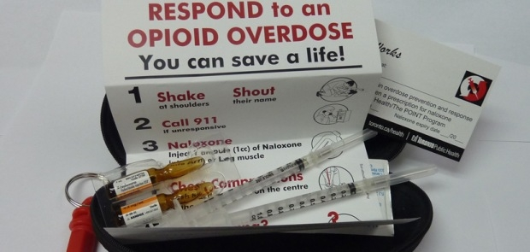
Responding to an opioid overdose
Recovery Position
Call 911
Ensure safety
Naloxone
Chest compressions

Slide 47
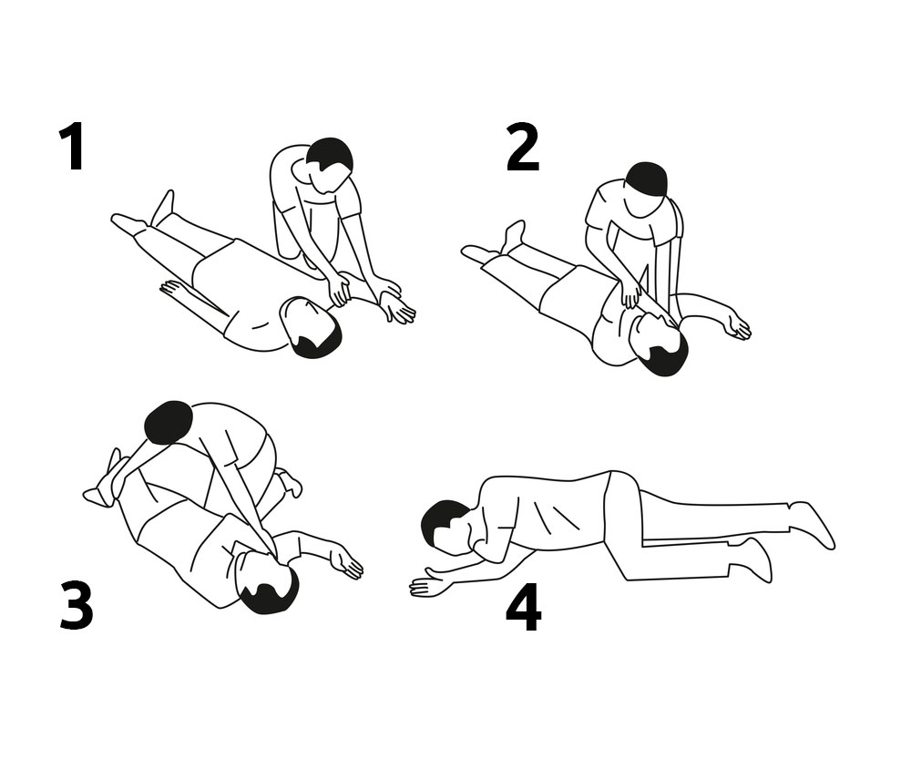
Step 1: recovery position
Keeps airway open, reduces chances of choking on fluids or vomit
Hand to the side to support their weight
Other hand across to face for their face to rest on
Roll over on their side with head tilted back
Top knee down to support their weight and keep the position

Slide 48
Step 2: call 911
Have someone call 911 and report back when they're done OR call 911 yourself if alone.
Try to keep person awake and responsive if conscious
The 911 procedure briefs paramedics on situation
1. “Police, fire or ambulance”: respond ambulance and stay on the line to be transferred
2. “What is your emergency”: respond with whatever info you are comfortable giving
3. Please try to give exact address and apartment number.
Even expired cell phones can call 911 if charged

Slide 49
Step 2: call 911
Police may attend as first responders
If you absolutely can’t stay, here are some steps to take before leaving:
Clean up (except what person was using)
Leave a note with details (especially drug used)
Prop doors open and unlocked, clear a path to the person

Slide 50
Step 3: Ensure Safety
You can’t help someone if you need
help yourself
Check the scene for anything that could be dangerous to you, other people, or the person experiencing the overdose
Uncapped syringes
Sources of heat /fire

Slide 51
Step 3: Ensure Safety
When ANY bodily fluid is present, such as blood, vomit, or saliva, always put a barrier between the fluid/victim and yourself such as gloves, plastic bag or a face mask if CPR trained
Always avoid contact with the fluid(s) and wash hands thoroughly immediately after giving first aid.

Slide 52
Step 4: prepare naloxone
Prepare the Naloxone if available and you are trained.
Holding top of vial, “flick” or “swing" it to force all liquid out of the top
2. Snap top of the Naloxone vial
Using snapper, alcohol swab, or rubber cover can protect you from sharp edges of the vial
3. Take out the “VanishPoint” muscle syringe
Pop cap off and insert into vial
Draw up all liquid from vial (one full dose)
Get rid of any major air from the syringe by holding syringe straight up, pushing air out

Slide 53
Step 5: administer naloxone
Administer Naloxone to thigh muscle or upper arm muscle
Press the plunger all the way until it “clicks”
Needle will disappear
Take note of the time administered and start chest compressions
“Stayin’ Alive” beat , at least 2 inches deep

Slide 54
Step 5: Administer Naloxone
If the person is still not breathing on their own after 4 minutes, give the second dose in the same way
Continue chest compressions and wait for paramedics to arrive
If the second administration does not stimulate breathing independently, it is not likely an opiate overdose
Always dispose of needles in the closest biohazard bin
As naloxone does not last as long as most opiates, the overdose will return when it wears off
Naloxone does not replace medical intervention, but it does buy life-saving time!

Slide 55
What is naloxone?
Naloxone is an opiate antagonist which works by forcing opioids off their receptor sites in the brain
Naloxone can temporarily reverse the effects of an opiate overdose
The opiates stay in the blood, but temporarily can’t access the receptor sites to cause its effects or “high”
Naloxone usually takes between 1-3 minutes to work
Naloxone lasts for up to 45 minutes (much shorter duration than most opioids)

Slide 56
Referral process
Anyone can receive overdose prevention training, but naloxone kits are only available to some individuals.
Criteria for receiving a naloxone kit
History of drug use, or be a friend, family member, roommate, partner, peer, etc.
Must have the ability to retain and process pertinent information around safety of kit use (literacy level is not an issue)
Must be able to physically administer naloxone effectively
Making a Referral
Contact us, make a warm referral and /or
Provide our business card

Slide 57
For more information contact
Lisa Toner
Outreach Coordinator (HCV)
lisat@reseauaccessnetwork.com
705-688-0500 ext. 221

Slide 58
Responsibility of the Pharmacist
When dispensing naloxone the pharmacist must determine the following:
If the person who naloxone is intended for has any known allergies to naloxone, or concomitant ingredients in specific formulations of naloxone (methylparaben or propylparaben).
Where the intended person has a known allergy encourage the person to seek medical attention from a physician.
Only dispense if in agreement with physician. Benefits often outweigh allergy risks.

Slide 59
Responsibility of the Pharmacist
Each transaction must occur under the direct supervision of a pharmacist
It is the professional responsibility of a pharmacist to ensure that he or she has sufficient knowledge, skills and abilities to competently deliver any pharmacy service.
Patients and/or agents must be educated on more than just naloxone Dispensing or Selling Naloxone therapy and how to administer it.

Slide 60
Pharmacists should ensure patients and/or agents purchasing naloxone are also educated on such topics as:
Harm reduction strategies when using opioids
How to identify an opioid overdose
Importance of immediately calling 9-1-1
Importance of cardiopulmonary resuscitation (CPR) and how and when to give breaths
When and how to administer naloxone
Aftercare and the importance of staying with the person until emergency first responders arrive
Withdrawal symptoms occur following naloxone administration and reversal of the effects of the opioid overdose
Naloxone may have variable efficacy in reversing the clinical effects of an overdose due to preparations containing buprenorphine
Naloxone is not effective against respiratory depression due to non-opioid drugs
Risk of secondary overdose if opioids used when patient regains consciousness
Any other information the pharmacist deems relevant.
Pharmacists must also provide educational information and the steps for dealing with an opioid overdose in writing to the patient and/or agent.
Responsibility of the Pharmacist
Notes:
Written resources are not a replacement for pharmacist interaction with the patient or agent, and are to be used as a supplemental resource only.

Slide 61
If people who use opioid are given naloxone, will they continue using more opioids?
Research has shown that having naloxone available does not increase risk-taking behaviour, or cause people to use more opioids.
The goal of distributing naloxone and training laypeople to prevent, recognize and respond to overdose is to prevent death and reduce brain injury or brain damage.
Other goals such as getting people into treatment are only possible if people are alive.

Slide 62
Why give breaths in opioid overdoses?
Breaths serve to re-oxygenate a person’s blood while chest compressions help circulate blood while the person’s heart is not beating.
Opioids bind to receptors in the area of the brain responsible for breathing. After binding, they decrease the rate of breathing, which can slow to a point where a person stops breathing.
When a person who is not in cardiac arrest stops breathing and is unconscious because of an opioid overdose, the appropriate course of action is to CALL 911 and give breaths to that person. Because the heart is still beating, giving breaths helps increase the oxygen in the person’s blood and supply it to oxygen sensitive tissues, such as the brain, preventing brain injury and death..

Slide 63
Why is it important to stay with an individual after giving them naloxone?
Some longer acting opioids (e.g. methadone) may last longer in the body than naloxone, so an overdose could return.
To make it less likely that an overdose will return, it is important to make sure that the individual knows not to take more drugs for several hours.
You may need to tell them what happened, as they may be confused.
Finally, it is important to tell emergency first responders everything you know about the situation so they can provide the best treatment.

Slide 64
Are there any anticipated adverse events with giving naloxone?
Withdrawal symptoms include pain, high blood pressure, sweating, agitation and irritability. In addition, it can be unsettling to come out of an overdose unaware of what has happened.
People with health conditions (e.g. heart, liver, respiratory etc.) and/or who have taken other substances need additional medical attention.

Slide 65
UW 5 in 5 Education
https://www.youtube.com/watch?v=ie1YXkDEPN0
https://www.youtube.com/watch?v=oT8EsHuikwY

Slide 66
Rapid Access Addictions Medicine (RAAM)

Slide 67
Summary
Naloxone kits are a life saving intervention that pharmacists can now provide to high risk patient’s or their agents with MoHLTC compensation
Pharmacist can provide Naloxone kits to high risk patient’s or their agents in accordance with OCP policy, with a particular focus on education.
Naloxone kits can be purchased commercially or can assembled at pharmacies according to OCP naloxone kit requirements

Slide 68
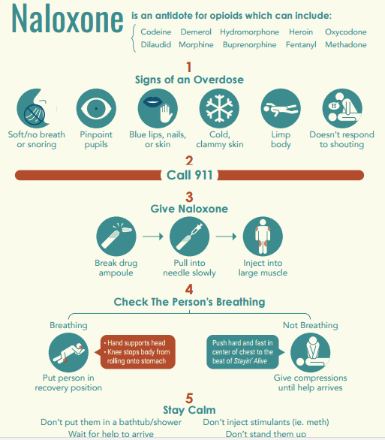
Questions?

