Slide 1
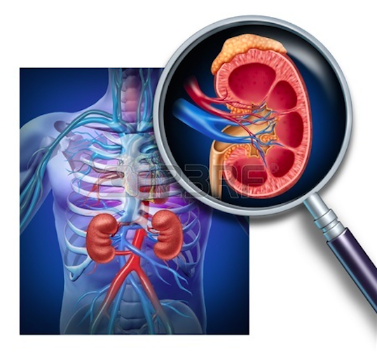
The Role of the Kidneys in Type 2 Diabetes:
Focus on SGLT2 Inhibitors
A Sudbury Journal Club Presentation
Speakers:
Kaitlin Bynkoski
&
Ken Burns_{CDE}

Slide 2
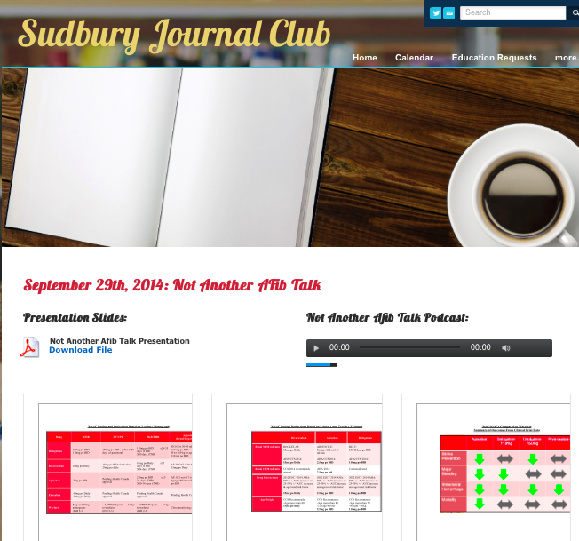
2

Slide 3
Disclosure of Commercial Support
This program has received financial support from Janssen Inc.
This program has received in-kind support from Janssen Inc. in the form of logistical support for the meeting.
Notes:
This slide must be visually presented to the audience AND verbalized by the speaker.

Slide 4
LEARNING OBJECTIVES
4
Describe the mechanism for the reabsorption of glucose in the kidneys;
Describe the SGLT2 inhibitors (sodium/glucose cotransporter 2), their mode of action and pharmacodynamic effects;
Discuss the potential role of SGLT2 inhibitors in the treatment of type 2 diabetes;

Slide 5
Presentation Outline
5
Overview of Treatment Guidelines and Options for T2DM
Role of Kidneys in Glucose Regulation
Mechanism of Action of SGLT2 Inhibitors
Efficacy and Safety Data for SGLT2 Inhibitors
  A1C, Weight, Hypoglycemia, Blood Pressure, Other Side Effects
Renal Considerations
CV Risks
Metabolism and Drug Interactions
Practical Tips and Considerations in Using SGLT2 Inhibitors

Slide 6
QUICK REVIEW

Slide 7
AT DIAGNOSIS OF TYPE 2 DIABETES
L
I
F
E
S
T
Y
L
E
Start lifestyle intervention (nutrition therapy and physical activity) +/- Metformin
A1C <8.5%
A1C ≥8.5%
Symptomatic hyperglycemia with metabolic decompensation
If not at glycemic target (2-3 mos)
Start metformin immediately
Consider initial combination with another antihyperglycemic agent
Initiate insulin +/-
metformin
Start / Increase metformin
If not at glycemic targets
Add an agent best suited to the individual:
Patient Characteristics
Degree of hyperglycemia
Risk of hypoglycemia
Overweight or obesity
Comorbidities (renal, cardiac, hepatic)
Preferences & access to treatment
Other
Agent Characteristics
BG lowering efficacy and durability
Risk of inducing hypoglycemia
Effect on weight
Contraindications & side-effects
Cost and coverage
Other
2013
See next page…
Notes:
May start Metformin at the time of diagnosis
Change to 8.5% as threshold
Start metformin immediately as an option
Concept of individualizing therapy based on patient and agent characteristics
With that in mind, the next figure shows the characteristics of the agents ….

Slide 8
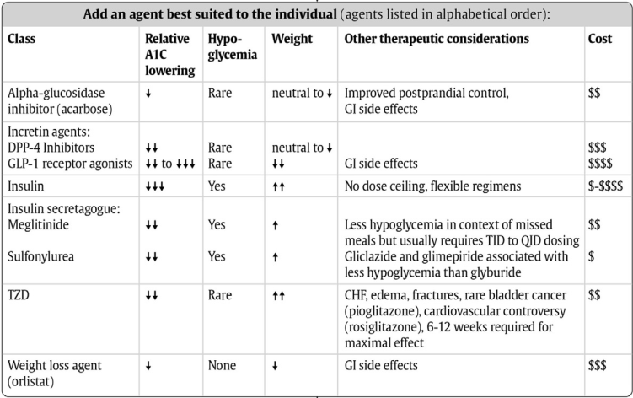
From prior page…
L
I
F
E
S
T
Y
L
E
If not at glycemic target
Add another agent from a different class
Add/Intensify insulin regimen
2013
Make timely adjustments to attain target A1C within 3-6 months
Notes:
Concept of RELATIVE A1c lowering – not absolute
Concept of RELATIVE cost considerations
Change to achieve target within 3-6 months.

Slide 9
AT DIAGNOSIS OF TYPE 2 DIABETES
L
I
F
E
S
T
Y
L
E
Start lifestyle intervention (nutrition therapy and physical activity) +/- Metformin
A1C < 8.5%
A1C ≥ 8.5%
Symptomatic hyperglycemia with metabolic decompensation
If not at glycemic target (2-3 mos)
Start metformin immediately
Consider initial combination with another antihyperglycemic agent
Initiate insulin +/-
metformin
Start / Increase metformin
If not at glycemic targets
Add an agent best suited to the individual:
Patient Characteristics
Degree of hyperglycemia
Risk of hypoglycemia
Overweight or obesity
Comorbidities (renal, cardiac, hepatic)
Preferences & access to treatment
Other
Agent Characteristics
BG lowering efficacy and durability
Risk of inducing hypoglycemia
Effect on weight
Contraindications & side-effects
Cost and coverage
Other
2013
See next page…
Notes:
May start Metformin at the time of diagnosis
Change to 8.5% as threshold
Start metformin immediately as an option
Concept of individualizing therapy based on patient and agent characteristics
With that in mind, the next figure shows the characteristics of the agents ….

Slide 10
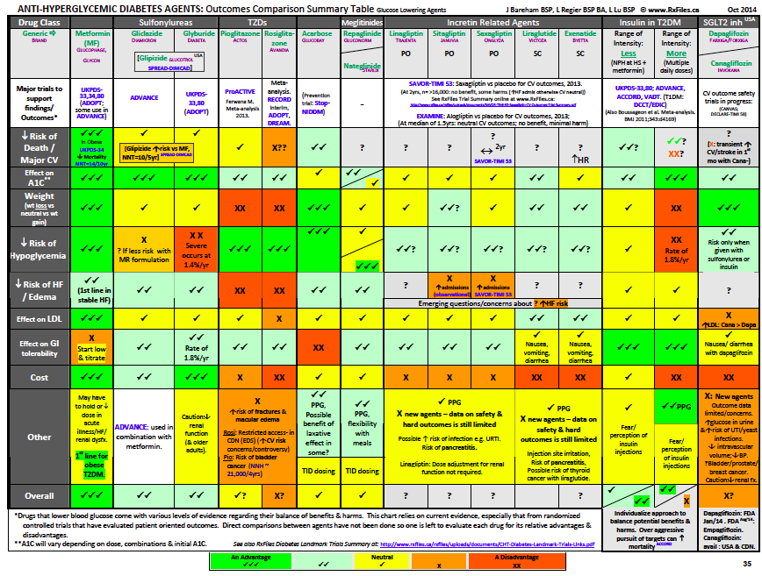

Slide 11
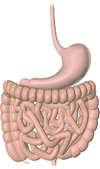


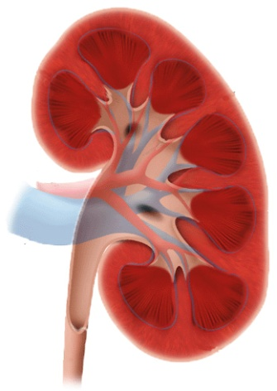


Antihyperglycemic Medications
Alpha-glucosidase Inhibitors
Biguanides
Insulin Secretagogues
SGLT2 Inhibitors
Delay the absorption
of glucose from
starch and sucrose
Reduce hepatic
gluconeogenesis
Sulfonylureas and
meglitinides
stimulate
insulin secretion
Reduce the reabsorption of glucose by the kidneys : glucosuria
Liver
Adipose Tissues
Muscles
Pancreas
Kidneys
Intestine
Thiazolidinediones
DPP-4 Inhibitors and GLP-1 Agonists
Improve insulin resistance
Increase insulin secretion,
inhibit glucagon secretion
Krentz AJ, Bailey CJ. Drugs 2005; 65:385-411.
Notes:
11
11
A new class of antihyperglycemic agents may soon become available: the SGLT2 inhibitors. They prevent glucose reabsorption in the kidneys,resulting in urinary glucose loss. Insulin independent mechanism of action – the first therapeutic target that does not impact insulin.

Slide 12
Meta-analysis (add-on to metformin)
Antihyperglycemic Medications
Added Therapy | Change in A_{1C} (%) | Change in Weight (kg) | Hypoglycemia Odds Ratio vs placebo
Sulfonylureas | -0.82 | 2.17 | 8.86
Meglitinides | -0.71 | 1.40 | 10.51
Thiazolidinediones | -0.82 | 2.46 | 0.45
Alpha-glucosidase Inhibitors | -0.66 | -1.01 | 0.40
DPP-4 Inhibitors | -0.69 | 0.23 | 1.13
GLP-1 Receptor Agonists | -1.02 | -1.66 | 0.92
Basal Insulin | -0.88 | 1.38 | 4.77
Liu, Sung-Chen et al. Diab Obes & Metab 14:810-820, 2012.
Notes:
12
Highlight overview side effects
Biphasic insulin, GLP-1 analogues and basal insulin were ranked the top three drugs in terms of A1C reduction. GLP-1 analogues did not increase the risk of hypoglycaemia and resulted in a significant decrease in body weight. Most oral antidiabetic drugs had similar effects on A1C, but some agents had a lower risk of hypoglycaemia and body weight gain.

Slide 13
The ROLE OF KIDNEYS IN GLUCOSE REGULATION
13

Slide 14
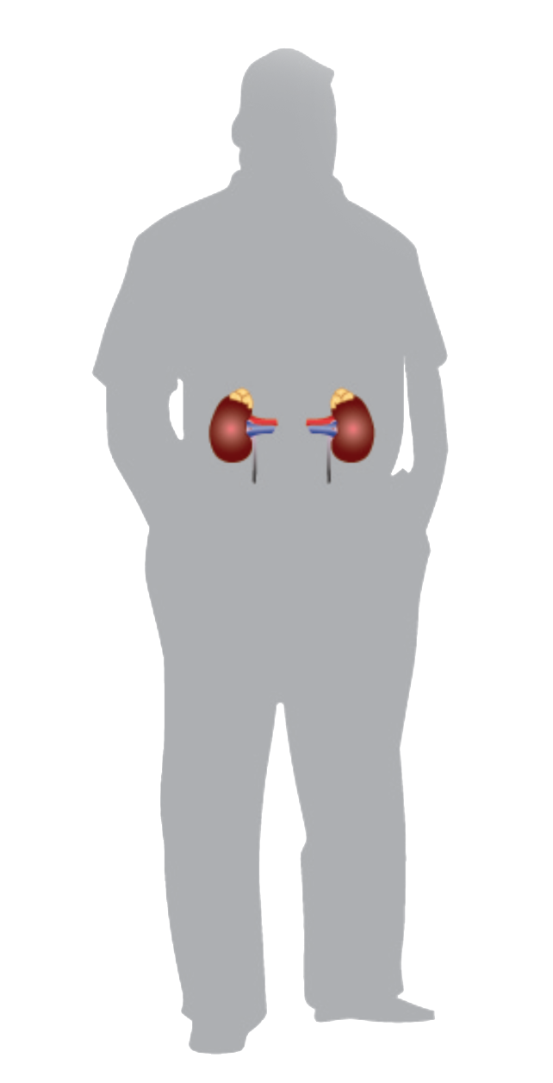
Glucose Homeostasis in the Body
Glucose input: ≈ 250 g/day | Glucose uptake : ≈ 250 g/day
• Dietary intake: ≈ 180 g/day • Glucose production: ≈ 70 g/day – Gluconeogenesis – Glycogenolysis | • Brain : ≈ 125 g/day • Rest of the body : ≈ 125 g/day
+
-
Glucose
reabsorbed
by the kidneys:
≈ 180 g/day
Glucose
filtered
by the kidneys:
≈ 180 g/day
Wright EM et al. J Intern Med. 2007;261:32‐43; 2. MarsenicO. Am J Kidney Dis. 2009;53:875‐83
Net : approximately 0 g/day
Notes:
Been cutting this out
-excede input but don’t utilize
The importance of the kidney in normal glucose homeostasis is now well recognized. The kidney reabsorbs a large amount of glucose each day, and by extension, has a major part in maintaining the overall metabolic balance of the body.
References:
Wright EM, et al. Active sugar transport in health and disease. J Intern Med 2007; 261(1):32-43.
Marsenic O. Glucose control by the kidney: an emerging target in diabetes. Am J Kidney Dis. 2009;53(5):875-883.

Slide 15
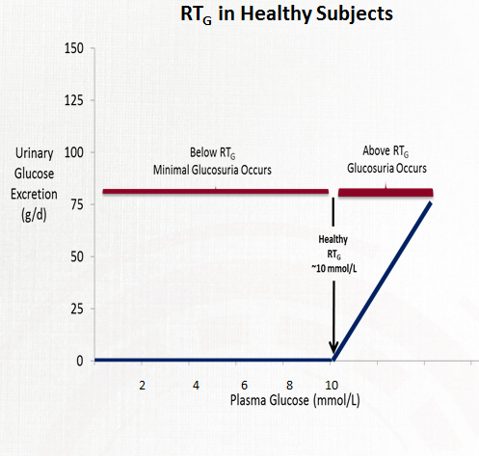
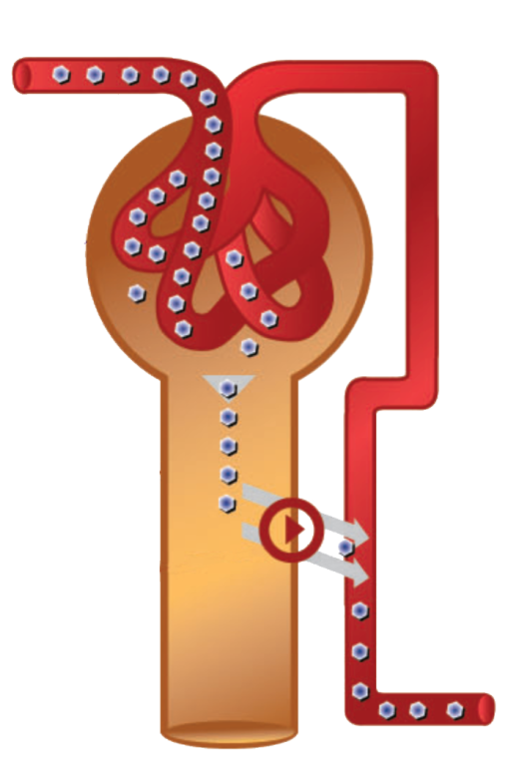
Renal Glucose Handling in the non-Diabetic
15
Healthy patient (normal kidney function & glucose tolerance)
Excess glucose
Glomerulus
Renal
proximal
tubule
Glucose reabsorption
Glucose
Urinary
excretion
Adapted from:
Chao EC & Henry RR. Nature Reviews Drug Discovery 2010;9:551-559.
DeFronzo RA, et al. Diab Obes Metab 2012;14:5-14.
Washburn WN. J Med Chem 2009;52:1785-1794.
Guyton AC, Hall JE. Textbook of Medical Physiology. 11th ed. Philadelphia, PA: Elsevier Saunders; 2006.
Notes:
Healthy-reabsorbed into systemic
Showing healthy SGLT2- luminal wall 1 molecule glucose and 1 molecule of sodium
Right side: worth noting maximum amount that can be reabsorbed/ people without diabetes 10mmol/l
In a healthy patient/kidney glucose is completely reabsorbed in the proximal convuluted tubule.
There is a threshold relationship between plasma glucose and urinary glucose excretion. Below 10 mmol/L all glucose is reabsorbed back into the plasma without glucosuria. When plasma glucose exceeds 10 mmol/L the sodium glucose cotransporters are overwhelmed (saturated) resulting in the appearance of glucose in the urine.
Plasma glucose filtered in the kidney glomeruli, is reabsorbed into the systemic circulation by sodium glucose transporters (SGLTs) in the proximal tubule.
In patients with type 2 diabetes, the reabsorption of glucose helps sustain hyperglycemia.
By redirecting excess glucose via urinary excretion, SGLT2 inhibition represents a novel approach to type 2 diabetes.
SGLT2 inhibitors block glucose reabsorption, increasing urinary glucose excretion. There is substantive decrease in net glucose entering the system plasma glucose is lowered.
Glucosuria leads to loss of ~80-100 g of glucose/day (~3-4 g/h) in subjects with type 2 diabetes mellitus.
References:
Adapted from:
Chao EC & Henry RR. SGLT2 inhibition — a novel strategy for diabetes treatment. Nature Reviews Drug Discovery 2010;9:551-559.
DeFronzo RA, et al. The role of the kidneys in glucose homeostasis: a new path towards normalizing glycemia. Diab Obes Metab 2012;14:5-14.
Washburn WN. Development of the renal glucose reabsorption inhibitors: a new mechanism for the pharmacotherapy of diabetes mellitus type 2. J Med Chem. 2009;52(7):1785-1794.

Slide 16
SGLT2 TRANSPORTERS
Lumen
K⁺
Blood
Segment 1 of proximal tubule
ATPase
Glucose
Na⁺
Na⁺
GLUT2
SGLT-2
^{Glucose}
.
.
1. Chao EC et Henry RR. Nature Reviews Drug Discovery 2010;9:551-9.
Notes:
16
Glucose is a very polar molecule, that cannot cross the membrane by itself.
The energy comes from the Na-K pump that creates a Na+ gradient.
This gradient pulls the Na through the SGLT-2 transporter dragging along a glucose molecule for each sodium molecule.The GLUT2 transporter then facilitates the exit of glucose by its gradient

Slide 17
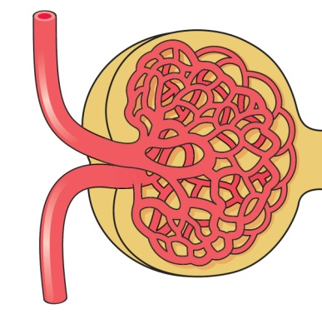
MECHANISM OF ACTION OF SGLT2 INHIBITORS
17
Collecting
Duct
Glomerulus
Proximal
tubule
Distal
tubule
S1
Glucose
filtration
S3
Glucose
Reabsorption
Loop of
Henle
~90%
~10%
SGLT2 and GLUT2
High capacity
(10 nmol/mg/min)
Low affinity
(Km=2mM)
(ex: BULLDOZER)
SGLT1 and GLUT1
Low capacity
(2 nmol/mg/min)
High affinity
(Km=0.4mM)
(ex: BROOM)
No/minimal
glucose
excretion
SGLT=Sodium/GLucose co-Transporter; GLUT=GLUcose Transporter.
Abdul-Ghani MA, DeFronzo, RA. Endocr Pract. 2008;14(6):782-790. Bays H. Curr Med Res Opin. 2009;25(3):671-681.
Notes:
**
1 unit of the kidney schematic
-no matter how much glucose (human brita filter)- spill all small molcules into proximal
-reabsorption mediated between two proteins
-GLUT2 and GLUT 1 are on outside and SGLT1 and 2 on inside (get from inside back into circulation)
-
Shown is a closer look at the functional unit of the kidney—a nephron.
In normal glucose-tolerant subjects, virtually all filtered glucose is reabsorbed back into the bloodstream in the proximal tubule, and a minimal amount of glucose is excreted in the urine.
Majority of renal glucose reabsorption takes place in the convoluted segment (S1) of the proximal tubule where the high-capacity, low-affinity sodium-glucose transporter (SGLT) 2 and facilitative glucose transporter (GLUT) 2 are located.
The remaining 10% is reabsorbed in the distal straight segment (S3) of the proximal tubule where the high-affinity, low-capacity SGLT1 transporter, and GLUT1, are located.
This variation is thought to allow the majority of glucose to be reabsorbed in
the S1 segment of the proximal tubule, whereas any glucose that is left in the ultrafiltrate by the time it reaches S3 is avidly reabsorbed.
Reference:
Abdul-Ghani MA, DeFronzo RA. Inhibition of renal glucose reabsorption: a novel strategy for achieving glucose control in type 2 diabetes mellitus Endocr Pract. 2008;14(6):782-790.

Slide 18
Mechanism of Action: Induces Glucosuria
Beyond a given glycemia, called the renal threshold for glucose
(RT_{G}), this reabsorption mechanism becomes saturated, and glucose appears in the urine: glucosuria. This is a defense mechanism against hyperglycemia.
At normal glucose levels, the amount of glucose filtered by the glomerulus increases with glycemia, and is entirely reabsorbed from the proximal tubule by SGLT2 transporters: no glucosuria
MECHANISM OF ACTION OF SGLT2 INHIBITORS
SGLT2 = SODIUM/GLUCOSE CO-TRANSPORTER 2
SGLT2 inhibition reduces the glucose reabsortion capacity of the renal tubule, leading to a decrease in the RT_{G} and the appearance of glucosuria at normal or mildly elevated blood glucose levels.
18
RT_{G}
Glomerulus
Filtered
Filtered, reabsorbed and excreted glucose
Renal
Proximal
Tubule
Glucose reabsorption by SGLT2
Reabsorbed
Excreted
No
glucosuria
Glucosuria
0
5
10
15
SGLT=sodium-dependent glucose transporter; GLUT=facilitative glucose transporter.
Abdul-Ghani MA, DeFronzo, RA. Endocr Pract. 2008;14(6):782-790.
Bays H. Curr Med Res Opin. 2009;25(3):671-681. Reprinted with permission.
Glycemia (mmol/L)
18
Notes:
-MOA
-SGLT2 upregulated (more physically present in t2dm)-evolution
-shifts threshold to 14mmol/L
-why we see chronic hyperglycemia- evolution makes them absorb more
PP spike: say spike up to 18mmol; 6 mmol will see in urine and positive urine glucose test (concept why class of drug was developed-piggyback on that concept)

Slide 19
Effects of SGLT2 Inhibitors on RT_{G}
Under the RT_{G} ,
no or minimal glucosuria occurs
Above the RT_{G} ,
glucosuria occurs
Glucose Excretion (g/day)
Healthy
RT_{G}
~10 mmol/L
Under treatment
with SGLT2 inhibitors
Adaptation
in patients
with diabetes
0
2
4
6
8
10
12
14
16
Plasma glucose (mmol/L)
Nair S & Wilding J. J Clin Endocrinol Metab. 2010;95:34-42.
Polidori D, et al. American Diabetes Association Meeting, June 25-29, 2010, Orlando, Florida; Abstract 2186-PO
Notes:
Just to reiterate previous slide
Higher
-shift threshold even lower (by locking)- shifting into more physiological level
-90% are being blocked at steady state; if so many are being blocked why don’t we see hypo’s
Think we don't due to SGLT1 ->mops up all the extra
-SGLT1 has the ability to absorb a lot due to high affinity (can suck up more if it needs to)
PK: no one knows the exact number blocked not exactly 100%
-
One main question: are you harming the kidneys with excess glucose in nephrons
**Second question: cauisng hypoglycemia state-starving ourself **this is a class wide effect
What was the amount of reabsorbed glucose before and after
Even when you double the maximum dose you give; still having the renal threshold around 6mmol; spilling glucose in urine but we still have a plasma level of 6mmol (which is above hypoglycemia);
The effects of SGLT2 inhibition can be well described by lowering renal threshold for glucose excretion. This has been well-described in animal models in graded glucose infusion studies.
Treatment with SGLT2 inhibitors decreases the RT_{G} in healthy subjects, as calculated based on the subject’s glomerular filtration rate, urinary glucose excretion, and plasma glucose.
Appreciable urinary glucose excretion in subjects receiving SGLT2 inhibitors occurs when plasma glucose exceeds the renal threshold for glucose excretion, and urinary glucose excretion is minimal when plasma glucose is below the renal threshold for glucose excretion.
References:
Bakris GL, Fonseca VA, Sharma K, Wright EM. Renal sodium-glucose transport: role in diabetes mellitus and potential clinical implications. Kidney Int. 2009;75:1272-1277.
Washburn W. et al. Evolution of sodium glucose co-transporter 2 inhibitors as antidiabetic agents. Expert Opin. Ther. Patents 2009; 19 (11): p14851499.
Idris I. et al. Sodium–glucose co-transporter 2 inhibitors: an emerging new class of oral antidiabetic drug. Diabetes, Obesity and Metabolism 2009; 11: p79–88.
Polidori D, et al. 2010. Abstract 2186-PO. American Diabetes Association. June 25-29, 2010; Orlando, Florida.
Polidori D, et al. 2010. Presented at: European Association for the Study of Diabetes. September 20-24, 2010; Stockholm, Sweden.

Slide 20
Efficacy & Safety Data for SGLT2 Inhibitors
20

Slide 21
SGLT2 Inhibitors
Mechanism: Induces glucosuria | A1c | Weight | Hypos | BP | Side Effects | Summary
Agent | Manufacturer | Status
Canagliflozin | Janssen Inc. | Approved in Canada, the United States, Australia, Europe and Mexico
Dapagliflozin | AstraZeneca | Approved in Europe Australia and United States
Empagliflozin | Boehringer Ingelheim/Eli Lilly | Approved in Europe
Ertugliflozin | Merck/Pfizer
Ipragliflozin | Astellas/Kotobuki | Approved in Japan
Luseogliflozin | Taisho
Tofogliflozin | Chugai/ Roche
Notes:
A large number of SGLT2 inhibitors are under investigation. In this program , we will focus on the SGLT2 inhibitors that have phase 3 data available: canagliflozin, dapagliflozin and empagliflozin.
Reference:
Isaji M. SGLT2 inhibitors: molecular design and potential differences in effect. Kidney Int Suppl 2011; 79 (Suppl 120):S14-S19.

Slide 22
Inhibiting SGLT2 In Diabetes: ImPACT
22
A₁C
RT_{G} moves closer to that of patients without diabetes and glycosuria occurs until plasma glucose falls below RT_{G}. Blood sugar and A₁C fall. Little or no hypoglycemia.
Wt
Net loss of glucose amounts to 80-100g/day (300-400cal/day). There is the potential for 3-4 kg of durable weight loss.
BP
Increased sodium excretion due to blockade of SGLT2 will lead to a diuretic effect and lower BP, approximately 5mm/Hg in systolic BP (similar to thiazide diuretics).

Slide 23
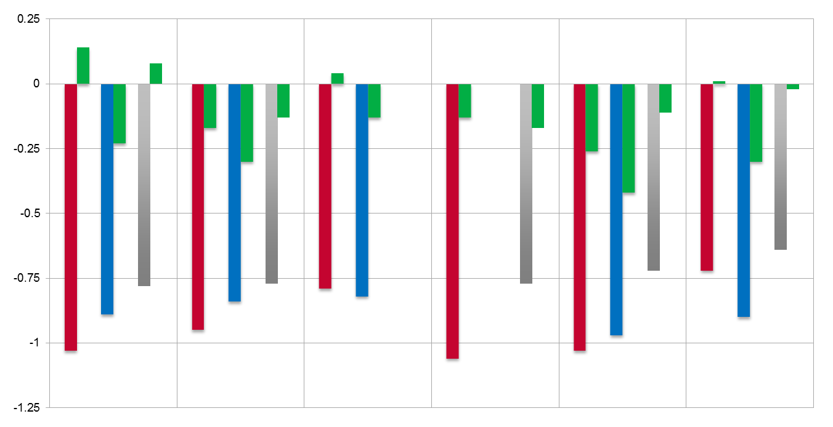
Mechanism: Induces glucosuria | A1C | Weight | Hypos | BP | Side Effects | Conclusion
Reduces A1c: 0.5 to 1.2%
EFFECTS OF SGLT2 INHIBITORS ON A1C LEVELS
A1C DECREASES BY 0.6 TO 1.1% (0.5 TO 1.2% PLACEBO-CORRECTED)
*These are not head to head trials
Monotherapy + Metformin + SU + Met + SU + Pio ± SU + Insulin
%
(-0.62)
(-0.60)
(-0.61)
(-0.73)
(-0.70)
(-0.64)
(-0.83)
(-0.69)
(-0.54)
(-0.60)
(-0.66)
(-0.78)
(-0.55)
(-1.17)
(-0.93)
(-0.77)
Canagliflozin 300 mg/d Dapagliflozin 10 mg/d Empagliflozin 25 mg/d Placebo
1. CANA: Adapted from http://www.fda.gov/downloads/AdvisoryCommittees/CommitteesMeetingMaterials/Drugs/EndocrinologicandMetabolicDrugsAdvisoryCommittee/UCM336236.pdf. Accessed January 23, 2013
2. DAPA: Available at: www.fda.gov/AdvisoryCommittees/CommitteesMeetingMaterials/Drugs/EndocrinologicandMetabolicDrugsAdvisoryCommittee/ucm252891.htm
3. EMPA: ADA Annual Meeting 2013: Roden M et al 1085-P; Haring H et al: 1092-P; Kovacs C et al: 1120-P and Rosenstock J et al 1102P.
Notes:
Overview of clinical safety and efficacy date
-tend to focus on background medications each study looked at
-across entire class reductions in A1C
Enrolment criteria for studies table dose of the following medications; or 12 week stabilization period with no medication and then had 12 weeks to stabilize on the medication
-may see some of the reductions from the initial drug
-on established doses of what we see on the top row
***NOTE: The bars represent the absolute numbers however the values in brackets are placebo corrected (right click on the graph and select edit data if you would like to see the absolute number)
SU is sulfonureas, met=metformin, pio is pioglitazone (TZD)
Canagliflozin reduces the reabsorption of filtered glucose (by inhibiting SGLT2) and lowers the renal threshold for glucose (RTg), thereby increasing urinary glucose excretion (UGE)
The decline in plasma glucose and corresponding increase in urinary glucose excretion (UGE) are dependent upon the dose of canagliflozin

Slide 24
A₁C: SGLT2 Inhibitors vs DPP-4 Inhibitors
MONOTHERAPY
24 weeks
A1c 7.9%
+ MET
52 weeks
A1c 7.9%
+MET +SU
52 weeks
A1c 8.1%
Placebo
EMPA
10
EMPA
25
SITA
100
CANA
100
CANA
300
SITA
100
CANA
300
SITA
100
0
0.08
–0.25
Change in A1c (%)
-0.50
-0.66
-0.66
-0.66
-0.75
-0.73
-0.73
-0.78
**p<0.05 vs sitagliptin
-0.88**
–1.00
-1.03**
Roden M et al. ADA Annual Meeting, 2013; 1085-P. Lavalle Gonzalez FJ et al. ADA Annual Meeting, 2013; 238-OR.
Schernthaner G et al. Diabetes Care 2013.
Notes:
Results of the primary endpoint showed placebo-adjusted reductions in HbA1c from baseline to week 24 of 0.74% (p<0.001) and 0.85% (p<0.001) for the empagliflozin 10mg and 25mg dose, respectively. Sitagliptin 100mg, which was used as an active comparator and not powered for a head-to-head comparison with empagliflozin, showed a placebo-adjusted reduction in HbA1c of 0.73% (p<0.001).
At Week 52, both CANA doses were non-inferior to SITA and CANA 300 mg was statistically superior to SITA in A1C-lowering.
At 52 weeks, canagliflozin 300 mg demonstrated noninferiority and, in a subsequent assessment, showed superiority to sitagliptin 100 mg in reducing A1C (-1.03% [-11.3 mmol/mol] and -0.66% [-7.2 mmol/mol], respectively.

Slide 25
Mechanism: Induces glucosuria | Reduces A1c: 0.7 to 1.2 | BW | Hypos | BP | Side Effects | Conclusion
Reduces Wt: 1.0 to 3.7 Kg
EFFECTS OF SGLT2 INHIBITORS ON BODY WEIGHT
BW DECREASES BY 0.1 TO 3.9 KG (1.0 TO 3.7 KG PLACEBO-CORRECTED)
*These are not head to head trials
Monotherapy + Metformin + SU + Met + SU + Pio ± SU + Insulin
Weight- kg
( -1.6)
(-1.8)
(-1.7)
(-1.8)
(-2.7)
(-1.6)
(-2.0)
(-2.3)
(-2.2)
(-2.95)
(-1.9)
(-2.0)
( -1.0)
(-3.2)
(-2.9)
(-3.7)
Canagliflozin 300 mg/d Dapagliflozin 10 mg/d Empagliflozin 25 mg/d Placebo
*
1. CANA: Adapted from http://www.fda.gov/downloads/AdvisoryCommittees/CommitteesMeetingMaterials/Drugs/EndocrinologicandMetabolicDrugsAdvisoryCommittee/UCM336236.pdf. Accessed January 23, 2013
2. DAPA: Available at: www.fda.gov/AdvisoryCommittees/CommitteesMeetingMaterials/Drugs/EndocrinologicandMetabolicDrugsAdvisoryCommittee/ucm252891.htm
3. EMPA: ADA Annual Meeting 2013: Roden M et al 1085-P; Haring H et al: 1092-P; Kovacs C et al: 1120-P and Rosenstock J et al 1102P.
Notes:
Positives of this class
-fair amount of weight loss
-how are we losing this weight? Is it all water weight-> it is in the first 2-3 weeks that it is; long term you are losing 2/3rds fat mass
-showing maximal approved doses everywhere across the globe
-6-9lbs of weight loss on these
*not head to head trials
*length of time= 26 weeks to 2 years
*weight loss was consistent for 6 months (peaked and maintained till 2 years)
-patients tended to increase energy intake after 6 months(tend to compensate for diet)
-if you had dietary counseling you could have more weight loss
***NOTE: The bars represent the absolute numbers however the values in brackets are placebo corrected (right click on the graph and select edit data if you would like to see the absolute number)
Treatment with canagliflozin has been show to reduce body weight vs placebo as a monotherapy as an add on to metformin, SU (glimerperide), metformin + SU and metformin + TZD (pio). Subset data from CANVAS study has also shown CANA to decrease body weight when added to insulin, GLP -1 and DPP-4
Approximately 80% of patient on cana lose at least 3% of body weight (1-2kg). Patients with great weight loss experienced greater reducations in HbA1c
Subjects with T2DM showed UGE of 80-100 g/day equivalent to approx. 320-400 kcal/day. The caloric loss is likely attributing to weight loss

Slide 26
Body Composition Studies with SGLT2 Inhibitor Treatment
(DEXA measurements)
26
Canagliflozin
Dapagliflozin
Variation at week 52
Variation at week 24
Glimepiride
n = 68
CANA.
100 mg
n = 71
CANA.
300 mg
n = 69
Placebo
+ Met.
n = 79
DAPA.
+ Met.
n = 82
Variation versus baseline
(kg)
Variation versus baseline (kg)
Lean mass
Fat mass
Toubro S et al.EASD Annual Meeting, 2012. Abstract 762.
Bolinder J et al. J Clin Endocrinol Metab. 97; 2012.
Notes:
Body composition analysis was conducted to determine the relative contributions of weight loss from fat and lean mass in a subset of subjects with T2DM enrolled in 2 randomised, double-blind, Phase 3 studies. In T2DM subjects on background metformin (Study 1 [Table]), CANA 100 and 300 mg significantly reduced body weight compared with GLIM (P <0.001 for both) at 52 weeks (least squares [LS] mean changes from baseline of -4.2, -4.7, and 1.0 kg, respectively). Loss of fat mass accounted for approximately two-thirds of the overall body weight reduction seen with CANA. Both CANA doses also showed reductions in percent total fat (fat percentage of the total weight) compared with GLIM. Similar results were observed in Study 2 subjects on a variety of background AHAs . CANA 100 and 300 mg significantly reduced body weight compared with PBO (P <0.001 for both) after 26 weeks of treatment (LS mean changes from baseline of -2.5, -3.3, and -0.2 kg, respectively). Greater loss from fat mass than from lean mass was observed for CANA 100 and 300 mg, and both CANA doses showed reductions compared with PBO in percent total fat. Analysis of abdominal fat in Study 1 showed slightly greater changes in the amount of visceral adipose tissue (LS mean changes relative to GLIM of -7.4% and -8.3%, respectively) than changes in subcutaneous adipose tissue (LS mean changes relative to GLIM of -7.2% and -7.4%, respectively) with CANA 100 and 300 mg. The body weight reductions seen in subjects with T2DM following 26 or 52 weeks of treatment with CANA 100 or 300 mg were predominantly (>2/3) from fat mass. There was a numerically greater percentage loss of visceral relative to subcutaneous fat in the abdomen.
At wk 24, placebo-corrected changes with dapagliflozin were as follows: Total body weight, -2.08 kg [95% confidence interval (CI)=-2.84 to -1.31; P<0.0001]; waist circumference, -1.52 cm (95% CI=-2.74 to -0.31; P=0.0143); FM, -1.48 kg (95% CI=-2.22 to -0.74; P=0.0001); proportion of patients achieving weight reduction of at least 5%, +26.2% (95% CI=15.5 to 36.7; P<0.0001); visceral adipose tissue (VAT), -258.4 cm3 (95% CI=-448.1 to -68.6; nominal P=0.0084); sc adipose tissue (SAT) volume, -184.9 cm3 (95% CI=-359.7 to -10.1; nominal P=0.0385).
Toubro S et al. EASD Annual Meeting 2012. Abstract 762.
Bolinder J et al. J Clin Endocrinol Metab. 97; 2012.

Slide 27
Mechanism: Induces glucosuria | Reduces A1c: 0.7 to 1.2 | Reduces Wt: 1.0 to 3.7 Kg | Hypos | BP | Side Effects | Conclusion
↓Risk hypos
EFFECTS OF SGLT2 INHIBITORS ON HYPOGLYCEMIA
LOW RISK OF HYPOGLYCEMIA
*These are not head to head trials
Monotherapy + Metformin + SU + Met + SU + Pio ± SU + Insulin
50
40
30
20
10
0
Percentage of Hypos
Canagliflozin 300 mg/d Dapagliflozin 10 mg/d Placebo
1. CANA: Adapted from http://www.fda.gov/downloads/AdvisoryCommittees/CommitteesMeetingMaterials/Drugs/EndocrinologicandMetabolicDrugsAdvisoryCommittee/UCM336236.pdf. Accessed January 23, 2013
2. DAPA: Available at: www.fda.gov/AdvisoryCommittees/CommitteesMeetingMaterials/Drugs/EndocrinologicandMetabolicDrugsAdvisoryCommittee/ucm252891.htm
Notes:
-spike: SU background and insulin background
-monitor in first few weeks and consider dose adjustment of SU or Insulin
-reduce insulin dose by 10%-20% and monitor
-
The pancreas independent action of SGLT2 inhibitors lend them to a low risk of hypoglycemia. However, when added to agents known to cause hypoglycemia (ie. SU and insulin) the increased incidence of hypoglycemia is likely due to the aforementioned agents.

Slide 28
Mechanism: Induces glucosuria | Reduces A1c: 0.7 to 1.2 | Reduces Wt: 1.0 to 3.7 Kg | ↓Risk hypos | BP | Side Effects | Conclusion
Reduces BP: 1.7 to 6.6
EFFECTS OF SGLT2 INHIBITORS ON BLOOD PRESSURE
BP DECREASES BY 2.4 TO 6.9 MMHG (1.7 TO 6.6 PLACEBO-CORRECTED)
*These are not head to head trials
Monotherapy + Metformin + SU + Met + SU + Pio ± SU + Insulin
mmHg
( -2.5)
(-2.9)
(-3.4)
( -2.1)
( -4.8)
( -1.7)
( -4.7)
(-5.4)
( -3.5)
( -6.6)
( -4.8)
( -1.8)
( -3.7)
( -5.8)
( -5.5)
(-4.4)
Canagliflozin 300 mg/d Dapagliflozin 10 mg/d Empagliflozin 25 mg/d Placebo
1. CANA: Adapted from http://www.fda.gov/downloads/AdvisoryCommittees/CommitteesMeetingMaterials/Drugs/EndocrinologicandMetabolicDrugsAdvisoryCommittee/UCM336236.pdf. Accessed January 23, 2013
2. DAPA: Available at: www.fda.gov/AdvisoryCommittees/CommitteesMeetingMaterials/Drugs/EndocrinologicandMetabolicDrugsAdvisoryCommittee/ucm252891.htm
3. EMPA: ADA Annual Meeting 2013: Roden M et al 1085-P; Haring H et al: 1092-P; Kovacs C et al: 1120-P and Rosenstock J et al 1102P.
Notes:
Across all studies- on average 5mmHg (partially weight loss and diuretic effect)
If you have a patient hypotensive (may dose adjustment or be cautious)
-If patient SBP is around 100mmHg may not be appropriate candidate
-Volume depleted
***NOTE: The bars represent the absolute numbers however the values in brackets are placebo corrected (right click on the graph and select edit data if you would like to see the absolute number)
Changes in BP are due to a combination of approximately one extra void per day and body weight loss
Patients with greater weight loss had greater reductions in SBP. Each 1% reduction in body weight was associated with a 0.62 mg Hg reduction in SBP
Weir et al (ADA 2013) investigated BP lowering with cana in T2 patients using pooled data from 6 studies. In the overall population, placebo subtracted BP decreases with both cana doses were similar among subjects on antiHTNs and those not on these agents.
Cana was not associated with changes in HR.

Slide 29
Mechanism: Induces glucosuria | Reduces A1c: 0.7 to 1.2 | Reduces BW: 1.0 to 3.7 Kg | ↓Risk hypos | Reduces BP: 1.7 to 6.6 | Side Effects | Conclusion
Side Effects: Genital mycotic
INCREASE IN GENITAL MYCOTIC INFECTIONS; UTI?
EFFECTS OF SGLT2 INHIBITORS ON INFECTIONS
*These are not head to head trials
URINARY TRACT INFECTIONS GENITAL MYCOTIC INFECTIONS
Men Women Men Women
Percentage
Percentage
Canagliflozin 300 mg/d Dapagliflozin 10 mg/d Empagliflozin 25 mg/d Placebo
1. CANA: Adapted from http://www.fda.gov/downloads/AdvisoryCommittees/CommitteesMeetingMaterials/Drugs/EndocrinologicandMetabolicDrugsAdvisoryCommittee/UCM336236.pdf. Accessed January 23, 2013
2. DAPA: Available at: www.fda.gov/AdvisoryCommittees/CommitteesMeetingMaterials/Drugs/EndocrinologicandMetabolicDrugsAdvisoryCommittee/ucm252891.htm
3. EMPA: ADA Annual Meeting 2013: Roden M et al 1085-P; Haring H et al: 1092-P; Kovacs C et al: 1120-P and Rosenstock J et al 1102P.
.
Notes:
-number 1 ADR->GMI (yeast) and UTI
-more glucose and providing a substrate for bacteria to grow off of
-1 in 10 women yeast; in men 4-6% (uncircumsized)
-UTI: rates are lowers
-not sure why emp was higher
CAVEAT: patient with recurrent 4 or more per year not the right medication
-wait and see, worth trying, could caution them or educate them
Rates in clinical trials were 10% but post marketing rates are lower (could be a positive culture- actively looking for them; diagnosis based on culture only not symptoms)
-less an issue in the real world**
Physicians report patients with uncontrolled hyperglycemia tend to have a higher incidence of genital infections
The exact mechanism of the increase compared to placebo in the incidence of GMI is unclear but is likely related to changes in the perineal environment with increased UGE induced by SGLT2 inhibition. Because increases in UGE could increase fungal growth in the perineum which could increase colonization with Candida a risk factor for the development of genital infections may exist.

Slide 30
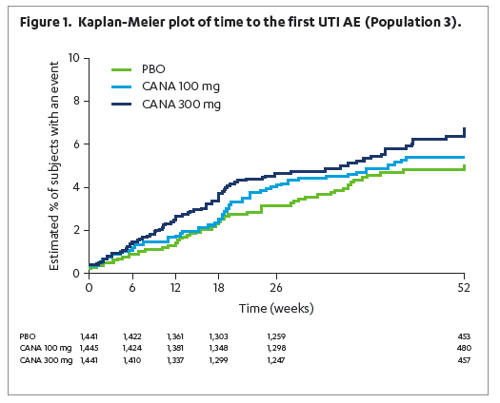
Urinary Tract Infection with CANA
Time to First UTI AE
):
Notes:
-tend to see in first 4-6 months (that’s when the spike in urinary glucose)
Time to first

Slide 31
Side Effects of SGLT2 Inhibitors in relation to circulating volume
Mechanism: Induces glucosuria | Reduces A1c: 0.5 to 1.2% | Reduces weight: 1.0 to 3.7 Kg | Rare Hypos | Reduces BP: 1.7 to 6.6 | Side Effects | Summary
Volume Depletion
Canagliflozin pooled data
Events of interest:
  Hypotension
  Postural Hypotension
  Dehydration
  Syncope
  Reduced urinary output
12
≥ 75 years
10
8
< 75 years
6
Patients (%)
4
8.7%
4.9%
2
3.1%
2.6%
1.4%
2.2%
0
Other
Cana
100
Cana
300
Other
Cana
100
Cana
300
http://www.fda.gov/downloads/AdvisoryCommittees/CommitteesMeetingMaterials/Drugs/EndocrinologicandMetabolicDrugsAdvisoryCommittee/UCM336236.pdf.
Accessed January 23, 2013
MENU
Notes:
*volume related ADR’s
-risk factors to watch out for and where would you want to be cautious: over 75 years
-under 75 very low ADR rates but doubled-tripled in 75 years
*First sub group
-Acts like a diuretic (older patients on drier side)
300 mg is pooled data; 300 mg the most common side effect is hypotension and postural hypotension (account for about 2% each) and orthostatic hypotension was next; none of these events lead to serious AE, discontinuation 3/3000 in the entire study 0.1% in 300 mg; 15/172 had intravascular effects
Decreased urinary output is correct given that we are looking at volume depletion.

Slide 32
RISK FACTORS for VOLUME DEPLETION SYMPTOMS
Patients on loop diuretics
Canagliflozin
pooled data
Dapagliflozin
pooled data
10
8.8
9.7
8
6
4.7
Patients (%)
3.2
4
2
1.8
Population at risk
> 75 yo
0
Cana
100
Cana
300
Placebo
Dapa
10
All non-CANA
Events of interest:
  Hypotension
  Postural hypotension
  Dehydration
  Syncope
  Decreased urinary output
Patients with low baseline eGFR
Canagliflozin pooled data
10
< 60mL/min
60 to < 90 mL/min
≥ 90 mL/min
8
8.1
6
4.7
Patients (%)
4
2.5
2.4
2.9
2.4
2
1.5
1.2
1.3
0
Cana
100
Cana
300
Others
Cana
100
Cana
300
Others
Cana
100
Cana
300
Others
http://www.fda.gov/downloads/AdvisoryCommittees/CommitteesMeetingMaterials/Drugs /EndocrinologicandMetabolicDrugs
AdvisoryCommittee/UCM336236.pdf. Consulted January 23, 2013. FDA Advisory Committee, July 19 2011 : http://www.fda.gov.
Notes:
Two risk factors: potent diuretics: lasix (exercise caution and their volume)
Risk factor: eGFR <60 rates jumped up; power kidney function more volume related symptoms
HCTZ- rates much lower; nearly identical to what we saw with placebo; do not adjust HCTZ dose; ask them to drink more water; not the case for HCTZ
ACE/ARB- if you were iniating an Ace/ARB in patient; same as adding other agent; would not initiate both at the same time!!
The risk factors for volume depletion symptoms are dosing with a loop diuretic, patients with low baseline eGFR and patients greater than 75 yoa

Slide 33
Renal Safety

Slide 34
Diabetic nephropathy: Basic Principles
34
Elevated plasma glucose (not tubular glucose) leads to increased glomerular mesangial matrix production and glomerular injury
Increased tubular glucose resulting in glycosuria likely has no significant effect on the glomerulus or the microvascular system
  Patients with renal glycosuria do not develop diabetic nephropathy

Slide 35
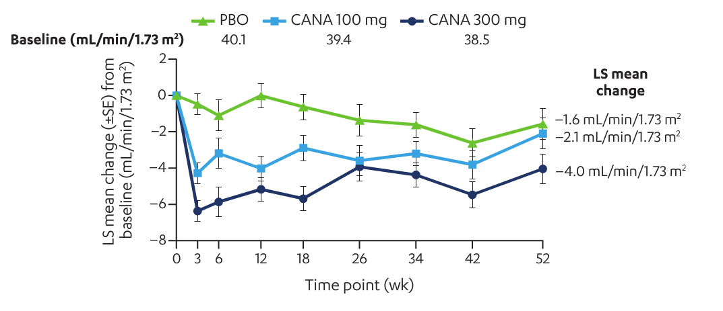
EFFECTS of SGLT2 Inhibitors on eGFR
in presence of moderate renal failure
The eGFR decreases slightly, then increases slowly towards baseline
in presence of moderate renal failure
Yale JF et al. ADA Annual Meeting 2013. Abstract 1075-P.
Notes:
-GFR drops lowers with SU
-see across all of the studies; initial drop in GFR; then it tends to stabilize; 2-3 ml/min (104 weeks)
-* CREDENCE and (not just its effects on GFR; albumin/creatinine ratio; ACR went down) –two studies on the go looking at whether we can slow the progression of diabetic nephropathy
As expected with a diuretic like agent there is an initial drop in eGFR however, there is a recovery to near baseline at 52 weeks/one year.
Yale JF et al. ADA Annual Meeting 2013. Abstract 1075-P. http://www.fda.gov/downloads/AdvisoryCommittees/CommitteesMeetingMaterials/Drugs/EndocrinologicandMetabolicDrugsAdvisoryCommittee/UCM334550.pdf. Accessed January 23, 2013 Barnett A et al. ADA Annual Meeting 2013. Abstract 1104-P.
The average decline in eGFR over time is about 1 mL/min/1.73 m²

Slide 36
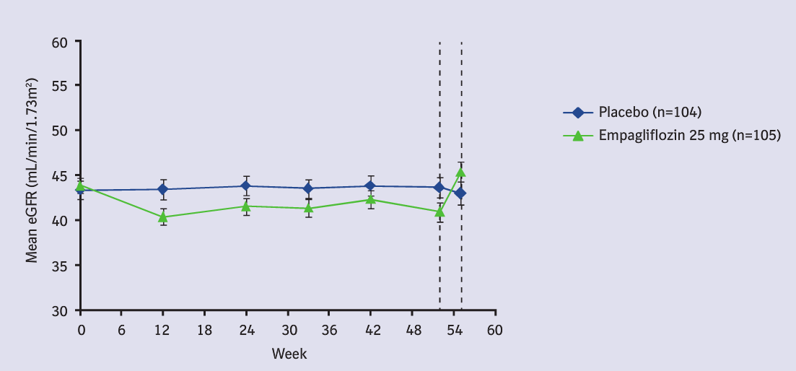
EFFECTS of SGLT2 Inhibitors on eGFR
in presence of moderate renal failure
The eGFR decreases slightly, then increases slowly towards baseline
In presence of moderate renal failure
Placebo
Empagliflozin
Yale JF et al. ADA Annual Meeting 2013. Abstract 1075-P.
Notes:
If you stop an SGLT2
-4 weeks GFR improved
Yale JF et al. ADA Annual Meeting 2013. Abstract 1075-P. http://www.fda.gov/downloads/AdvisoryCommittees/CommitteesMeetingMaterials/Drugs/EndocrinologicandMetabolicDrugsAdvisoryCommittee/UCM334550.pdf. Accessed January 23, 2013 Barnett A et al. ADA Annual Meeting 2013. Abstract 1104-P.

Slide 37
EFFECTS of SGLT2 INHIBITORS on A1c LEVELS in CKD
In moderate renal failure, the A1C reduction is halved
Canagliflozin
eGFR 30 to <50
(N=269)
Dapagliflozin
eGFR 30 to 59
(N=252)
Empagliflozin
eGFR 30 to <60
(N=374)
Baseline mean A1C (%)
Baseline mean eGFR
(mL/min/1.73m²)
8.0
39.4
8.4
44.6
8.0
≈ 43
0.2
0.0
-0.2
0.05
-0.03
Change from Baseline
(± 95% CI) A1C (%)
-0.4
-0.32
-0.37
-0.44
-0.44
-0.6
-0.40*
-0.42*
(-0.56,-0.28)
-0.11
(-0.40,0.45)
-0.8
Placebo
CANA 300 mg
Placebo
DAPA 10 mg
Placebo
EMPA 25 mg
* p <0.001; †p <0.05.
Yale JF et al. Diabetes Obesity & Metabolism 2013;15:463-473. Kohan D et al. J Am Soc Nephrol 2011;22:232A:TH-PO524.
Barnett A et al. ADA Annual Meeting 2013. Abstract 1104-P.
Notes:
*Often gets asked the question
Canada label use it to 45ml/min
Here are the studies that show why they got that label
-worse kidney function you have the drug doesn’t work; not from a side effect reason but more from an efficacy stand point
-stratified into different points
HbA1c was significantly reduced from baseline with canagliflozin 100 and 300 mg compared with placebo at week 26. Differences in LS mean changes relative to placebo were –0.30% for canagliflozin 100 mg (p<0.05) and –0.40% for canagliflozin 300 mg (p<0.001). A numerically higher proportion of subjects treated with canagliflozin 100 or 300 mg than with placebo achieved HbA1c<7.0% at week 26 (27.3, 32.6 and 17.2%,
respectively;.Yale JF et al).
In patients with mild RI (eGFR [MDRD equation] ≥60 to <90 mL/min/1.73 m²; n=290; mean age 62.6 years; mean BMI 31.5 kg/m²) receiving EMPA 10 or 25 mg qd or placebo (PBO), EMPA significantly reduced HbA_{1c} vs PBO at week 24 (Barnett A et al).
Kohan D et al. J Am Soc Nephrol 2011;22:232A:TH-PO524.
Barnett A et al. ADA Annual Meeting 2013. Abstract 1104-P.

Slide 38
CV Risk

Slide 39
Dapagliflozin: Cardiovascular Risk
Phase 2/3 Studies
DAPA. vs Controls
Relative Risk: 0.674
98 % CI : 0.385 – 1.178
 | DAPA |  | Controls
 | Number of first events | Event Rate | Number of first events | Event Rate
Patients with an event | 48 | 1.13 % | 30 | 1.66 %
CV Deaths | 8 | 0.19 % | 4 | 0.22 %
MI | 18 | 0.42 % | 18 | 1.00 %
CVA | 11 | 0.26 % | 5 | 0.28 %
Unstable angina | 11 | 0.26 % | 3 | 0.17 %
Controls
DAPA
Number of patients
DAPA. | 4 097 | 3 826 | 2 767 | 2 350 | 1 532 | 1 368 | 1 062 | 585
Controls | 1 850 | 1 696 | 1 197 | 1 004 | 622 | 538 | 415 | 233
Langkilde A el al. American Heart Association Meeting, 2011; abstract 8947.
Notes:
A meta-analysis of 14 phase II/III trials comprising 6,228 patients corroborated the lack of increased risk for cardiovascular events during treatment with dapagliflozin, which was rather associated with a potential reduction in cardiovascular event rates.

Slide 40
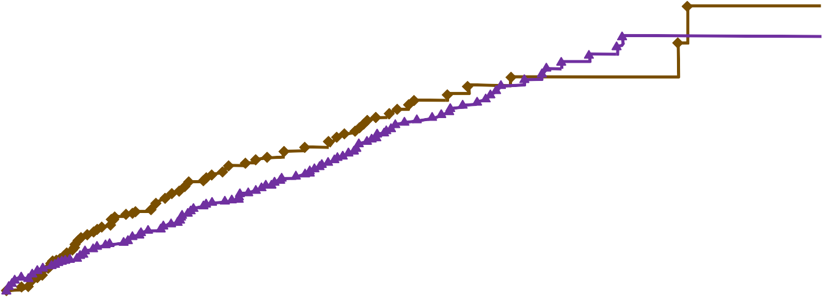
Canagliflozin : MACE-plus
All phase 2/3 studies, including CANVAS
Kaplan-Meyer estimate
Probability of a MACE-plus Event
0.05
HR = 0.91 (95% CI : 0.68 – 1.22)
HR = 1.00 (0.72 – 1.39) – CANVAS
HR = 0.65 (0.35 – 1.21) – Other trials
0.04
All non-CANA.
0.03
All CANA.
0.02
0.01
0.00
26
Study Week
0
6 12 18
39
52
65
78
91
104
Number of subjects at risk
All non-CANA.
All CANA.
3 327 3 282 3 161 2 991
6 305 6 224 6 000 5 715
2 848
5 539
2 650
5 227
1 985
4 065
931
1 935
508
1 039
213
462
42
91
Note : Includes all studies with data base lock prior to January 31, 2012; mTTT analysis set; events within 30 days of last dose
http://www.fda.gov/downloads/AdvisoryCommittees/CommitteesMeetingMaterials/Drugs
/EndocrinologicandMetabolicDrugsAdvisoryCommittee/UCM336236.pdf. Consulted January 23, 2013.
Notes:
Had to present this slide to FDA
-to get
MACE (major adverse cardiovasulcar events-
All non-cana (placenp, metformin, SU, etc.)
-out to 2 years
-hard outcomes data in progress
-HR: lower than comparators
All three companies
For the prespecified, primary composite MACE-plus endpoint, the HR of the combined
canagliflozin group to the non-canagliflozin group was 0.91, (95% CI: 0.68, 1.22). The prespecified, primary composite assessment was conducted in 95% of subjects through the cut-off date; when excluding subjects that withdrew consent for follow-up, the assessment was conducted in 97% of subjects.
The results were highly similar by dose and consistent across subgroups. The HRs were
0.91 (95% CI: 0.65, 1.28) and 0.92 (95% CI: 0.65, 1.28) for the canagliflozin 300 mg group
versus the non-canagliflozin group and for the canagliflozin 100 mg group versus the
non-canagliflozin group, respectively. The results were also examined for the CANVAS
(DIA3008) study and the non-CANVAS (ie, other Phase 2 and 3 studies) separately; the HR in the CANVAS study was 1.00 and was 0.65 in the non-CANVAS studies.
Examination of the Kaplan-Meier curve for MACE-plus endpoint showed that there
was a modestly higher rate of events in the canagliflozin groups relative to the non-canagliflozin
groups occurring in the first 30 days after randomization (15 events in the total canagliflozin
group vs 5 in non-canagliflozin group; with 2:1 randomization ratio, canagliflozin to noncanagliflozin)
in the overall CV meta-analysis; this was more prominent in the DIA3008 study
(13 events in the canagliflozin groups relative to the 1 placebo event), with the opposite pattern
in the non-DIA3008 studies (2 events in the canagliflozin group relative to 4 events in the noncanagliflozin
group). On the other hand, in the next 30 day period in the DIA3008 study (Days 31 to 60), a higher rate of events was observed in the placebo group: 5 events in the combined canagliflozin groups, and 8 events in the placebo group, with a similarly higher rate in the subsequent 30 day period (ie, Days 61 to 90) in this study in the placebo group. Since the incidence of adverse events related to reduced intravascular volume most prominently increased over the first 12 weeks post-randomization , the higher incidence of CV events in CANVAS within the first 30 days, and then lower incidence over the subsequent 60 days, would
not suggest a relationship to reduced intravascular volume. Overall, marked month-to-month
variability in the estimate monthly hazard rates was seen suggesting that the imbalance observed
in the first month in DIA3008 likely reflects a chance occurrence.

Slide 41
SGLT-2 Inhibitors: Ongoing CV Trials
 | Treatment | n | Population | Endpoints | Results
CANVAS | Canagliflozin vs Placebo | 4 363 | CVD or high risk for CVD | CV death, non-fatal MI or non-fatal CVA | June 2018
C-SCADE 8 | Empagliflozin vs Placebo | 7 000 | CVD | CV death, non-fatal MI or non-fatal CVA | March 2018
DECLARE | Dapagliflozin vs Placebo | 17 150 | CVD or high risk for CVD | CV death, non-fatal MI or non-fatal CVA | April 2019
Clinicaltrials.gov.

Slide 42
SGLT2 Metabolism
42
Canagliflozin (Invokana®)
UGT1A9
UGT2B4
Dapagliflozin (Farxiga®)
UGT1A9 - major substrate
OAT3 – substrate
P-glycoprotein- weak substrate
Cytochrome P450 metabolism - undefined, minor pathway
Empagliflozin (Jardiance®)
UGT2B7, UGT1A3, UGT1A8, and UGT1A9 - substrate
OAT3 – substrate
OATP1B1 and OATP1B3- substrate
P-glycoprotein- substrate
BCRP - substrate

Slide 43
Drug Interactions
 | VIA | Canagliflozin | Dapagliflozin | Empagliflozin
Diuretics (loop, aldosterone antagonists) | ⬆urine volume and frequency of voids ⬇volume depletion
Rifampin | UGT |  | No Effect | No Effect
Phenytoin/CBZ | UGT |  | No Effect | No Effect
Ritonavir/Efavirenz | UGT |  | No Effect | No Effect
Barbituates | UGT |  | No Effect | No Effect
Digoxin | Weak PGP inhibitor |  | No Effect | No Effect
Drugs that raise potassium (ie. ACE/ARB) | Hyperkalemia
St Johns Wort | Weak CYP3A4 inhibitor |  | No Effect | No Effect
Notes:
0 that are contraindicated
0 that are precaution
All closely monitor- Yellow is caution- dose reduction
Took out thiazide diuretics because in studies there was no dosage adjustment of Invokana needed

Slide 44
Guideline Statement on SGLT2
The American Association of Clinical Endocrinologists’ (AACE) Comprehensive Diabetes Management Algorithm 2013 Consensus Statement lists SGLT2 inhibitors as a monotherapy option for T2DM patients with A1C <7.5%, or as a dual- or triple-therapy option for patients with baseline A1C ≥7.5% or patients who did not reach their A1C goal after 3 months of noninsulin monotherapy.
The consensus statement cites the ability of SGLT2 inhibitors to provide glucose lowering without weight gain or risk of hypoglycemia as justification for their recommendation.
In patients where weight loss is a therapeutic goal, the AACE recommends using an SGLT2 inhibitor or a GLP-1 receptor agonist along with metformin and intensive lifestyle management in preference over other therapies that promote weight gain.
The most recent guidelines published by the American Diabetes Association do not address the use of SGLT2 inhibitors in the treatment of T2DM.

Slide 45
Practical tips and Considerations in Starting SGLT2 Inhibitors

Slide 46
Initiating Therapy
Drug | Dosage Form | Typical Dosage Range | Maximum Dose | Food
Canagliflozin (Invokana®) | Tablet 100mg 300mg | Starting 100mg once daily Maintenance 100 - 300mg once daily | 300mg/day | Take before first meal of the day
Dapagliflozin (Farxiga®) | Tablet 5mg 10mg | Starting 5mg once daily Maintenance 5 - 10mg once daily | 10mg/day | Take in morning with or without food
Empagliflozin (Jardiance®) | Tablet 10mg 25mg | Starting 10mg once daily Maintenance 10 - 25mg once daily | 25mg/day | Take in morning with or without food

Slide 47
Monitoring Parameters
Parameter | Interval | Comments
A1C | q3 months
FG and PPG | SMBG, q3 months
Renal Function -EGF and ACR | Prior, 1 month, q3months | More frequent monitoring in patients with eGFR <60ml/min
Electrolytes -Potassium | Prior, 1 month, q3-6months | Check more often with certain medications/medical conditions
Weight | 1 month | Peak wt loss at 6 months
Blood Pressure | 1 month | Peak BP loss at 6 months
Cholesterol | 3 months then q year | LDL, TG, HDL
Dehydration Status | 1 month | BUN, electrolytes, SCr
Genital Mycotic Infections | Check at refills and new antibiotic Rxs | Most common in first 4 months

Slide 48
Considerations
48
Benefit | Risk Considerations
Reduced A1C >0.8% | Increased Yeast and UTI Infections
Effects both FBG and PPG | Reduced Intravascular Volume (in susceptible patients)
Low Risk Hypoglycemia | Increased LDL-Cholesterol
Reduced Triglycerides | Not indicated with eGFR < 45 ml/min
Reduced Blood Pressure | Long term clinical efficacy and safety is unknown
Reduced Weight
Oral medication, Once Daily
Can be combined with any drug therapy in T2DM and used at any stage of T2DM

Slide 49
Mechanism: Induces glucosuria | Reduces A1c: 0.5 to 1.2% | Reduces weight: 1.0 to 3.7 Kg | Rare Hypos | Reduces BP: 1.7 to 6.6 | Side Effects | Summary
SUMMARY:
SGLT2 inhibitors induce glucosuria, resulting in a loss of glucose in the urine.
A1c is reduced by 0.5 to 1.2 %
Body weight is reduced by 1.0 to 3.7 kg
SGLT2 inhibitors rarely induce hypoglycemia, except when added to insulin or insulin secretagogues.
Blood pressure is reduced by 1.7 to 6.6 mm Hg
The following side effects can be observed: genital mycotic infections and side effects related to volume depletion.

Slide 50
Case Discussions
With Ken Burns

Slide 51
Case #1
Patient R:
    Female, 56
    Type 2 diabetes
    Overweight
    Sedentary through winter

Slide 52
Case #1
Blood sugar | Metformin | 500mg at lunch and at supper
Blood sugar | Onglyza | 5mg in the morning
Blood pressure | Norvasc | 10mg at night
Blood pressure | Diovan | 80mg in the morning
Cholesterol | Crestor | 10mg in the morning
Breathing | Flovent | 250mcg inhaler 2 puffs twice daily
Breathing | Bricanyl turbuhaler | Use as directed
Supplement | Vitamin D | 1000 units daily
Supplement | Omega 3 | Fish oil 1000mg EPA/DHA twice daily
Thyroid | levothyroxine | 0.1mg daily

Slide 53
Case #1

Slide 54
Options?
    Increase metformin
    Secretagogue
    Incretin
      GLP-1
    TZD
    Acarbose
    Xenical
    Insulin
    SGLT2
    Dietary changes and physical activity

Slide 55
Case #1

Slide 56
Case #1
Issues and concerns:
    Does not want insulin
      Hectic work/life schedule
      Meals erratic
    Boss makes her eat at her desk if she has time
    Lives with daughter and food choices are her daughters
    Metformin causes GI side effects over 1000mg per day
    Not a fan of weight gain

Slide 57
Case #2
Patient P:
    Female, 48 years old
    Type 2 diabetes
    Obese
    Chronic pain, fibromyalgia, osteopenia

Slide 58
Blood sugar | Metformin | 1000mg twice daily
Blood sugar | Gliclazide | 30mg MR daily
Blood pressure | Telmisartan | 40mg daily
Water pill | Amiloride and hydrochlorothiazide | 5mg/50mg daily
Cholesterol | Rosuvastatin | 20mg daily
Stomach | Rabeprazole | 20mg daily
Pain | Naproxen | 500mg daily
Iron | Ferrous fumarate | 300mg twice daily
Supplement | Vitamin C | 1000mg
Supplement | Coenzyme Q-10 | 1 or 2 daily
Supplement | Cranberry | Once daily
Supplement | Calcium/magnesium | 1-2 daily (Jamieson brand)
Supplement | Vitamin D | 1000 units daily
Supplement | Omega 3 | Wild fish oil blend
Supplement | Quercetin
Asthma | Advair | 250mcg inhaler 2 puffs twice daily
Nose | Omnaris | Used when has a cold
Supplement | Centrum select | Adult 50plus once daily
Supplement | Vitalux | For eye health
Supplement | Glucosamine/chondroitin/MSM | 3 daily
Supplement | Melatonin | 5mg before bed
Supplement | Digestive enzymes | Webber
Supplement | Chromium | 500mcg once daily
 | Zeal | Nutrient supplement

Slide 60
Case #2
Options?
    Increase Gliclazide
    Incretin
      DPP4
      GLP-1
    TZD
    Acarbose
    Xenical
    Insulin
    SGLT2
    Dietary changes and physical activity

Slide 61
Case #2

Slide 62
Case #2
Issues and concerns:
  Weight gain
  Levels improved, but then got worse again
  I don’t want insulin
    I don’t like needles
    I don’t want to gain wait
  I thought sugar was bad for my kidney
  Then can I eat whatever I want?
What do we want to do?

Slide 63
Case #2

Slide 64
Bonus case
Patient D:
  Male, 64
  Type 2 diabetes
  Overweight
  Chronic pain

Slide 65
Bonus case
Blood sugar | Janumet | 50mg/850mg twice daily
Blood sugar | Gliclazide | 30mg MR once daily
Blood pressure | Avapro | 150mg daily
Blood pressure | Metoprolol | 75mg twice daily
Cholesterol | Niacin | 500mg three times daily
Cholesterol | Ezetrol | 10mg daily
Cholesterol | Atorvastatin | 80mg daily
Antiplatelet | Clopidogrel | 75mg daily
Stomach | Rabeprazole | 20mg daily
Nose | Avamys | Use one spray in each nostril at bedtime
Mood | Cipralex | 10mg daily
Gout | Allopurinol | 300mg daily
Gout | Colchicine | 0.6mg twice daily
Gout | Indomethacin | 25mg when needed for gout
Pain | Tramadol and acetaminophen | 37.5/325mg every 4 hours when needed
Sleep | Zopiclone | 7.5mg at bedtime
Prophylaxis | Amoxicillin | 2g 1 hour before appointment
Pain | Tylenol #3 | When required

Slide 66
Bonus case

Slide 67
Bonus case
Options?
  Increase gliclazide
  Incretin
    GLP-1
  Increase metformin
  TZD
  Acarbose
  Xenical
  Insulin
  SGLT2
  Dietary changes and physical activity

Slide 68
Bonus case
Issues and concerns:
  Just starting to take diabetes seriously
  Didn’t know much about diabetes before
  Willing to make changes
  What is next after diet and exercise are changed?

Slide 69
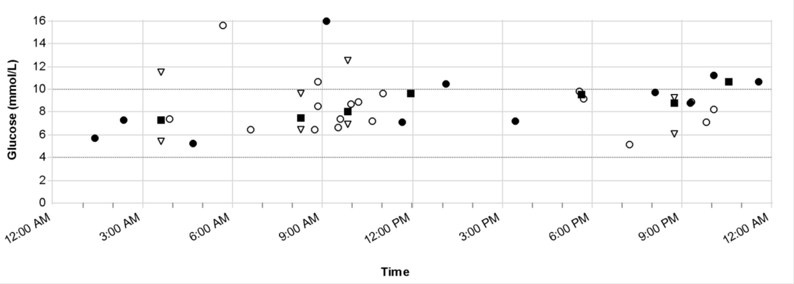
Bonus case

Slide 70
Thank You

