Slide 1
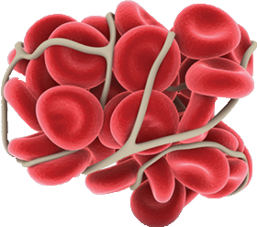
VTE Prophylaxis

Slide 2
Disclosures
Notes:
Sanofi- TRISH

Slide 3
Learning Objectives
Identifying the risk & likelihood of developing a VTE
Rationale for initiating VTE prophylaxis
Available agents for VTE prophylaxis
and associated ODB coverage
Familiarization of HSN VTE prophylaxis policy
Identifying which patients require post-discharge prophylaxis and the duration of such treatment

Slide 4
What does VTE Prophylaxis mean?
Anticoagulation to prevent venous thromboembolism
Deep vein thrombosis (DVT)
Pulmonary embolism
Why?
Notes:
DVTs can break off and travel to lungs causing death

Slide 5
Outline
Reason for VTE prophylaxis
Indication
Contraindications
Available Agents
Duration of Therapy
Coverage
VTE Prophylaxis : Surgical Oncology

Slide 6
Why use VTE prophylaxis in hospital?

Slide 7
10% - 20% VTE in med pts
42% at mod or high risk (CHEST)
>1 Risk Factor
VTE Prophylaxis (Hospitalized Patients)
Morbidity & Mortality
Liability
Resource Burden
Accreditation
Most common preventable death
Autopsy data : >10% med pts
http://www.saferhealthcarenow.ca/EN/Interventions/vte/Documents/VTE%20Getting%20Started%20Kit.pdf
Notes:
http://www.bloodjournal.org/content/120/8/1562?sso-checked=true
Almost every hospitalized patient has at least one risk factor for VTE and most have multiple risk factors
Autopsy data : >10% of deaths in hospitalized medical pts
Mortality: 30 day case fatality rate for DVT is 5% and for PE is 33% (Safer Healthcare Now)
Resources: VTE doubles hospital length of stay and costs of hospital care

Slide 8
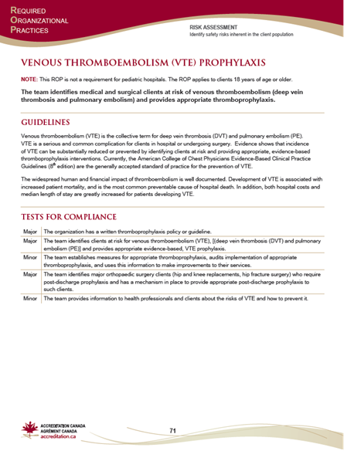
ROP
Required Organization Practice for accreditation

Slide 9
Notes:
Safer Healthcare Now!, the flagship program of the Canadian Patient Safety Institute, invests in frontline providers and the delivery system to improve the safety of patient care throughout Canada by implementing interventions known to reduce avoidable harm.
Safer Healthcare Now! has resources and expertise for frontline healthcare providers and others who want to improve patient safety. The tools and resources you find here are customizable, reliable, tested, and based on five years of improving care.​​​​​​​​

Slide 11
Risk Factors
Surgery
Trauma (major trauma or lower-extremity injury)
Immobility, lower-extremity paresis
Cancer (active or occult)
Cancer therapy (hormonal, chemotherapy, angiogenesis inhibitors, radiotherapy)
Venous compression (tumor, hematoma, arterial abnormality)
Previous VTE
Increasing age (>60)
Pregnancy and the postpartum period
Heart failure
Acute respiratory disease
Estrogen-containing oral contraceptives or hormone replacement therapy
Selective estrogen receptor modulators
Erythropoiesis-stimulating agents
Acute medical illness
Inflammatory bowel disease
Nephrotic syndrome
Myeloproliferative disorders
Paroxysmal nocturnal hemoglobinuria
Obesity
Central venous catheterization
Inherited or acquired thrombophilia
http://www.saferhealthcarenow.ca/EN/Interventions/vte/Documents/VTE%20Getting%20Started%20Kit.pdf

Slide 12
Meanwhile, in hospital…
Immobility

Slide 13
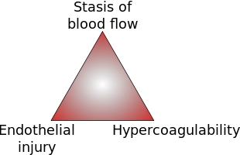
Virchow’s Triad
Notes:
https://upload.wikimedia.org/wikipedia/commons/thumb/b/b7/Virchow's_Triad.svg/310px-Virchow's_Triad.svg.png

Slide 14
Approximate Risks of DVT in Hospitalized Patients
Patient Group | Prevalence of DVT
Medical patients | 10–20
General surgery | 15–40
Major gynecologic surgery
Major urologic surgery
Neurosurgery
Stroke | 20–50
Hip/knee arthroplasty Hip Fracture Surgery | 40–60
Major trauma | 40–80
Spinal Cord Injury | 60–80
Critical care patients | 10–80
http://www.ncbi.nlm.nih.gov/pmc/articles/PMC1925160/
Notes:
http://www.ncbi.nlm.nih.gov/pmc/articles/PMC1925160/
Medical Patients

Slide 15
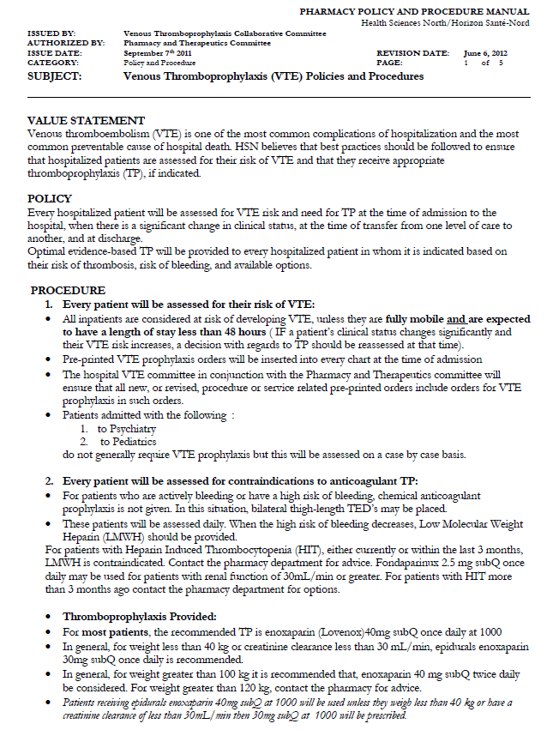
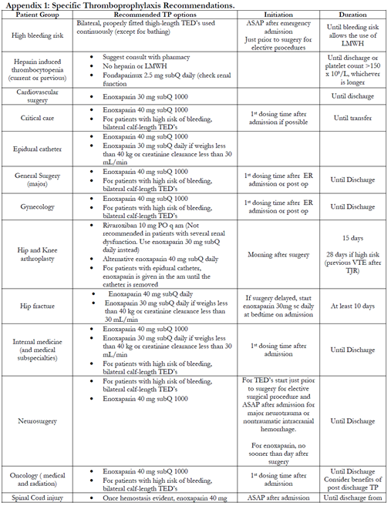
HSN POLICY

Slide 16
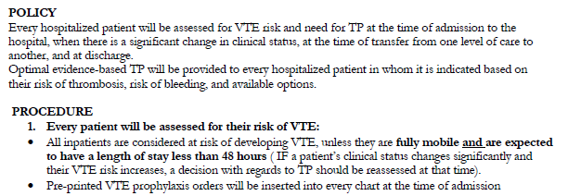
HSN policy (scan)

Slide 17
HSN policy
Exclusions
• Under 18 years
• Rehab patients
• Psychiatry patients

Slide 18
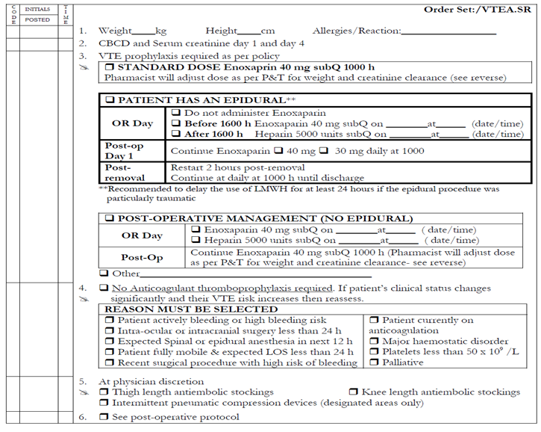
Pre Printed Order
Notes:
Reasons for not receiving prophylaxis: eg. Procedure/surgery soon (24 hours), fully mobile, bleeding, platelets low
Quantifying the risk on the safety side– Reasons not to be on prophylaxis

Slide 20
Contraindications
Absolute Bleeding Risk
• Active hemorrhage
• Thrombolytics used within the past 24 hours
Patients should still be re-assessed as contraindications may resolve
http://www.saferhealthcarenow.ca/EN/Interventions/vte/Documents/VTE%20Getting%20Started%20Kit.pdf

Slide 21
Relative Bleeding Risk -
If the risk for bleed out weighs the risk for VTE:
• GI/GU hemorrhage within the past 30 days
• INR ≥ 2.0
• End stage liver disease with coagulopathy
• Transfusion ≥ 2 units PRBC in last 72 hours
• Vitamin K use in last 24 hours
• Hgb drop ≥ 20 g/L or 10%
• Epidural catheter placement or removal
• Craniotomy within the past 2 weeks
http://www.saferhealthcarenow.ca/EN/Interventions/vte/Documents/VTE%20Getting%20Started%20Kit.pdf
Notes:
http://www.uwhealth.org/files/uwhealth/docs/pdf3/Bleeding_Risk_VTE_Prophylaxis.pdf
Risk factors associated (not necessarily causing…)

Slide 22
Relative Bleeding Risk – continued…
If the risk for bleed out weighs the risk for VTE:
• Severe trauma to spinal cord or head with hemorrhage in the past 4 weeks
• Recent intraocular, spinal or intracranial surgery
• Recent intraabdominal, retroperitoneal, intrathoracic surgery in last 24 hours
• Hypertensive crisis
• Multiple trauma
• Acute leukemia or other high-grade hematologic malignancy
http://www.saferhealthcarenow.ca/EN/Interventions/vte/Documents/VTE%20Getting%20Started%20Kit.pdf

Slide 23
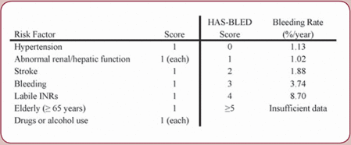
Bleed Risks: HASBLED
Notes:
http://www.healio.com/cardiology/arrhythmia-disorders/news/online/%7Be19c14d0-aba5-4098-9ed9-d91058aac6af%7D/managing-anticoagulant-complications-with-af

Slide 25
Agents for VTE prophylaxis
DRUG | MOA | Dosing for Prophylaxis | Route
Unfractionated heparin (UFH)** | Inactivation of Factor Xa and thrombin | 5000 Units BID-TID | IV, SubQ
Low molecular weight heparin (LMWH) | Factor Xa inhibition; some thrombin inhibition | Lovenox: 40 mg daily Adjust if >100 kg, poor renal function, or <40 kg | SubQ, IV
Fondaparinux | Factor Xa inhibition | 2.5 mg daily | SubQ
Warfarin | Vitamin K antagonist | Daily | PO
NOAC: Rivaroxaban | Factor Xa inhibitor | 10 mg daily | PO
NOAC: Apixaban | Factor Xa inhibitor | 2.5 mg BID | PO
Notes:
*dialysis patients use UFH- call HSN for information if unsure for (Dialysis Outpatient Program)

Slide 26
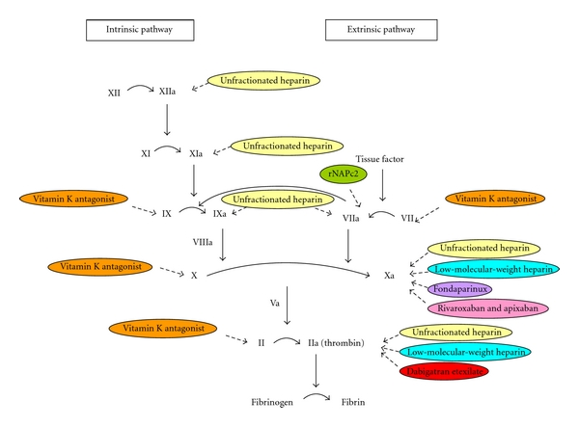
Notes:
http://www.hindawi.com/journals/isrn/2011/124610.fig.001.jpg

Slide 27
Approximate Risks of DVT in Hospitalized Patients
Patient Group | Prevalence of DVT (%)
Medical patients | 10–20
General surgery | 15–40
Major gynecologic surgery
Major urologic surgery
Neurosurgery
Stroke | 20–50
Hip or knee arthroplasty, Hip Fracture Surgery | 40–60
Major trauma | 40–80
Spinal Cord Injury | 60–80
Critical care patients | 10–80

Slide 28
Low Risk: <10% risk of DVT without thromboprophylaxis
Patient Group | Recommended
Medical patients who are fully mobile | No thromboprophylaxis Early ambulation
Minor surgery in mobile patients
http://www.saferhealthcarenow.ca/EN/Interventions/vte/Documents/VTE%20Getting%20Started%20Kit.pdf
Notes:
aka fully mobile

Slide 29
Moderate Risk:10-40% risk of DVT without thromboprophylaxis
Patient Group | Recommended
Most general, open gynecologic or urologic surgery patients | LMWH UFH Fondaparinux
Medical patients, bed rest or sick
Moderate VTE risk plus high bleeding risk | Mechanical thromboprophylaxis
http://thrombosiscanada.ca/?page_id=18
http://www.saferhealthcarenow.ca/EN/Interventions/vte/Documents/VTE%20Getting%20Started%20Kit.pdf

Slide 30
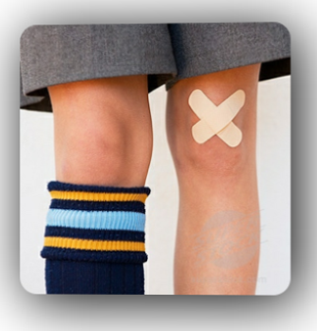
High Risk:40-80% risk of DVT without thromboprophylaxis
Patient Group | Recommended
Hip or knee arthroplasty Hip Fracture Surgery | LMWH Fondaparinux Warfarin (INR 2–3) NOACs
Major trauma, spinal cord injury
High VTE risk + high bleed risk | Mechanical thromboprophylaxis
http://www.saferhealthcarenow.ca/EN/Interventions/vte/Documents/VTE%20Getting%20Started%20Kit.pdf

Slide 32
Who SHOULD NOT continue prophylaxis?
Acutely ill hospitalized medical patients
Outpatients with cancer who have no additional risk factors
http://thrombosiscanada.ca/?page_id=18
Notes:
CHEST guidelines

Slide 33
VTE prophylaxis until discharge
Cardiovascular surgery
Critical Care (until transfer)
General Major Surgery
Gynecology
Internal medicine/subspecialties
Neurosurgery
Oncology (depends)
Peds
Spinal Cord injury (discharge from rehab)
Spine surgery
Stroke (ischemic or hemorrhagic)
Trauma (discharge from rehab)
Urology
Nephrology

Slide 34
Special Scenarios
Transfer to nursing home
In chronically immobilized persons residing at home or at a nursing home, we suggest against the routine use of thromboprophylaxis (Grade 2C).
In-hospital > 30 days
Automatic stop date of 15 days
Checkpoint for re-assessment
Notes:
Grade 2C CHEST guidelines
The available data suggest that nursing home patients have an incidence of symptomatic VTE of 1% annually nes

Slide 35
Who SHOULD get discharged on prophylaxis?

Slide 36
VTE Prophylaxis post - discharge
Post-natal at high risk
Hx VTE (unprovoked/estrogen, multiple VTEs, family hx, thrombophilia)
6 weeks
Post-natal at intermediate risk
C-section, BMI>40, prolonged hospitalization, medical comorbidities
7 days
http://thrombosiscanada.ca/?page_id=18#

Slide 37
VTE Prophylaxis post - discharge
Oncology outpatients
+ solid tumours
+ risk factors
- risk of bleeds
Additional risk factors for venous thrombosis
in cancer outpatients include previous venous thrombosis, immobilization, hormonal therapy, angiogenesis inhibitors, thalidomide, and lenalidomide.

Slide 38
VTE Prophylaxis post-discharge
Hip and Knee arthroplasty:
Rivaroxaban 10 mg or Lovenox 40 mg subQ daily
: 15 days; 28 days if high risk (hx VTE post TJR)
: minimum 10 days (up to 35 days)
Hip fracture: Lovenox 40 mg subQ daily
: minimum 10 days
: minimum 10 days (up to 35 days)
Falck-Ytter Y, et al. Chest 2012;141(2 Suppl):e278S-325S
http://thrombosiscanada.ca/?page_id=18
Notes:
Falck-Ytter Y, et al. Prevention of VTE in orthopedic surgery patients: Antithrombotic Therapy and Prevention of Thrombosis, 9th ed: American College of Chest Physicians Evidence-Based Clinical Practice Guidelines. Chest 2012;141(2 Suppl):e278S-325S
Chest prefers LMWH due to decreased risk of bleeding compared to alternatives

Slide 39
Coverage
Lovenox (enoxaparin)
No LU code for prophylaxis
Patients must pay out of pocket
Heparin
Not covered
Warfarin
Covered
https://www.healthinfo.moh.gov.on.ca/formulary/

Slide 40
Coverage
Fondaparinux 2.5 mg
Requires LU code
378: For the post-operative prophylaxis of venous thromboembolic events in patients undergoing orthopedic surgery of the lower limbs such as hip fracture, hip replacement or knee surgery.
NOTE: Limited to 9 days of reimbursement
https://www.healthinfo.moh.gov.on.ca/formulary/

Slide 41
Coverage
Xarelto/Apixaban
Requires LU code
433: For the prevention of venous thromboembolic events in patients who have undergone elective total knee replacement surgery.
Note: Limited to 14 days of reimbursement in TKR. Limited to 1 claim in a 120 day period.
434: For the prevention of venous thromboembolic events in patients who have undergone elective total hip replacement.
Note: Limited to 35 days of reimbursement in THR. Limited to1 claim in a 120 day period.
https://www.healthinfo.moh.gov.on.ca/formulary/

Slide 42
Dosing Recommendations
Heparin
5000 units subQ BID-TID
Lovenox
40 mg SubQ daily
30 mg SubQ daily if
CrCl <30 ml/min
Weight <40kg
if post-cardiac surgery
40 mg SubQ BID if
Weight>100 kg
Xarelto/Apixaban- 10 mg daily/2.5 mg BID (orthopedic)

Slide 43
Key Points We must ask ourselves
Is it indicated (or still indicated)?
Risk vs benefit
Duration (indication may no longer be there)

Slide 44
Your Role
Pharmaceutical opinion to discontinue Lovenox
Risk of bleeds
Indication/Contraindications
Cost
Patient injection ☹
Assess for indication and duration.

Slide 45
Summary: Who might need VTE prophylaxis on discharge?
Hip/Knee
Just had a baby!
Cancer
Nursing home:
Not indicated unless other risk factors!

Slide 46
Counselling
Xarelto/Apixaban
Adherence: Importance and reason
e.g. 40-60% VTE in patients with hip/knee surgery
Same time each day
Monitor for bleeds

Slide 47
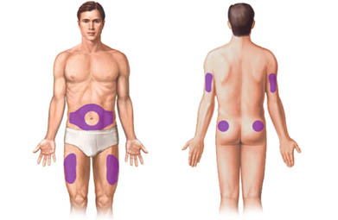
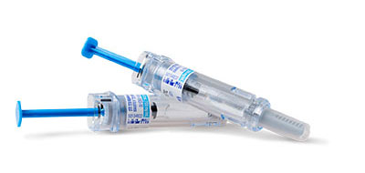
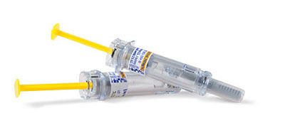
Counselling Lovenox Injections
Notes:
http://www.lovenox.com/hcp_default.aspx

Slide 48
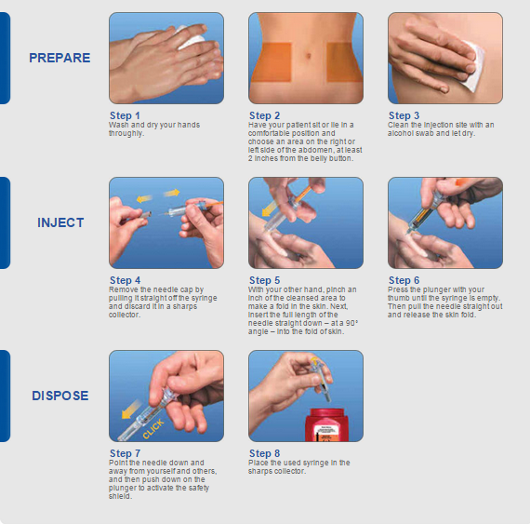

Slide 49
Questions?

Slide 50
VTE Prophylaxis focusing on Surgical Oncology
General
Urology
Gynecological

Slide 51
No conflicts

Slide 52
Objectives
To describe the kind of tool used to determine VTE risk
Look at the key evidence-based clinical data and guidelines related to VTE prophylaxis in surgical patients
Outline current best practices for this small patient population

Slide 53
Risk Factors
Major abdominal surgery and cancer either treated with chemotherapy or untreated are independent risk factors.
Looked at the Caprini Predictive Model
Score 5 or high is considered high risk
Add on a cancer diagnosis and the recommended length of prophylaxis increases.

Slide 54
VTE in Surgical Patients: Caprini Predictive Model

Slide 55
Case 1
A 46 year-old, obese (BMI = 31 kg/m²) female schoolteacher is scheduled to undergo laparoscopic colon resection for ulcerative colitis that is retractable to medical therapy. She is to be hospitalized for 1-2 days after surgery.
According to the Caprini risk assessment model, this patient’s risk for post-operative DVT is considered…
Very low (0-1 points)
Low (2 points)
Moderate (3-4 points)
High (≥5 points)

Slide 56
Case 1
46 years = 1point
Obesity (BMI>25) = 1 point
History of inflammatory bowel disease = 1 point
Laparoscopic surgery greater than 45 mins = 2 points
Total 5 points
Assuming not at risk for major bleed should receive VTE prophylaxis 7-10 days

Slide 57
Recommendations for Prevention of VTE in Surgical Cancer
 | ASCO | NCCN | ESMO | ACCP | Throm can
Initial prophylaxis | All patients with malignancies undergoing major surgery should be considered for prophylaxis with UFH or LMWH unless contraindicated (active bleeding or high risk bleeding) | Prophylaxis anticoagulation is recommended with LMH , UFH or Fondaparinux | Prophylaxis anticoagulation with s.c. LMWH or UFH for patients undergoing elective major abdominal or pelvic surgery | LMWH , UFH for moderate /high VTE-risk patients who are not at risk of major bleed | Cancer patients undergoing surgery should receive LMWH prophylaxis while in hospital
Prolonged prophylaxis | LMWH for up to 4 wks should be considered in major abdominal /pelvic surgery in high risk patients (eg. Restricted mobility, residual malignancy disease, history of VTE) or those with additional risk factors | Outpatient prophylaxis is recommended for up to 4 wks post-op . Particularly for high risk abdominal or pelvic surgery. | Should receive post-discharge prophylaxis with LMWH for up to one month after elective major abdominal or pelvic surgery | Extended prophylaxis (4 wks) with LMWH is recommended for high –VTE risk patients undergoing abdominal or pelvic surgery who are not at high risk for bleeding. (Grade 1B) | Patients with additional risk factors may benefit from extended prophylaxis until 1 month after surgery
UFH: Unfractionaled heparin; LMWH: Low molecular weight heparin; s.c.: Subcutaneous; VTE: Venous thromboembolism; wks: Weeks; pts: patients;
1. Lyman GH, et al. J Clin Oncol. 2013;31(17):2189-2204; 2. National Comprehensive Cancer Network. 2013. Available at: www.nccn.org; 3. Mandalà M, et al. Ann Oncol. 2011;20(Suppl 6):vi85-92.; 4. Gould MK, et al. Chest. 2012;141(2 Suppl):e227S-77S.; 5. Thrombosis Canada Clinical Guides, Available at: www.thrombosiscanada.ca
Notes:
Asco= American society of Hematology
NCCN=national comprehensive cancer network ESMO= European society for medical oncology
ACCP=Americian collage of chest physicians

Slide 58
Case 2
A 67 year-old non-obese female, recently retired lawyer, is scheduled to undergo liver resection for an isolated hepatic metastasis following a colon resection 2 years ago for colon adenocarcinoma. She is expected to be hospitalized for 4-5 days.
According to the Caprini risk assessment model, this patient’s risk for post-operative DVT is considered…
Very low (0-1 points)
Low (2 points)
Moderate (3-4 points)
High (≥5 points)

Slide 59
Case 2
67 years= 2 points
Malignancy (past or present)= 2 points
Confined to bed for greater than 72 hours= 2 points
Major surgery for greater than 45 minutes= 2 points
Total 8 pionts

Slide 60
What do guidelines recommend for post-operative DVT prophylaxis? (Grade 1 = strong, Grade 2 = weak)
VTE Risk Category | Average Bleeding Risk (~1%) | High Bleed Risk (~2%) or Severe Impact
Very Low Risk Caprini Score 0 | No Specific Prophylaxis (Grade 1B)
Low Risk Caprini Score 1-2 | Mechanical prophylaxis, preferably with IPC (Grade 2C)
Moderate Risk Caprini Score 3-4 | LMWH (Grade 2B), LDUH (Grade 2B) or mechanical prophylaxis with ES or IPC (Grade 2C) | Mechanical prophylaxis, preferably with IPC (Grade 2C)
High Risk Caprini Score ≥5 | LMWH (Grade 1B), LDUH (Grade 1B) plus mechanical prophylaxis with ES or IPC (Grade 2C) | Mechanical prophylaxis, preferably with IPC, until risk of bleeding diminishes and pharmacologic prophylaxis can be added (Grade 2C)
High Risk Cancer Surgery | LMWH or LDUH plus mechanical prophylaxis with ES or IPC and extended-duration prophylaxis (4 weeks) with LMWH post-discharge (Grade 1B)
High Risk LMWH and LDUH contraindicated | Fondaparinux or low-dose ASA (160 mg), mechanical prophylaxis, preferable with IPC or both (Grade 2C)

Slide 61
Time Distribution of VTE Events Following Cancer Surgery
40% of VTE events occurred >21 days after surgery
N=2373, @RISTOS Registry: Prospective cohort study
Number of Patients
Days after Surgery
Agnelli G et al. Ann Surg. 2006;243(1):89-95.
Notes:
The @RISTOS study prospectively observed patients undergoing general, urological, or gynecological surgery for cancer and sought to evaluate the incidence of clinically overt VTE. Assessments for VTE were performed up to 30±5 days after surgery, or longer if the hospital stay was >35 days. The study included 2,373 patients.
Note: 81.6% of the patients received in-hospital prophylaxis and 30.7% received post-discharge prophylaxis. The average hospital stay was 12.3 days for general surgery patients, 9.1 for gynecological surgery patients, and 6.2 days for urological surgery patient. Interestingly, 40% of the events occurred >21 days after surgery.
Reference:
Agnelli G, Bolis G, Capussotti L, et al. A clinical outcome-based prospective study on venous thromboembolism after cancer surgery: the @RISTOS project. Ann Surg. 2006;243(1):89-95.
The @RISTOS study prospectively observed patients undergoing general, urological, or gynecological surgery for cancer and sought to evaluate the incidence of clinically overt VTE. Assessments for VTE were performed up to 30±5 days after surgery, or longer if the hospital stay was >35 days. The study included 2,373 patients.
Note: 81.6% of the patients received in-hospital prophylaxis and 30.7% received post-discharge prophylaxis. The average hospital stay was 12.3 days for general surgery patients, 9.1 for gynecological surgery patients, and 6.2 days for urological surgery patient. Interestingly, 40% of the events occurred >21 days after surgery.
Reference:
Agnelli G, Bolis G, Capussotti L, et al. A clinical outcome-based prospective study on venous thromboembolism after cancer surgery: the @RISTOS project. Ann Surg. 2006;243(1):89-95.

Slide 62
Risk Factors for Major Bleeding Complications
General Risk Factors | Procedure-specific risk factors | Procedures*
Active bleeding Previous major bleeding Known, untreated bleeding disorder Severe renal or hepatic failure Thrombocytopenia Acute stroke Uncontrolled systemic hypertension Lumbar puncture, epidural, or spinal anesthesia within previous 4 h or next 12 h Concomitant use of anticoagulants, antiplatelet therapy, or thrombolytic drugs | Abdominal surgery: Male sex, preoperative hemoglobin level ˂13 g/dL, malignancy, and complex surgery defined as two or more procedures, difficult dissection, or more than one anastamosis Pancreaticoduodenectomy: Sepsis, pancreatic leak, sentinel bleed Hepatic resection: Number of segments, concomitant extrahepatic organ resection, primary liver malignancy, lower preoperative hemoglobin level, and platelet counts Cardiac surgery: Use of aspirin Use of clopidogrel within 3 d before surgery BMI >25 kg/m² , nonelective surgery, placement of ≥ 5 grafts, older age Older age, renal insufficiency, operation other than CABG, longer bypass time Thoracic surgery: Pneumonectomy or extended resection | Craniotomy Spinal surgery Spinal trauma Reconstructive procedures involving free flap
Notes:
What is considered before VTE prophylaxis prescribed

Slide 63
VTE Prophylaxis dosing regimens in Surgical Patients with Cancer
Drug | Regimen
Unfractionated Heparin | 5000 units 2-4 hours pre-op and once every 8 hours thereafter or 5000 units 10-12 hours pre-op and 5000 units q8h
Dalteparin | 2500 units 2-4 hours pre-op and 5000 units daily there after or 5000 units 10-12 hours pre-op and 5000 units daily there after
Enoxaprin | 20mg 2-4 hours pre-op and 40mg once daily thereafter or 4mg 10-12 hours pre-op and 40mg daily thereafter
Fondaparinux | 2.5mg once daily beginning 6-8 hours post-op

Slide 64
What does this all mean in Sudbury?
We use Enoxaparin as our LMWH at HSN
We dose adjust according to weight and renal function. Therefor could see doses of 30mg sc daily and 40mg sc bid
General Surgeons are in agreement this is best practice they estimate it will effect about 50 patients per year. ( 50 prescriptions for 4 week post discharge prophylaxis)
LU code???? ( application made)

Slide 65
QUESTIONS?

